Slide 1


Research Management on Water, Disaster and Climate Change: A practical experience from the Thailand Research Fund (TRF)
S. Jongdeepaisarl & A. Chidthaisong, TRF

Slide 2
Thailand Research Fund (TRF)
A Catalyst for Change
Established in 1993 by the Research Endowment Act of 1992 as a research management organization under the Prime Minister’s Office
Covers all research fields, basic research to policy
research, domestic and international/transnational,
area/community/agenda-based issues

Slide 3
TRF’s Administrative Structure
TRF Policy Board
TRF Evaluation Board
Director
Deputy Director
Internal Audit Section
Research and Development Cluster
Basic Research and Researcher Development Cluster
Strategy Management Cluster and Special Task Cluster
Administration Cluster
National Policy and Transnational Relations Division
Agriculture Division
Public Well-Being Division
Community and Social Development Division
Industry Division
Community-Based Research Division
Academic Research Division
The Royal Golden Jubilee Ph.D. Program
Research and Researchers for Industries Program
International Research Network Program
Humanities Research Unit
Research Monitoring and Evaluation Division
Area-Based Collaborative Research Unit
EGAT-TRF Energy Research Program
Office of the Director– Strategy Implementation Group
Office of the Director - Administration Group

Slide 4
Mission
To support research and development to create knowledge, policy, innovation, and intellectual property
National Governments,
Private sectors
Provincial & Local Organizations
Researchers
&
Research Community
Research
System
To foster professional researchers and develop research clusters
To enhance national research system and linkage research policy direction
Public, Business, Social Media
Communities& Civil Society Organizations
To encourage the utilization of research results
To empower local community

Slide 5
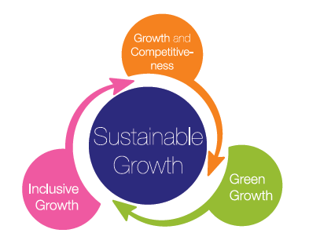
TRF Strategy 2014-2017

Slide 6
TRF’s Strategic Research Issues (SRIs)
SRI 1 ASEAN Community and the
East Asian Region
SRI 2 Food Security and Safety
SRI 3 Climate Change, Water,
Land and Environmental
Management
SRI 4 Inequality Reduction
SRI 5 Creative Learning and
Educational Reform
SRI 6 Good Governance and
Corruption Reduction
SRI 7 National Interests on
Marine Resources and
Maritime Security
SRI 8 Ethics, Culture, and
Discipline of Thais
SRI 9 Health and Demographic
Transition
SRI 10 New Knowledge and
Innovation on Sciences,
Social Sciences and
Humanities
SRI 11 Energy and Alternative
Energy
SRI 12 Overcoming the Middle
Income Trap

Slide 7
Program and support
Climate change
science & impact
Water
Disaster
Earthquake
Adaptation
policy
strategic water resources management
flood & drought
Adaptation to CC
Green city
National marine management strategy
Marine and terrestrial Biodiversity

Slide 8
Current Focus
Variability in precipitation on time scale of 3-6 months
  Atmospheric physics and chemistry
    Cloud physics and chemistry
    Surface-air exchange and interactions
    Soil moisture, evapotranspiration
    etc.
  Variability and teleconnections
  Short-term prediction & database
  Mainstreaming Climate Change into Development Strategies
  Adaptive capacity of community
  Risk management mechanism - crop insurance
  Holistic approach for climate change adaptation
  Climate Policy
  Post-2020 Climate Change Regime
  Legal & Institutional Framework
  Measurement, Reporting and Verification (MRV) system
  Climate Change & Green Economy

Slide 9
Management consideration
Human Resource,
Budget
Research priority
Funding and research activity
Research utilization
Public understanding & support
Scientific development

Slide 10
How to get the right “Research topic” or High priority research
Consultation meeting/focus group
  Academic
  Government agency
  Public
  …
Country/global policy & trends

Slide 11
Managing funding & Research activity
Calls for proposal
Proposal evaluation by experts
Seek independent opinions from stakeholders & public
Progress report/routine meeting with researcher team
Research result evaluations/seek suggestions from experts
Institutional/block grant

Slide 12
Enhancing Research Utilization
Involve user from the beginning
Research question from users at different levels
Results tested/trial by relevant users
Enhance accessibility to research results
Simplify/digest technical data into information
Publish/communicate via various channels

Slide 13
Strategic Partners
Key agencies
  Office of natural resources and environmental policy and planning
  Office of agricultural economics,
  International organization department
  Thailand greenhouse gas management organization,
  Thai meteorological department,
  Office of the national economic and social development board
Academic institutions
  Chulalongkorn University, Thammasart university, Kasetsart University, King’s Mongkut University of Technology Thonburi, Ramkhamhaeng University, Silpakorn University, Khon Kaen University, Chiang Mai University, Burapha University
Private sector
  The federation of Thai Industries
  Thai Chamber of Commerce

Slide 14
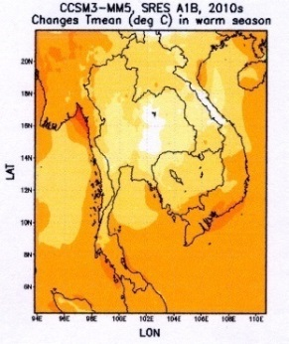
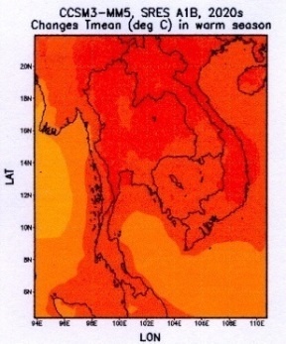
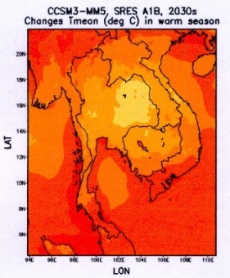
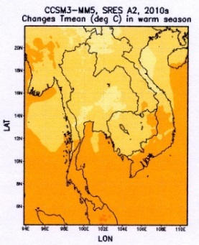
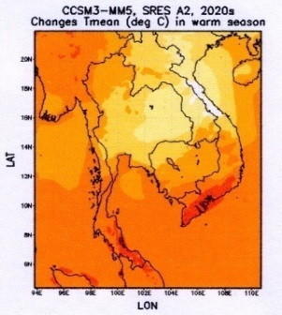
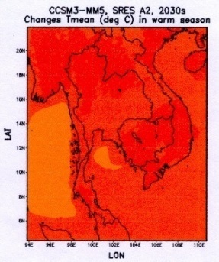
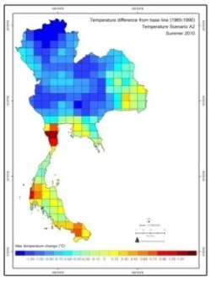
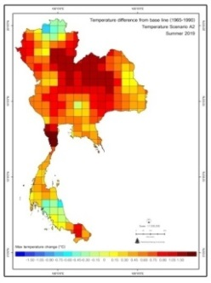
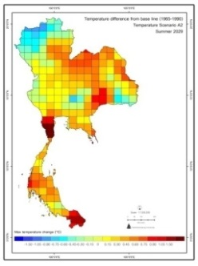
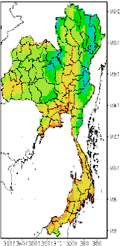
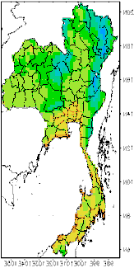
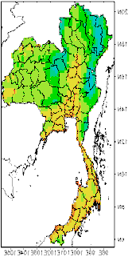
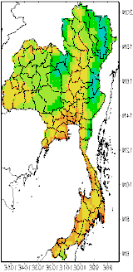
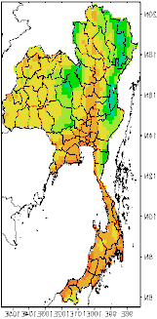
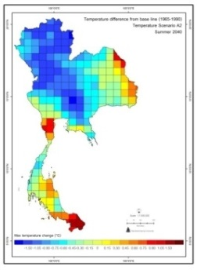
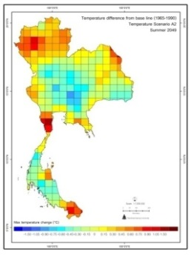
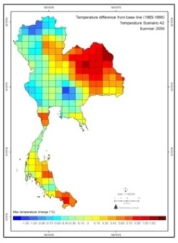
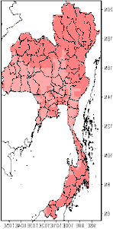
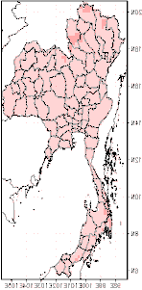
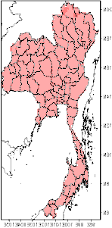
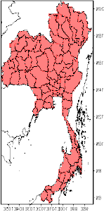
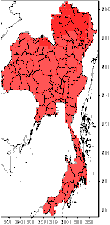
PRECIS
MM5
GFDL-R30
RegCM3

Slide 15
Support modeling research group
Engage them with international community
  Organizing seminar
  Support participation outside Thailand
  Set condition as part of research activity

Slide 16
Climate Change Research Center
RU
Climate projection & modeling
KMUTT Seasonal forecast
Future unit
SU
Cloud Physics
Climate
Carbon cycle,
GHGs mitigation
Air pollution, Aerosols
Short-term, seasonal forecast
Climate modeling
Hydrology
Earth Sc.
ASEAN-IAP center
IAP
MoU
KMUTT
KMUTT Climate Research Center

Slide 17
Current & past activities and roles of TRF & JGSEE
TRF- Climate Research
MoU with Ramkhamheang U on Climate projection & modeling
MoU with KMUTT on Seasonal forecast
Future unit
Mou With Silpakorn U on Cloud Physics
Several projects on climate change have been supported by TRF
Currently supporting Dr. Usa & Dr. Dusadee on developing capacity and knowledge on seasonal precipitation forecast
JGSEE provided computing equipment
During negotiation to sing MoU between KMUTT and TRF to support a kind of “Research Center”
Managed/facilitated by JGSEE

Slide 18
International Collaboration
China - National Natural Science Foundation of China (NSFC)
Asean - Southeast Asia Regional Climate Downscaling (SEACLID) which partial funding by Asia Pacific Network for Global Change Research (APN)

Slide 19
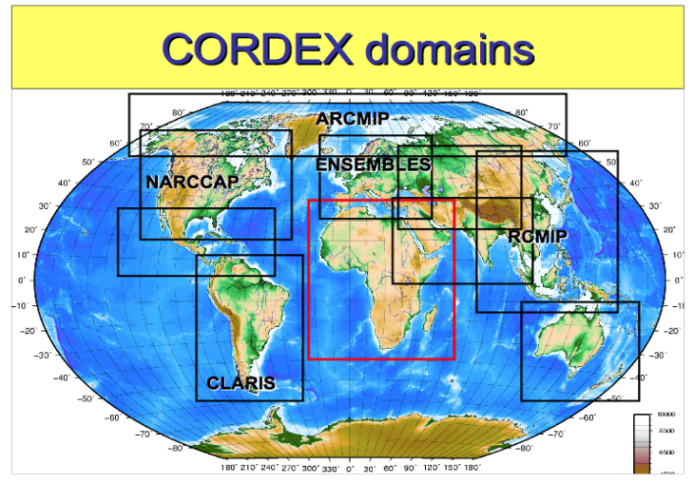
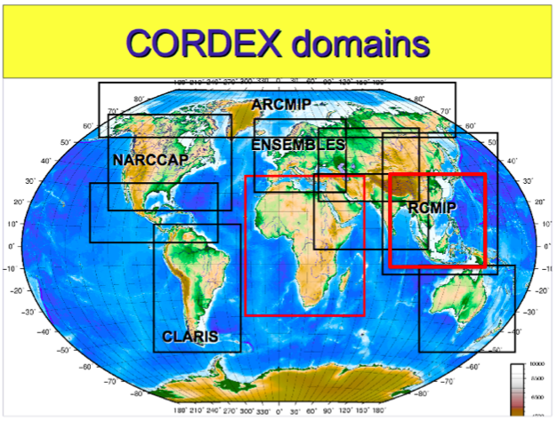
ASEAN member states
ASEAN Research Collaboration Program for Climate Change Impact Assessments on Agriculture
Impact Assessment
on Agriculture
Regional Climate
Downscaling
ASEAN
Southeast Asia Regional
Climate Downscaling
(SEACLID)
ASEAN academic
new
SEACLID
Regional climate change scenarios are the basis for assessment of impacts
SEA countries are not part of CORDEX
CORDEX resolution is 50 km; We may need higher than this
SEACLID Project has been invited to be part of CORDEX
SEACLID = CORDEX-SEA
Model resolution to be increased to 25 km.

Slide 20

Scope and activities
Downscaling techniques.
Capacity building on GCMs
downscaling and crop models.
Finer-scale CC scenario generated
& evaluated.
Links with some crop/impact
models.
Assessment report for specific
agricultural system from each
ASEAN participant member.
Database and data sharing
system and research networks
on CC impacts on ASEAN
agriculture and water resources.
Outputs
Phase I
Downscaling
Phase II
Impact Assessment
Themes
Each phase has 4 main activities : 1) ASEAN assessment report for impacts of climate change on agriculture, 2) GCMs downscaling 3) impact assessment and 4) database and data sharing system and research networking.
Activities
to be a
Catalyst
for Changes

Slide 21
Beneficiaries
ASEAN
policy recommendation for climate change impacts on ASEAN agricultural production as well as research network and data sharing systems.
Member state
capacity building on downscaling global climate models and crop model to driving further initiative in some member states as well as the expertise enhancement in experience of the member states.
Sub-national agency
recommendation to cope with the impacts of climate change on specific agricultural systems relevant to their needs and conditions.
UNFCCC, IPCC, donor & others
Contribution to Article 5 & 6
IPCC assessment report
Regional dialog & working models
Human resource developments
to be a
Catalyst
for Changes

Slide 22
TRF-NSFC Collaboration
TRF
NFSC
MOU
Call for proposal/
Funding
Call for proposal/Invited
Funding
International joint research
Research institutes
in China
Research institutes
in Thailand
Joint project/Exchange activity

Slide 23
TRF
NFSC
monsoon & its
variability
land surface &
atmospheric
interactions
regional
climate change
impacts
MOU
Call for proposal
Funding
Call for proposal
Funding
Exchange staffs
& students
Meeting &
seminars
Publication
sharing
Research
institutes
in Thailand
Joint research
Research
institutes
in China
Joint project/Exchange activity

Slide 24
Climate Change and Related Research
Thailand climatology
Monsoon system
ENSO, MJO, IOD
Climate modeling
Future climate modeling
Sectoral impacts & adaptation
Water resources and agriculture - impacts
Land surface fluxes (energy and carbon)
Community-based adaptive measures
Climate risk analysis
Climate policy
  Post-Kyoto Protocol (Commitments and implications to trade)
Economic mechanisms for climate change solutions

Slide 25
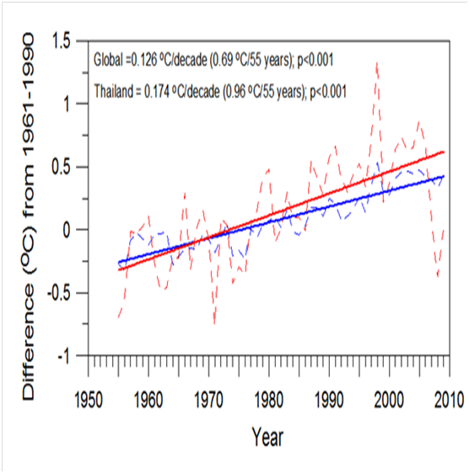
TRF Climate Change & related Research
Thailand climatology
  Monsoon system
  ENSO, MJO, IOD
Climate modeling
  Future climate modeling
Sectoral impacts & adaptation
  Water resources and agriculture - impacts on rice, sugarcane, cassava, and corn production
  Land surface fluxes (energy and carbon)
  Community-based adaptive measures
  Climate risk analysis
Climate policy
  Post-Kyoto Protocol (Commitments and implications to trade)
Projected warming for Thailand in the next 100 years.

Slide 26
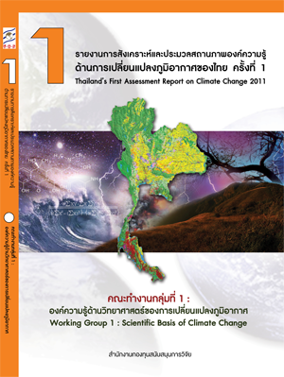
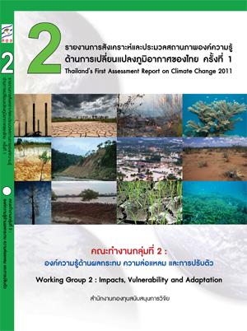
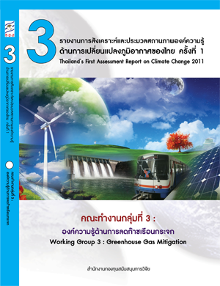
Thailand’s First Assessment Report on Climate Change 2011
Thailand’s 2nd Assessment is being processed
to be a
Catalyst
for Changes
Notes:
26

Slide 27

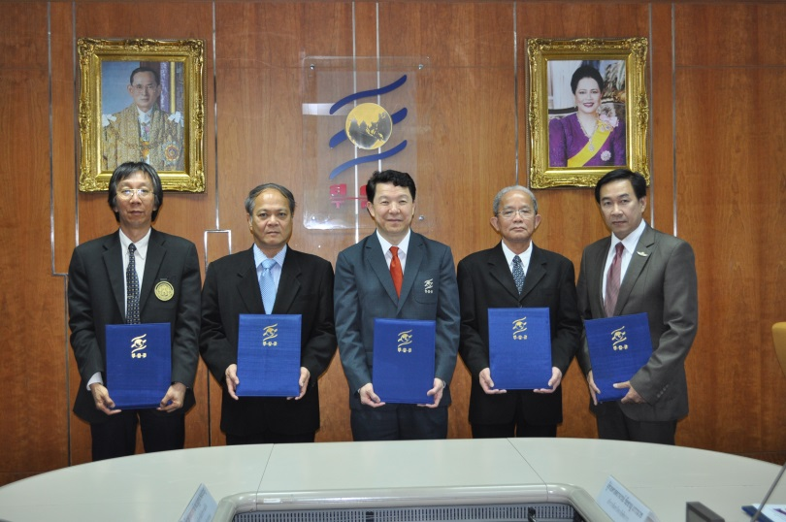
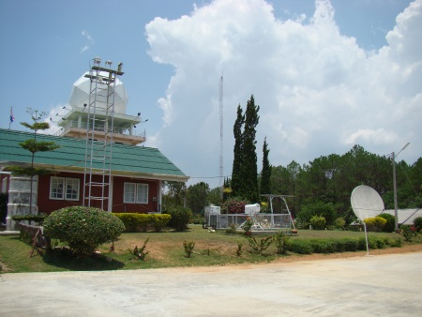
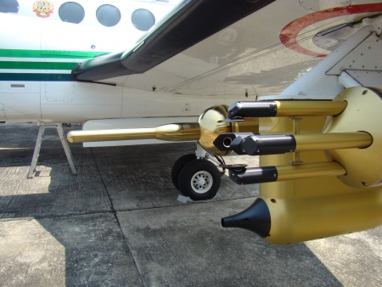
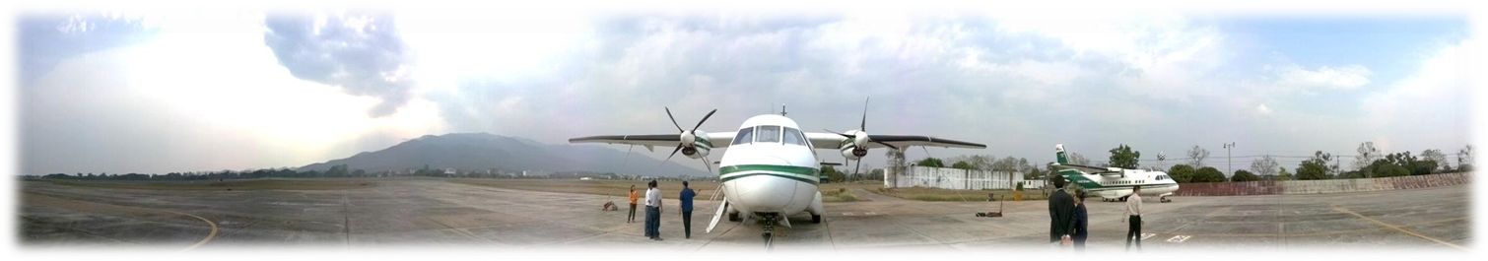
Institutional Grant : Users, Research Institutions
ความร่วมมือทางวิชาการด้านการเปลี่ยนแปลงภูมิอากาศ
ระหว่าง สำนักงานกองทุนสนับสนุนการวิจัย มหาวิทยาลัยรามคำแหง
มหาวิทยาลัยเทคโนโลยีพระจอมเกล้าธนบุรี มหาวิทยาลัยศิลปากร
กรมฝนหลวงและการบินเกษตร

Slide 28
TRF-National Natural Science Foundation of China (NSFC)/IAP Collaboration with involvement of KMUTT
Duration: 2011-2013
Southwest & Northwest Monsoon Research (Prof. Dusadee – Prof. CHEN Wen (IAP)
Eddy tower flux & modeling—Amnat-Prof. LIU Hushi (IAP)
Seasonal precipitation forecast (Dr. Usa vs. Prof. Lin
TRF
NFSC
MOU
Call for proposal/
Funding
Call for proposal/Invited
Funding
International joint research
Research institutes
in China
Research institutes
in Thailand
Joint project/Exchange activity
Exchange staffs, students
Meeting and seminars
Publication sharing

Slide 29
Research Management
Institutional Grant
International Network
- Internation Research Network Grant - IRN
- International Collaboration
China – NSFC, ASEAN
Users Collaboration
New direction of TRF Strategy 2557-2560
SRI – Climate Change, Land, Water, Environment Management

Slide 30
Institutional Grant
เป้าหมาย
สนับสนุนงานวิจัยเชิงสถาบันให้เป็นแหล่งพัฒนาวิชาการที่มีความเป็นเลิศเฉพาะด้าน
ขับเคลื่อนให้เกิดการสร้างองค์ความรู้อย่างต่อเนื่อง
ตอบสนองความต้องการของประเทศในทางวิชาการและการประยุกต์ใช้ในระดับนโยบายและระดับปฏิบัติ
ศูนย์วิจัยที่มีความเชี่ยวชาญเฉพาะ
แบบจำลองอากาศระดับภูมิภาค
มหาวิทยาลัยรามคำแหง
ระบบพยากรณ์อากาศรายฤดู
มหาวิทยาลัยเทคโนโลยีพระจอมเกล้าธนบุรี
ฟิสิกส์บรรยากาศเขตร้อน
มหาวิทยาลัยศิลปากร
และกรมฝนหลวงและการบินเกษตร
การประเมินผลกระทบและการปรับตัว
ต่อการเปลี่ยนแปลงภูมิอากาศ
Data and Activities Sharing

Slide 31
TRF-NSFC Collaboration
Monsoon
Land-air Interaction
Regional Climate Simulation
International Collaboration
TRF
NFSC/China
MOU
Call for proposal/
Funding
Call for proposal/Invited
Funding
International joint research
Research institutes
in China
Research institutes
in Thailand
Joint project/Exchange activity

Slide 32
International Research Network Grant
สร้างเครือข่ายวิจัยที่มีโจทย์วิจัยที่จำเพาะและชัดเจน ที่มีองค์ประกอบ นักวิจัยไทย นักวิจัยตปท องค์กรภาครัฐ เอกชนของไทย และ องค์กรตปท โดยสนับสนุนการสร้างเครือข่ายวิจัยนานาชาติ
  L-Full grant ผลิต Ph.D. 6 คน และ Postdoc 3 คน
  M-Full grant ผลิต Ph.D. 6 คน
  S-Full Grant ผลิต Ph.D. 4 คน และ Postdoc 2 คน
ผลิตองค์ความรู้และนวัตกรรมเพื่อใช้ประโยชน์เชิงพาณิชย์ และ นโยบาย และ/หรือพัฒนาชุมชน focus SRIs
  Climate Change, Water, Land, Forest, Environmental Management
  Logistic and Supply Chain
  Food Security and Food Safety
  Energy and Energy Alternatives
  Headlth and Demography Change

Slide 33
Challenges
Climate change is global, regional and national issue—transboundary in nature
  Some domestic experiences may be useful
Common issues/interests in ASEAN
  We need to identify this
Transboundary research management (sustainability);
  Differences among nations
  Budget/finance
  Human resource
  Basic infractructure
  Database maintenace/accessibility/exchange
  Output utilization

