Slide 1


EXTREME WEATHER AND ADAPTATION: studies in usm, Malaysia
Prof. Ismail Abustan
(Professor of Urban Water)
School of Civil Engineering
Universiti Sains Malaysia
ceismail@usm.my
Visiting Professor of King Saud University (2013-14)
Visiting Professor of Kyoto University (2008 -9; 2014-15)

Slide 2
Introduction on Extreme Weather
River bank Filtration (LRGS)
Rainfall Z-R relationship (RUI)

Slide 3

United Nation’s Committee on Economic, Social and Cultural Rights in General Comment No. 15, 2002 stated that:
Human right
Sufficient
Safe
Use of Water
Prevent death from dehydration
Reduce the risk of water related disease
Acceptable
Physically accessible
Affordable water for personal and domestic uses
Provide for consumption, cooking,
Personal and domestic hygienic requirements

Slide 4
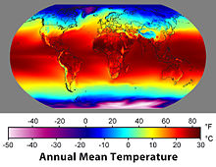
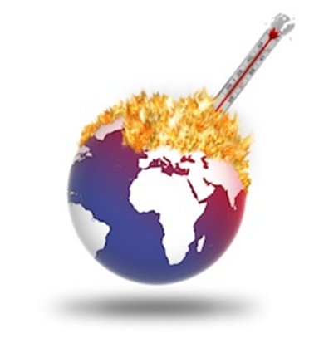
INTRODUCTION
Extreme weather includes weather phenomena that are at the extremes of the historical distribution especially severe or unseasonal weather.
An increase in extreme weather events has been attributed to anthropogenic global warming.
Global warming playing a significant role in the rising number of extreme events such as windstorms and floods which have tripled since 1980, a trend that is expected to persist.

Slide 5
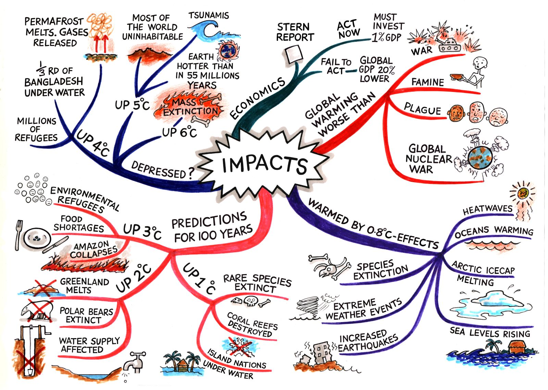
www.unisdr.org

Slide 6
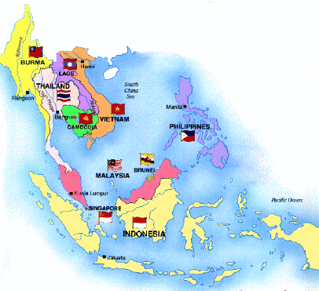
Number of disasters in ASEAN from 2001-2009:
Flood – 213 (13% of world total)
Storm – 132 (13%)
Earthquake – 42 (15%)
Landslide – 42 (24%)
Epidemic – 36 (6%)
Volcanic eruption – 15 (26%)
Drought – 12 (7%)
Wildfire – 7 (5%)
Affect
584 million or nearly 1/10 of world population
South East Asia is annually affected by climate extremes, particularly floods, droughts and tropical cyclones, while large areas of the region are highly prone to flooding and influenced by monsoons.
The climatic impacts will severely threaten the livelihood of poor people living in rural areas with limited adaptive capacity. (IFAD)
Source: http://www.emdat.be

Slide 7
Future Changes
Rainfall
  Increased water availability in moist tropics and high latitudes
  Decreased water availability and drought in mid-latitudes and semi-arid low latitudes
Temperature
  Global temperatures are likely to increase by 1.1 to 6.4°C from 1990 to 2100 (best estimates 1.8 to 5.4)
Sea level rise
  Sea levels are likely to rise in the range of 22-34 cm between 1990 and the 2080s
Extreme events
  Likely that future tropical cyclones, typhoons, and hurricanes will become more intense, with larger peak wind speeds and more heavy precipitation
  Rahman and Alam, 2007

Slide 8
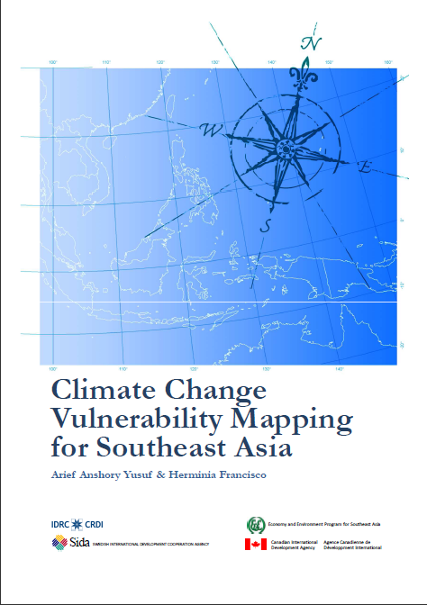
Climate Change Vulnerability Mapping for Southeast Asia, IDRC, 2009

Slide 9
SEA Climate hazard hotspots and dominant hazards
Climate hazard hotspots | Dominant hazards
Northwestern Vietnam | Droughts
Eastern coastal areas of Vietnam | Cyclones, droughts
Mekong region of Vietnam | Sea level rise
Bangkok and its surrounding area | Sea level rise, floods
Southern regions of Thailand | Droughts, floods
Philippines | Cyclones, landslides, floods, droughts
Sabah state in Malaysia | Droughts
Western and eastern area of Java Island, Indonesia | Droughts, floods, landslides, sea level rise

Slide 10
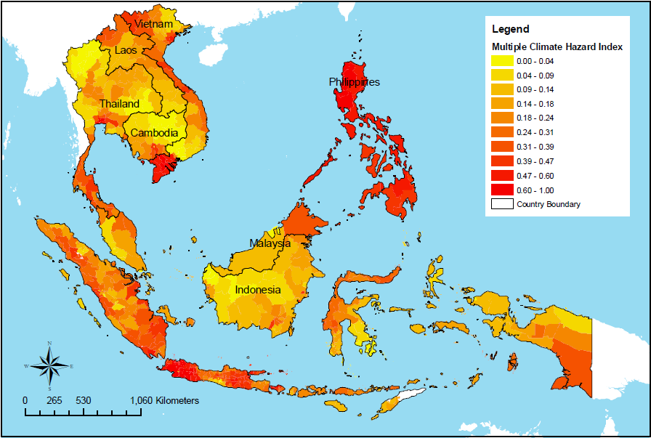
Multiple climate hazard index medium, as compared to its neighbors

Slide 11
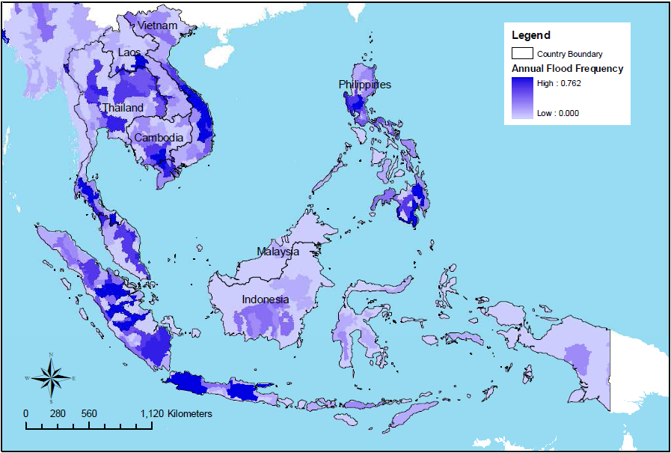
Flood frequency (event per year from 1980-2001)

Slide 12
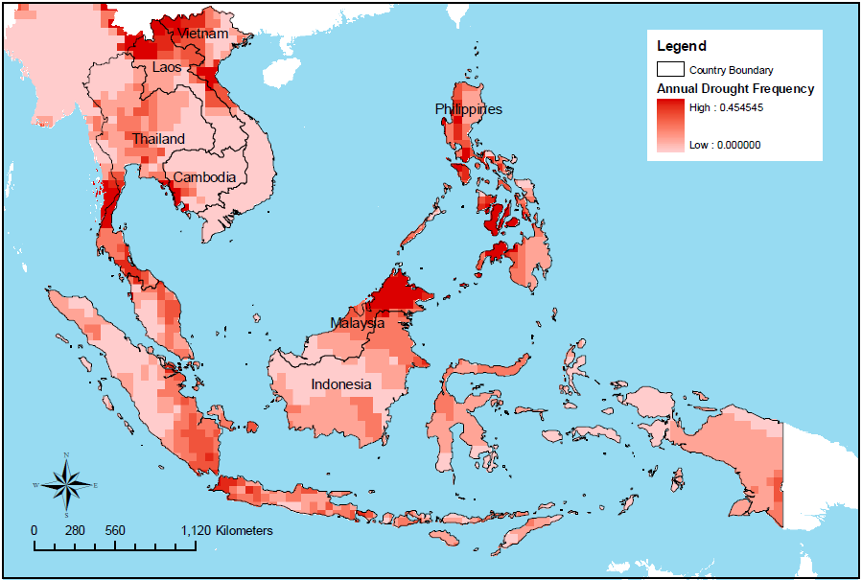
Drought frequency (event per year from 1980-2000)

Slide 13

Natural and Conflict related Hazards in Asia Pacific, OCHA, 2009

Slide 14
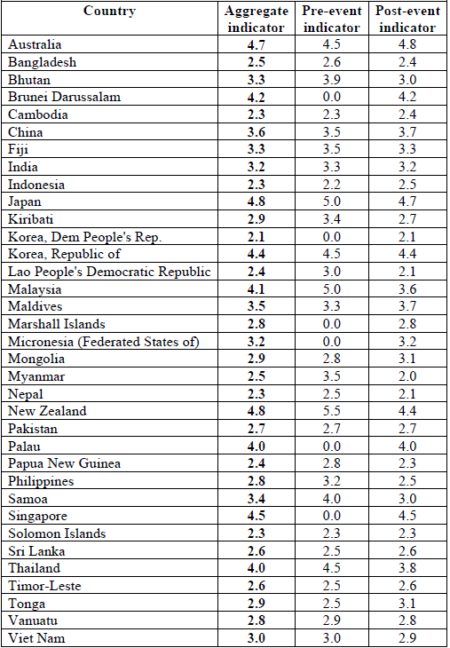
SEA coping capacity is low
Ten components of coping capacity:
  Hazard evaluation
  Consequence and vulnerability assessment
  Awareness-raising activities
  Sectoral regulations
  Structural defences
  Continuity planning
  Early warning
  Emergency response
  Insurance and disaster funds
  Reconstruction and rehabilitation planning

Slide 15
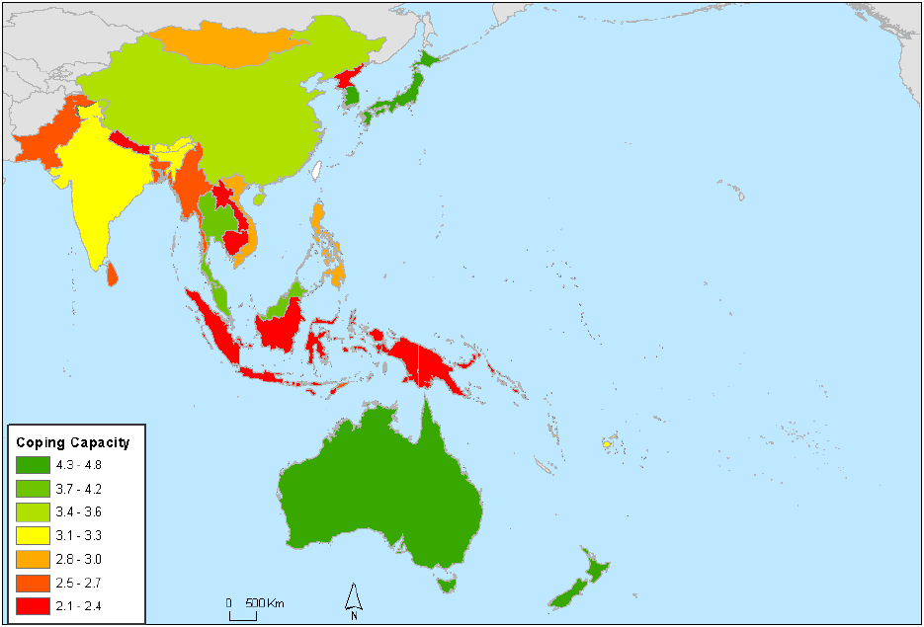
Coping capacity to disasters
Notes:
Most of the developing countries lack sufficient coping capacity to address a
wide range of hazards, especially rare events like tsunamis. International
cooperation and support are therefore highly desirable. A number of countries
have over the last decade been supportive with technical resources and
financial means to assist developing countries where the risk associated with
natural hazards is high. A key challenge with all projects from the donor
countries is to secure that they are need-based, sustainable and well anchored
in the countries’ own development plans. Another challenge is coordination
which often has proven to be difficult because the agencies generally have
different policies and the implementation periods of various projects do not
overlap. A subject which is gaining more and more attention is the need to
secure 100% ownership of the project in the country receiving assistance.
The capacity building initiatives should focus on institutions dealing with
disaster risks and disaster situations in the following four policy fields:
• Risk assessment and communication, i.e. the identification, evaluation
and possibly quantification of the hazards affecting the country and
their potential consequences, and exchange of information with and
awareness-raising among stakeholders and the general public;
• Risk mitigation, i.e. laws, rules and interventions to reduce exposure
and vulnerability to hazards;
• Disaster preparedness, warning and response, i.e. procedures to help
exposed persons, communities and organizations to be prepared for the
occurrence of a hazard, and initiate alerts and rescue activities after the
hazard occurs to reduce its immediate impact;
• Recovery enhancement, i.e. support to disaster-stricken populations and
areas in order to mitigate the long-term impact of disasters.
In each of these fields, institutions can operate at local, regional, national or
international levels.

Slide 16
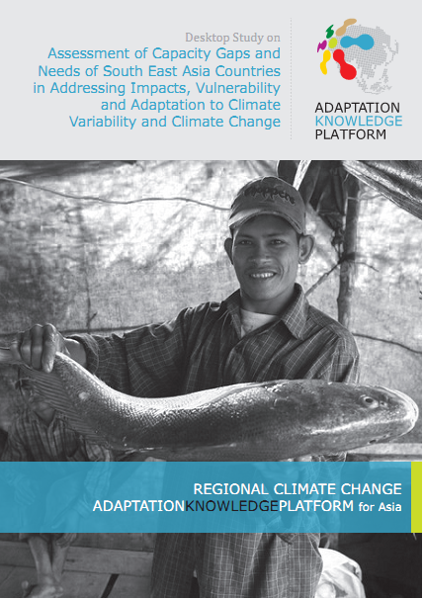
The Desktop study on Assessment of Capacity Gaps and Needs of South East Asia Countries in Addressing Impacts, Vulnerability and Adaptation to Climate
Variability and Climate Change

Slide 17
Adaptation Strategies in Water Resources
Water Resources
  Enlarging reservoir capacity
  Improving hydrological forecasting
  Promoting widespread use of groundwater
  Changing land use practices
  Demand side management for water resources
  Buffer zone for agriculture and forestry industries to minimize erosion and sedimentation
17
Notes:
17

Slide 18
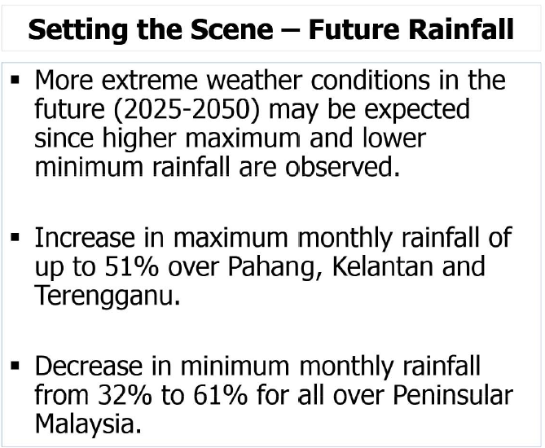
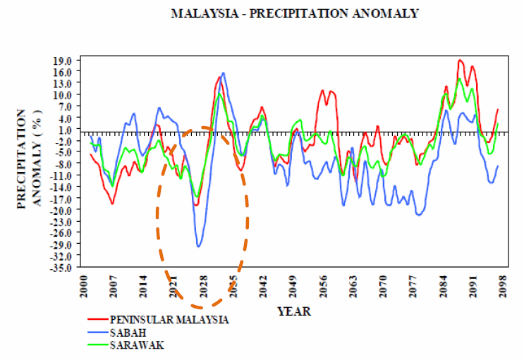
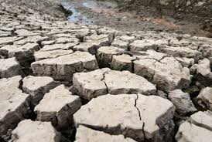


Why Malaysian needs Water Security?

Slide 19
www.civil.eng.usm.my
Research Activities
AUNSEED Net, GCOE, IHP-UNESCO, IAEA,
Urban Water Alliance
USM (CE) | USM (ME & Mineral) | UNITEN/ANM | NAHRIM/DID
Prof Ismail Abustan | Prof Zulkifli Abdullah (ME) | Dr Muhammad Salleh | Ir. Dr Nasehir
Assoc. Prof Rozi Abdullah | Dr Azmi (ME) | Dr Siti Hidayah | Dr. Aminur Rashid
Dr. Mohd Ashraf | Dr Khalil (Mineral E) | Dr Kamarudin Samuding (ANM) | Dr Norlida Md Dom (DID)
Dr Mohd Remy |  | Dr Abdul Rahman (ANM) | Ir Sazali (DID)
Research | Funder | Period
Physical Modelling of Mengkuang Dam Spillway | China Water Sdn Bhd | 2014-15
Study on the Sediment Transport Capacity of Sungai Kemaman, Terengganu | NAHRIM | 2013-14 ♦
Modelling of Emergency Gate in Tower 2 at Mengkuang Damn | Adasfa Sdn BhD | 2014-15
River bank/bed filtration for drinking water source abstraction | Ministry of Education | 2013 - 17
The Proposed Design and Tendering for the Proposed Design and Tendering for A Safe Closure of Muassim, Mina Disposal Site, Phase 1 | Mayor Of Makkah, Holy Makkah | 2010- 14 ♦
PROJEK TEBATAN BANJIR MACHANG BUBUK, Bukit Mertajam, Pulau Pinang | Majlis Perbandaran Seberang Perai | 2014- 15
Design and Construction of Pump Sump Model Testing for Sg Belibis Pahang | Jabatan Pengairan dan Saliran | 2014 -14 ♦
Development Of Modular Infiltration Within Permeable Pavements For Urban Stormwater Management | KEMENTERIAN SAINS, TEKNOLOGI DAN INOVASI MALAYSIA (MOSTI) | 2012- 14 ♦
School of Civil Engineering
UNIVERSITI SAINS MALAYSIA
19

Slide 20
Implementation of Adaptation Strategies

Slide 21
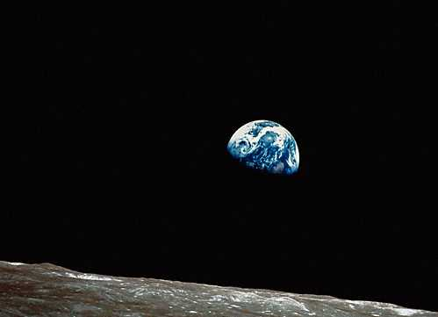
CC Adaptation Example
Stormwater Management Strategies
The new strategies incorporate runoff source control, management and delayed disposal on a catchment wide, proactive and multi-functional basis. - MSMA
This should be result in flood flow reduction, water quality improvement and ecological enhancement in downstream receiving waters

Slide 22
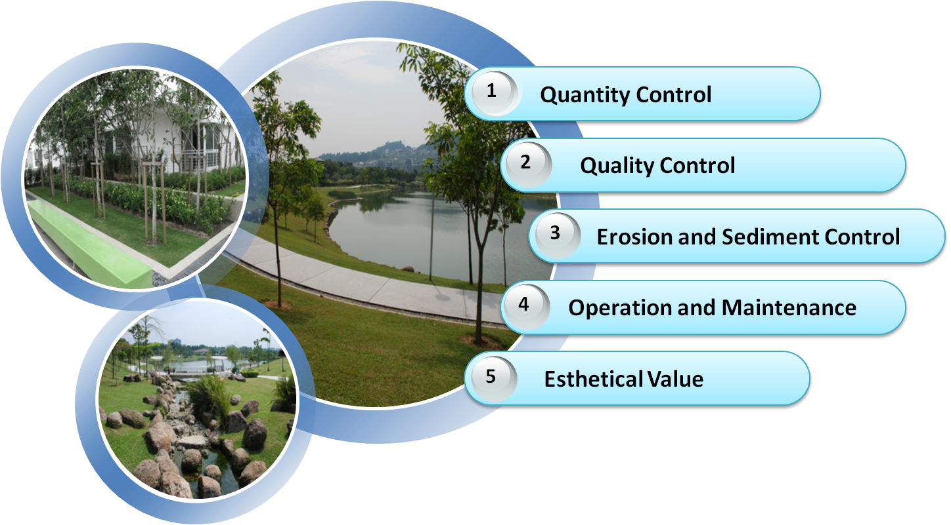
COMPONENT of MSMA
MSMA 2000 VS MSMA 2012

Slide 23
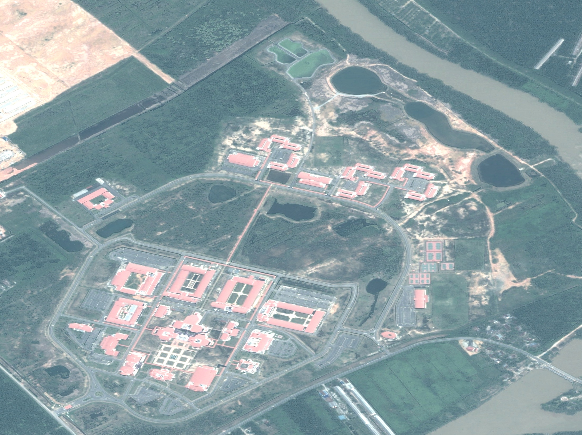

www.civil.eng.usm.my
River Bank Filtration:
Abstraction of Potable Water using Artificial Barrier
School of Civil Engineering
UNIVERSITI SAINS MALAYSIA
23

Slide 24
Objectives of the research program
Research in Civil Engineering
Natural reduction of physical characteristics, heavy metals and pathogenic organisms for drinking water using river bank filtration.
Removal of micro-pollutants in drinking water by optimization the process mechanisms in existing water treatment plant and advanced treatment systems
Social impact (well being, behavioral acceptance and economic outcome) of drinking water on public user.
School of Civil Engineering
UNIVERSITI SAINS MALAYSIA

Slide 25
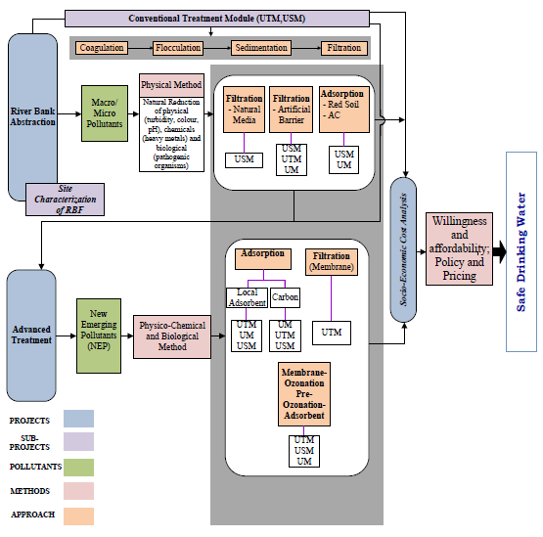

Slide 26
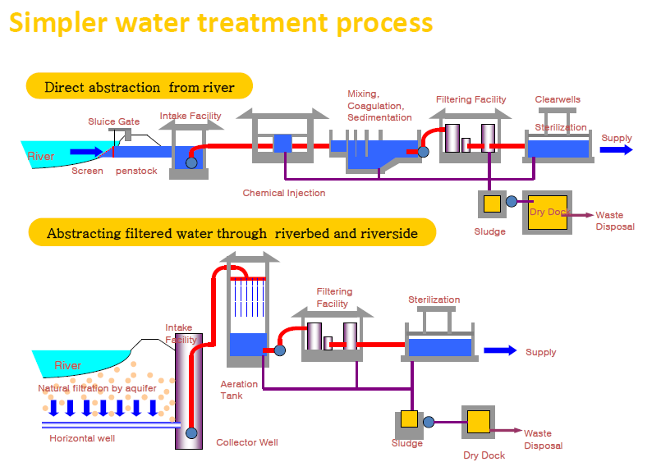
Research in Civil Engineering
Water Treatment Process : Direct versus RBF Abstraction

Slide 27
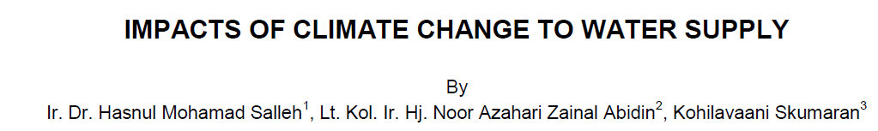
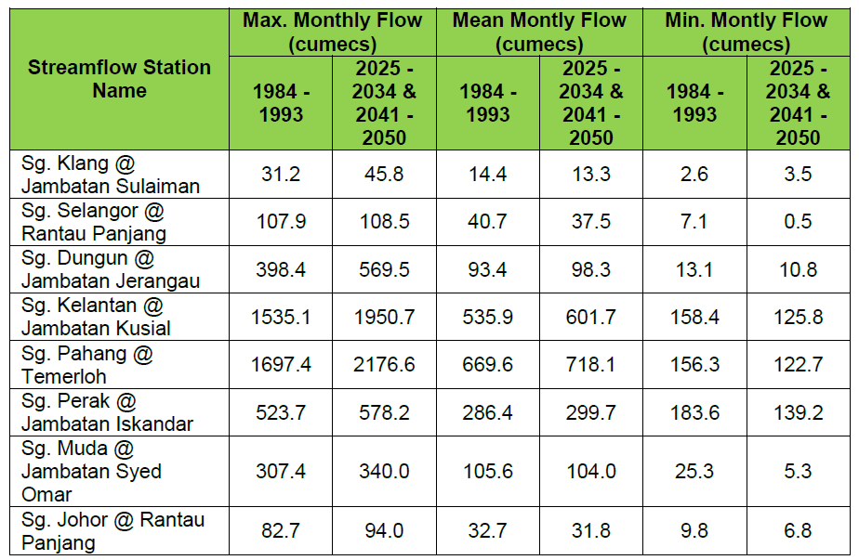
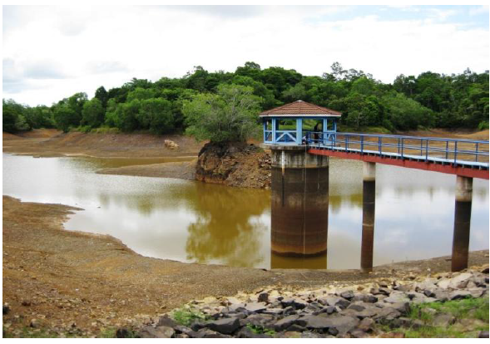
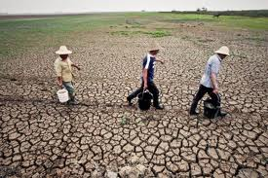
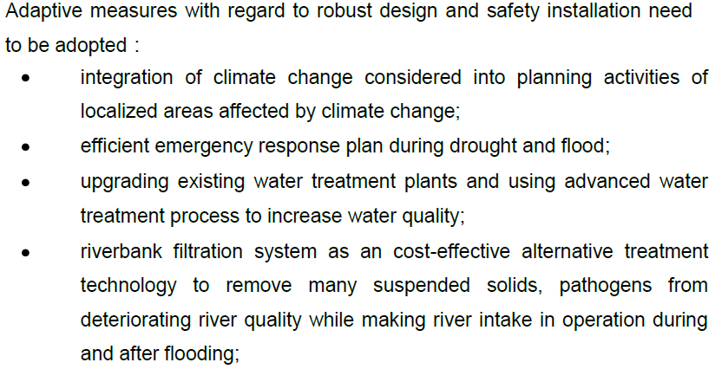

Slide 28
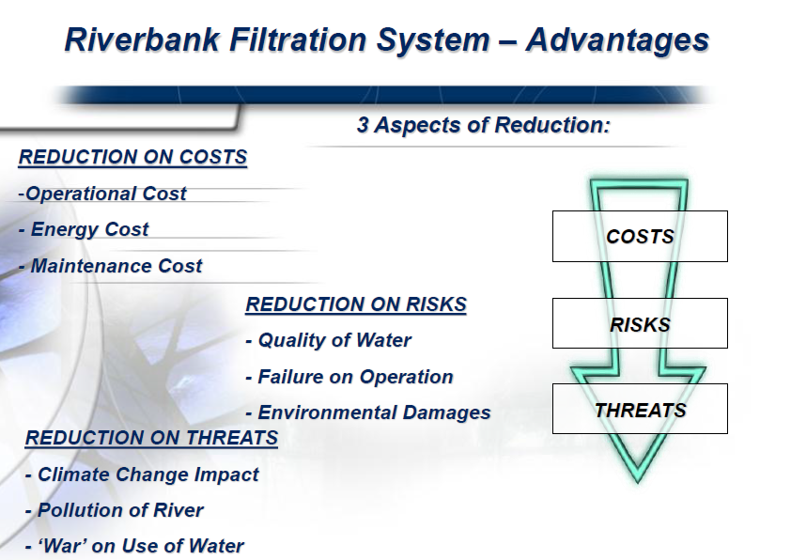

Slide 29
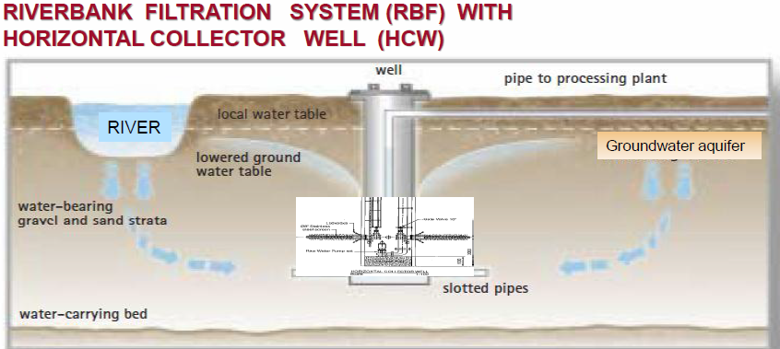
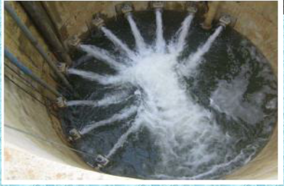
BENEFIT OF HORIZONTAL COLLECTOR WELL IN RIVER INFILTRATION SYSTEM
LARGE QUANTITIES OF WATER PRODUCED OVER SMALL CONSTRUCTION AREA
LOW IN CONSTRUCTION COST, LESS TIME TO CONSTRUCT AND IT’S GREEN TECHNOLOGY.
MAINTENANCE IS EASY AND ECONOMICAL WITH COST SAVING
PRODUCED WATER IS CLEAR AND PURE (LOW TURBIDITY) AND PROTECTED FROM OUTSIDE THREATS.
MINERAL CONTENT (IRON & MANGANESE) OF WATER IS LOW
WATER PRODUCTION IS GUARANTEED, ESPECIALLY DURING DRY SEASONS

Slide 30
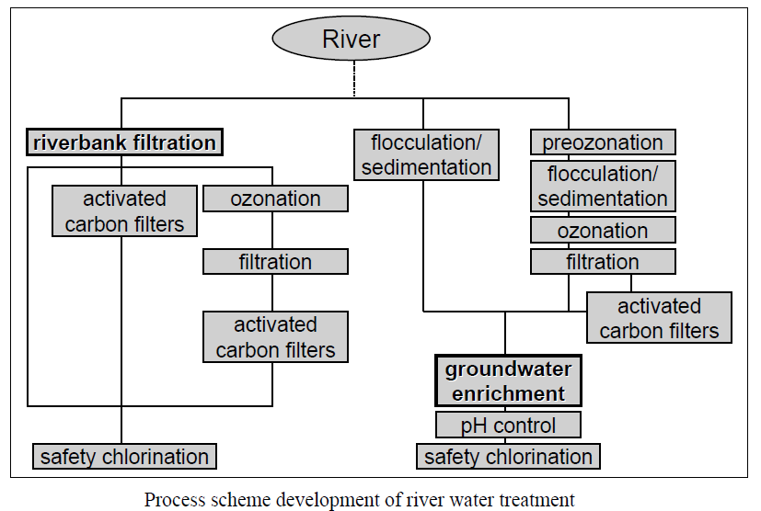
Water Treatment Process : Direct versus RBF Abstraction

Slide 31
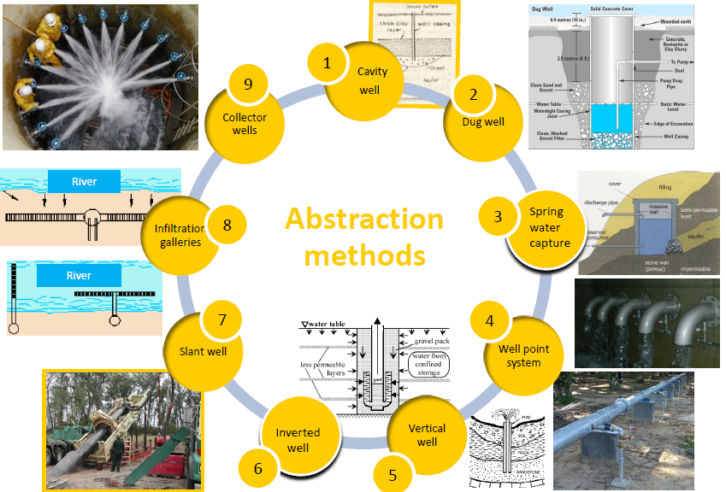
Abstraction Method

Slide 32
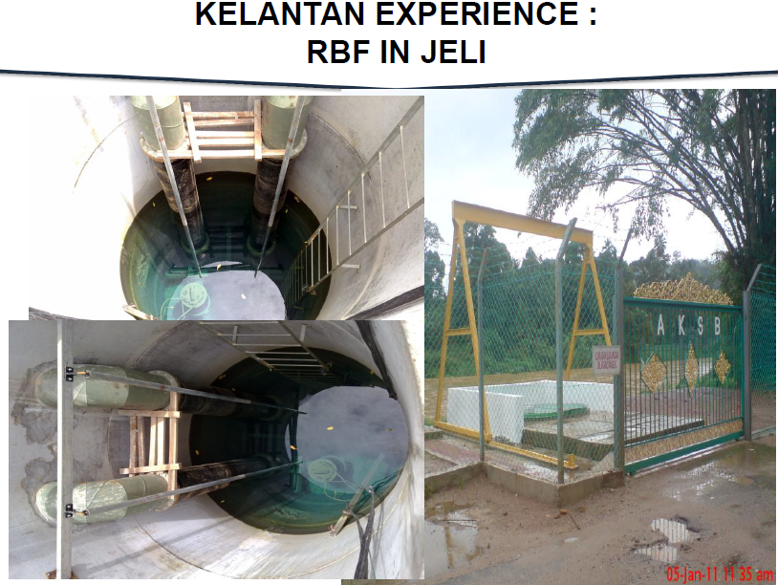
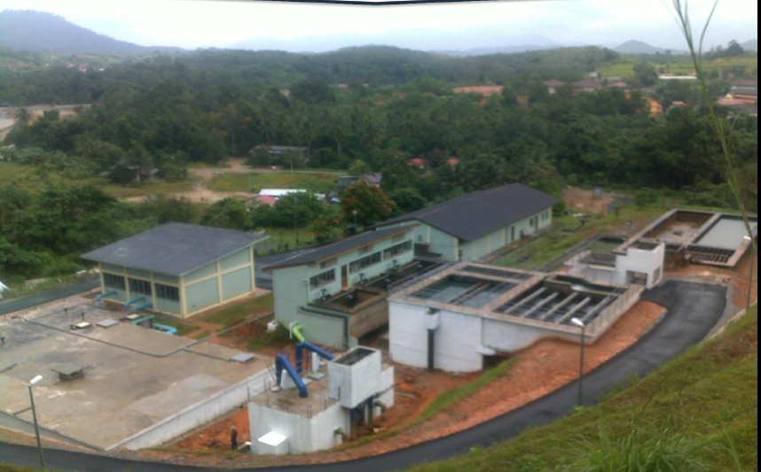
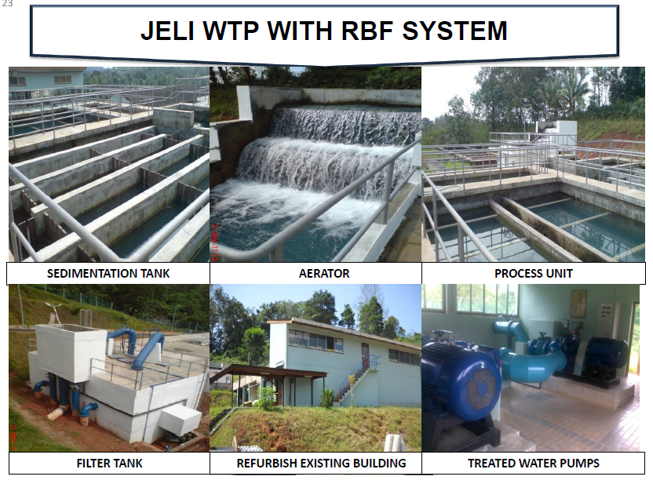
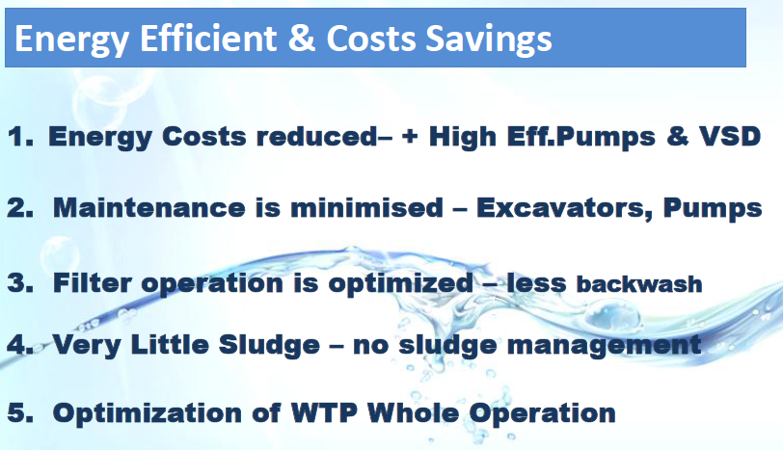

Slide 33
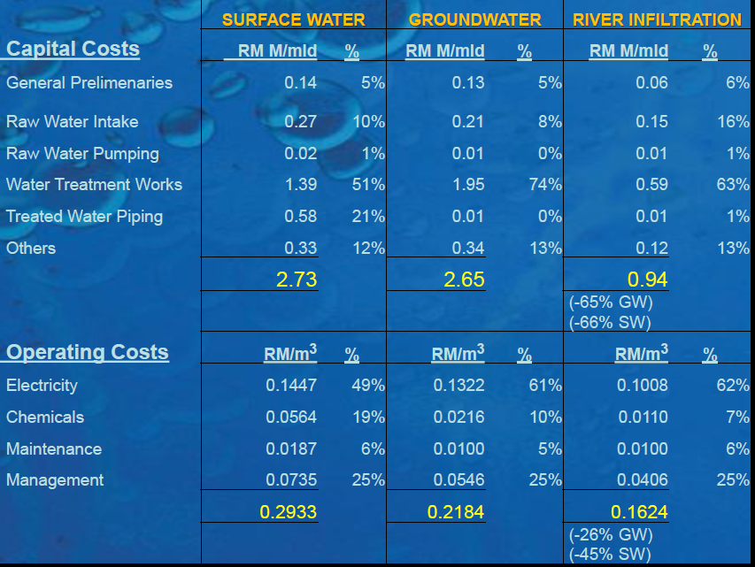

Slide 34
Heavy Metals and In Organic Trace Contaminants
Heavy Metals | Sg. Langat | DW2 | PW1 | Standards
Aluminum | 0.032 | 0.004 | 0.004 | 0.2
Arsenic | 0.002 | 0.001 | 0.001 | 0.01
Barium | 0.032 | 0.034 | 0.087 | 0.7
Boron | 0.052 | 0.025 | 0.048 | 0.5
Bromine | 0.025 | 0.021 | 0.059 | 0.025
Calcium | 3.400 | 0.919 | 4.673 | -
Carbon | 19.381 | 10.906 | 18.886 | -
Chlorine | 5.005 | 2.357 | 5.152 | 250
Chromium | 0.001 | 0.001 | 0.001 | 0.05
Cobalt | 0 | 0.001 | 0 | -
Copper | 0.019 | 0.010 | 0.014 | 1.0
Iodine | 0.001 | 0.000 | 0.001
Iron | 0.118 | 0.633 | 0.127 | 0.3
Lithium | 0.002 | 0.003 | 0.002 | -
Magnesium | 2.440 | 2.519 | 6.621 | 150
Manganese | 0.004 | 0.122 | 0.234 | 0.1
Mercury | 0.001 | 0.002 | 0.001 | 0.001
Molybdenum | 0.001 | 0 | 0 | 0.07
Nickel | 0.004 | 0.002 | 0.004 | 0.02
Phosphorus | 0.006 | 0 | 0.005 | -
Potassium | 0.627 | 0.393 | 1.695 | -
Rhodium | 0.01 | 0.006 | 0.015 | -
Rubidium | 0.01 | 0.007 | 0.015 | -
Scandium | 0.003 | 0.002 | 0.002 | -
Silicon | 1.488 | 1.405 | 1.492 | -
Sodium | 19 | 6 | 8 | 200
Strontium | 0.021 | 0.007 | 0.033 | -
Sulfur | 40 | 42 | 43 | -
Titanium | 0.007 | 0.001 | 0 | -
Vanadium | 0.001 | 0.001 | 0.001 | -
Zinc | 0.014 | 0.021 | 0.013 | 3
Notes:
Most of reading recorded not exceed the standard limits except
-bromine in PW1, mercury and iron in DW2
-Manganese also exceed the permissible limits in both well
-These heavy metals will discussed in detail letter.

Slide 35
Biological Analysis
Bacteria Analysis
Parasitological Analysis
Samples | Bacteria Analysis ( Analysis Quantitative)
 | Total Coliform | E.Coli
Sungai Langat | >2420 MPN/100mL, 35.5± 0.5°C / 24h | 1414MPN/100mL, 35.5± 0.5°C / 24h
DW2 | <1.0 MPN/ 100mL, 35.5± 0.5°C / 24h | <1.0 MPN/100mL, 35.5± 0.5°C / 24h
Samples | Parasitological Analysis
 | No of Giardia cysts counted on the slide | Giardia cysts/L | No of Cryptosporidium oocysts on the slide | Cryptosporidium oocyst/L
SW1 | 29 | 2.9 | 0 | 0
SW2 | 1 | 0.1 | 0 | 0
DW2 | 0 | 0 | 0 | 0
Notes:
-There are more than 2420 MPN/100ml of total Coliform and 1414 MPN/100mL E.Coli in Sg. Langat.
-after undergoing biological processes during filtration, both of the bacteria were found less 1.0 MPN/100mL
-Giardia cysts in River also had remove by a 99% of removal

Slide 36
SG LANGAT AND DENGKIL MONITORING WELLS WATER CHARACTERISTICS BASED ON AVERAGE VALUES IN COMPARISON TO RAW DRINKING WATER QUALITY.
TEST PARAMETER | UNIT | RESULTS |  |  |  |  |  |  |  |  | ªRaw Drinking
 |  | SG.LANGAT |  | MW1 | MW2 | MW3 | MW4 | MW5 | MW6 | PW | Water Quality
PH | - | 6.880 |  | 5.338 | 5.660 | 5.783 | 5.30 | 5.383 | 5.570 | 5.305 | 6.5 - 9.0
COLOUR (TRUE COLOUR) | PtCo | 22.500 |  | 5.333 | 20.333 | 27.333 | 8.000 | 7.000 | 17.667 | 8.333 | 15
TURBIDITY | NTU | 324.750 |  | 3.713 | 0.673 | 147.1 | 0.55 | 1.113 | 90.28 | 0.413 | 5
DO | mg/L | 5.560 |  | 2.960 | 2.375 | 2.988 | 2.35 | 2.388 | 2.430 | 1.938 | -
TDS | mg/L | 117.603 |  | 46.76 | 52.66 | 109.0 | 50.6 | 60.55 | 126.3 | 70.100 | 1000
HEAVY METAL
ARSENIC as As | mg/L |  | 0.073 | NA | 0.064 | NA | NA | 0.126 | 0.108 | 0.086 | 0.01
CHLORIDE as Cl | mg/L |  | 3.355 | NA | NA | NA | NA | NA | NA | NA | 0.200
IRON as Fe | mg/L |  | 4.916 | 1.295 | 1.605 | 1.561 | 1.39 | 1.237 | 2.355 | 0.609 | 0.3
MAGNESIUM as Mg | mg/L |  | 1.924 | 3.055 | 3.465 | 4.569 | 1.98 | 3.143 | 4.097 | 2.051 | 150
MANGANESE as Mn | mg/L |  | 0.093 | 0.945 | 1.474 | 1.135 | 0.67 | 0.950 | 0.924 | 0.348 | 0.1
ZINC as Zn | mg/L |  | 0.068 | 0.566 | 0.573 | 0.553 | 0.52 | 0.551 | 0.719 | 0.315 | 3
NOTE: MW - MONITORING WELL; PW - PUMPING WELL; NA - Not Available

Slide 37
SG PERAK AND MONITORING WELLS WATER CHARACTERISTICS BASED ON AVERAGE VALUES IN COMPARISON TO RAW DRINKING WATER QUALITY.
TEST PARAMETER | UNIT | RESULTS |  |  |  |  |  |  |  | ªRaw Drinking
 |  | SG. PERAK | MW1 | MW2 | MW3 | MW4 | MW5 | MW6 | PW | Water Quality
PH | - | 6.33 | 6.02 | 5.69 | 5.25 | 5.19 | 5.7 | 5.64 | 5.89 | 6.5 - 9.0
COLOUR (TRUE COLOUR) | PtCo | 91 | 71 | 40 | 20 | 7 | 98 | 109 | 47 | 15
TURBIDITY | NTU | 21.4 | 13.1 | 1.01 | 0.61 | 0.49 | 28 | 1.3 | 1.12 | 5
DO | mg/L | 6.59 | 0.04 | 0.74 | 0.19 | 0.67 | 0.18 | 0.3 | 2.26 | -
TDS | mg/L | 35.1 | 188.5 | 151.4 | 102.7 | 96.9 | 146.3 | 97.5 | 128.7 | 1000
HEAVY METAL
IRON as Fe | mg/L | 0.59 | 25.5 | 14.1 | 9.6 | 9.5 | 13.3 | 9.1 | 7.9 | 0.3
MANGANESE as Mn | mg/L | 3.9 | 2.5 | 4.3 | 1.2 | 3.4 | 3.6 | 2.2 | 1 | 0.1
NOTE: MW - MONITORING WELL; PW - PUMPING WELL; NA - Not Available

Slide 38
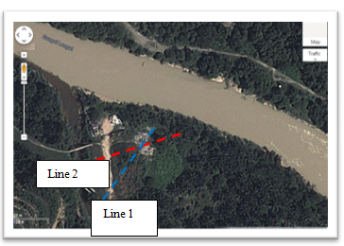
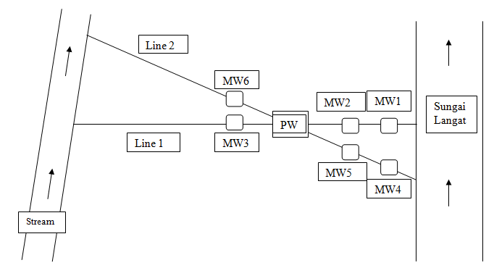
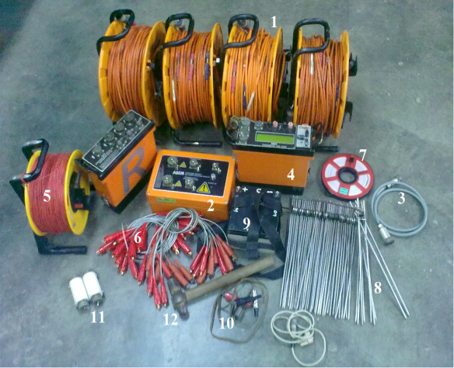
Determination of Water availability

Slide 39
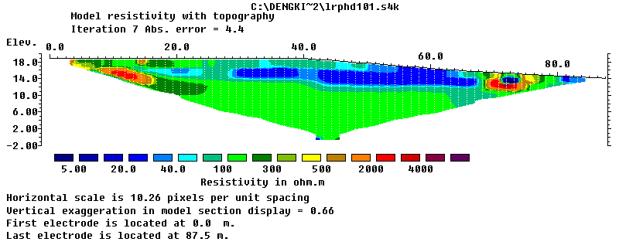
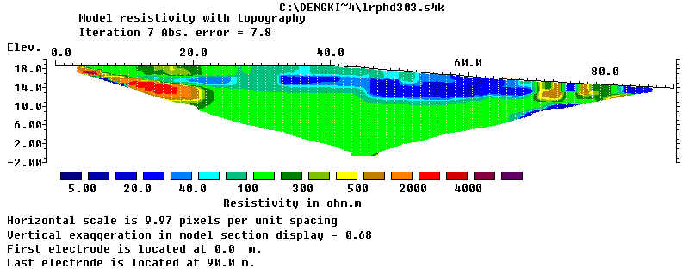
LINE 1 – BEFORE ‘PUMPING TEST’
LINE 1 – TEST AFTER 6 HOURS

Slide 40

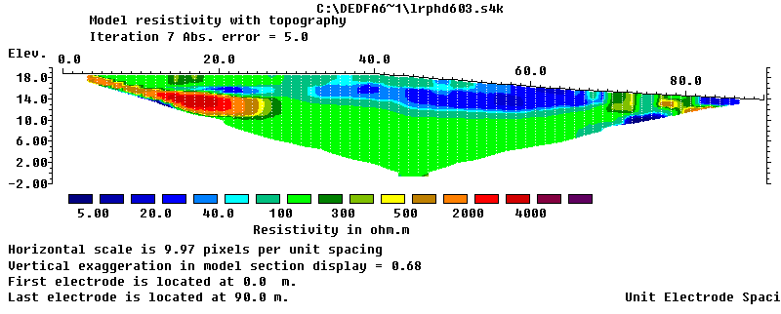
LINE 1 – TEST AFTER 24 HOURS
LINE 1 – AFTER 72 HOURS WITH ‘SALT TEST’

Slide 41
Monitoring and Pumping wells water level for every
6 hours during pumping test.
Well Hours | MW1(m) | MW2(m) | MW3(m) | MW4(m) | MW5(m) | MW6(m) | PW(m)
0 | 3.56 | 5.20 | 5.92 | 4.00 | 5.10 | 5.60 | 6.14
06 | 4.17 | 5.84 | 6.48 | 4.57 | 5.74 | 5.96 | 7.88
12 | 4.22 | 5.89 | 6.58 | 4.61 | 5.80 | 6.02 | 7.96
18 | 4.26 | 5.94 | 6.62 | 4.67 | 5.83 | 6.07 | 8.02
24 | 4.31 | 5.98 | 6.70 | 4.69 | 5.88 | 6.11 | 8.07
30 | 4.32 | 6.00 | 6.70 | 4.71 | 5.90 | 6.14 | 8.10
36 | 4.36 | 6.03 | 6.71 | 4.74 | 5.93 | 6.17 | 8.15
42 | 4.38 | 6.05 | 6.73 | 4.77 | 5.95 | 6.19 | 8.16
48 | 4.42 | 6.08 | 6.76 | 4.79 | 5.98 | 6.22 | 8.21
54 | 4.42 | 6.11 | 6.78 | 4.85 | 5.99 | 6.24 | 8.23
60 | 4.45 | 6.12 | 6.81 | 4.84 | 6.03 | 6.27 | 8.26
66 | 4.47 | 6.14 | 6.83 | 4.86 | 6.04 | 6.29 | 8.30
72 | 4.51 | 6.21 | 6.85 | 4.86 | 6.05 | 6.30 | 8.31

Slide 42
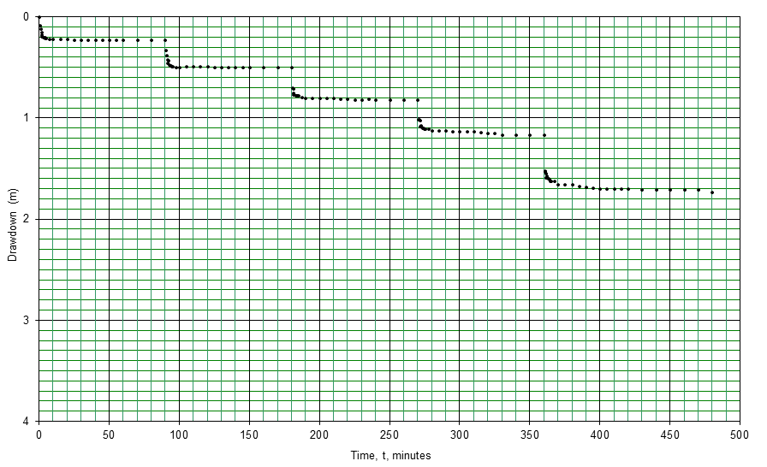
Step Drawdown test for pumping well at Dengkil, Selangor
82.95% in 120 min
STEP DRAWDOWN TEST FOR PUMPING WELL AT KUALA KANGSAR, PERAK
84.67% in 180 min

Slide 43
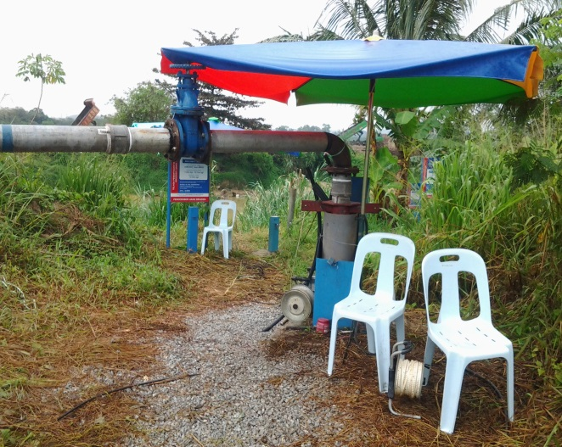
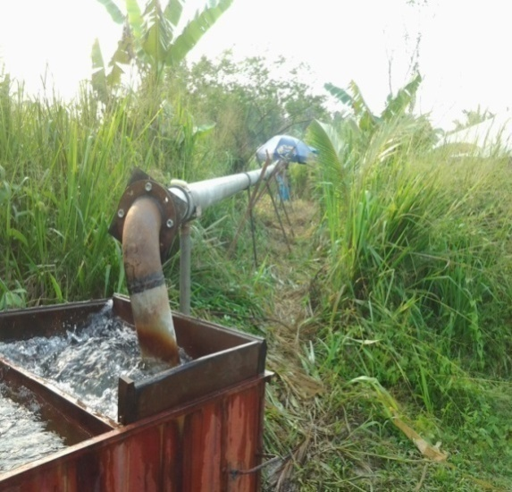
Availability of abstraction
Dengkil, Selangor
Water Capacity: 142.23 m³/hr (3.41 MLD)
Kuala Kangsar, Perak
Water Capacity: 112.10 m³/hr (2.70 MLD)

Slide 44
remarks
Malaysia needs groundwater supply systems - systems are in place to address lack of surface water and to adapt to climate change
The availability of shallow groundwater could be harvested (RBF) as untapped natural water
RBF could be a vital water security abstraction sources for potable water due to climate changes and anthropogenic pollution sources

Slide 45
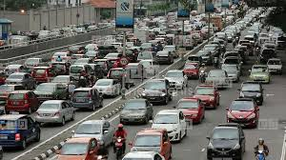
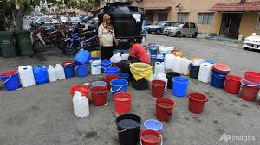
Better facing traffic jam rather than water shortage – public opinion
(Sinar, 3 March 2014)

Slide 46
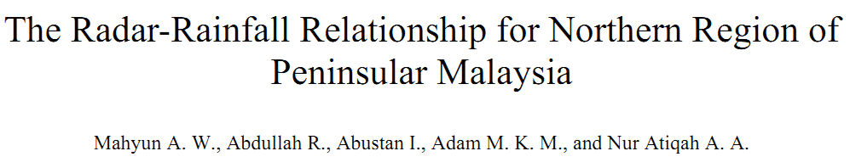

Slide 47


Z-R relationship
Weather radar can potentially provide high-resolution spatial and temporal rainfall estimates bringing more accuracy to flood estimations as well as having some other applications in areas with insufficient rainfall stations
Weather radar cannot be used to measure the rainfall depth directly; so an empirical relationship between the reflectivity (Z) and rainfall rate (R).
Z-R relationship (Z = AR^{b}), is generally used to assess the rainfall depth using radar.

Slide 48
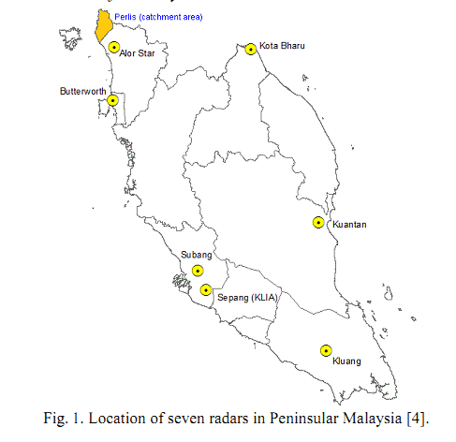
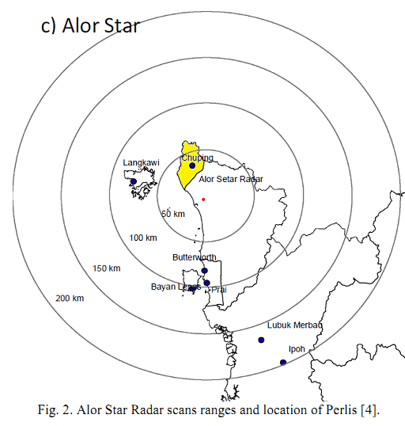
Malaysian Weather Radar

Slide 49
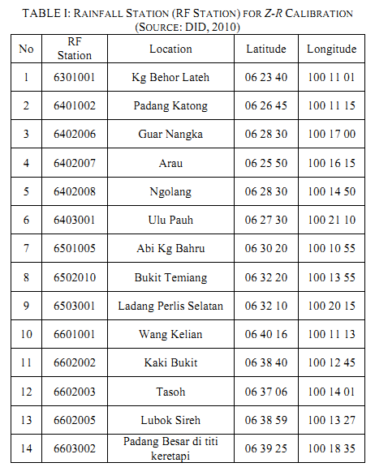
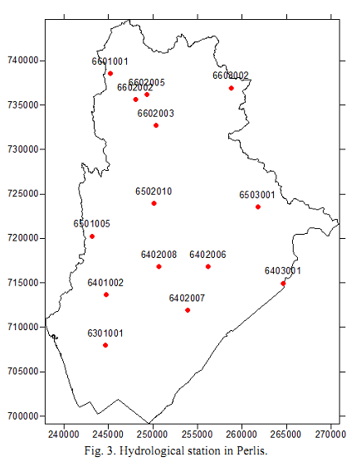

Slide 50



Z-R Values

Slide 51




Location of Weather Radar

Slide 52
Remarks
To integrate the weather radar data into flood forecasting, calibration of Z-R should be performed.
Based on pervious and current studies, the point rainfall values always underestimate by radar values.
It is probably due to normally
  Standard ZR value of Z=200R^{1.6}
  ^{Northern} Malaysian Value of Z=40R^{1.6}
  High humidity/saturated air during thunderstorm in tropic
Next step will focus on storm moving…

Slide 53


Hexagonal Modular Pavement System (HMPS)
Principle Inventor:
Prof. Dr. Ismail Abustan, USM
Prof. Dr. Meor Othman Hamzah, USM
Co-Researchers
Dr Mohd Aminur Rashid bin Mohd Amiruddin Arumugam, UNITEN
Dr. Nasehir Khan E.M Yahaya, Drainage and Irrigation Depatment (DID)
School of Civil Engineering
Engineering Campus
Universiti Sains Malaysia
14300 NIBONG TEBAL

Slide 54





Hexagonal Modular Pavement System (HMPS)
HMPS (Hexagonal modular, cubical aggregates) with high air voids > 35%
Large permeable surface area (+94%)
Improves local infiltration capacity and thus decreases storm water runoff
Holding loose aggregates in pack and increase loading capacity
Environmental friendly and MSMA compliance

Slide 55




Problem Statements
Urbanization reduce permeable area and thus urban runoff volumes increase significantly
Lower groundwater table since less local infiltration and percolation
Since in urban areas, most of directly connected impervious areas are parking and pavement, it is essential to capture rainfall at source (source control)

Slide 56


Figure 1: The arrangement of HMPS similar to the bee nest structure
(a) (b) (c)
Figure 2: Market available permeable pavers (a) Permeable interlocking concrete pavers with pea gravel fill (heavy and minimum permeable surface), (b) Concrete grid pavers with topsoil and grass fill (heavy and minimum permeable surface), (c) Plastic reinforcement grid pavers with earth and grass fill (minimum loading).

Slide 57


OBJECTIVE OF THE INVENTION
To improve infiltration rates of permeable pavement, the Hexagonal Modular Pavement System (HMPS) was developed
HMPS invention objectives:
To increase infiltration rates of permeable pavement
To provide initial treatment at source
To withstand significant structural loads and the grid provides
stability, flexibility, and continuity for large areas
To comply with MSMA concept (control at source)

Slide 58



HMPS COMPONENTS
Surface Layer
Base Layer
Subgred
Dimension of whole system of HMPS in
millimetres in CAD

Slide 59

EVALUATION OF RESULTS (Compression Test)
Examples of usage HMPS in
daily life
Item | Maximum load (kN) | Safety factor
Auto tires | 275 | 27
Truck tires | 758 | 10
F-16 tires | 2413 | 3
Fire truck outriggers | 558 | 13
Physical modelled unit data made from HDPE was tested with dimension of 5 mm thickness and 100 mm diameter by 100mm high. Lab test data showed that bare rings of 72kN per modular with deflection stopped at 3.9 mm. while sand filled modular with zero deflection has 75kN per modular.

Slide 60




Slide 61

Expansion of Mengkubau Dam, Brunei, Darul Salam

Slide 62







