Slide 1
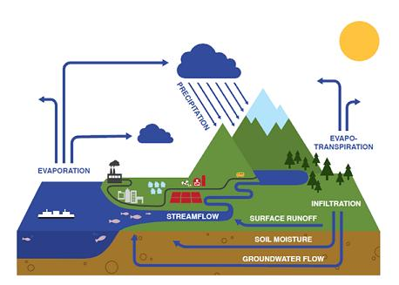
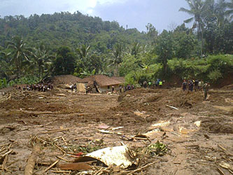



Ecohydrology for Inland Waters Improvement & Disaster Risk Reduction
Prof. Hery Harjono
Asia Pacific Centre for Ecohydrology
Category II Centre of UNESCO
Apip Arief
Research Centre for Limnology
Indonesian Institute of Sciences
23-26 September 2014, Chulalongkorn University, Thailand

Slide 2
Presentation Outline:
Introduction on Ecohydrology
Asia Pacific Centre for Ecohydrology (APCE)
Ecohydrology approach of APCE for Disaster Risk Reduction and Inland Waters Improvement
Recent Activities of APCE
Summary
This presentation would give a brief description about the Asia Pacific Centre for Ecohydrology (APCE) and introduces the ecohydrology theory and concepts as integrative science solution to water resources problems
Research Centre for Limnology-LIPI & Asia Pacific Centre for Ecohydrology (APCE)

Slide 3
ECOHYDROLOGY as Integrative Science
Since 1996, International Hydrological Programme's (IHP) through a key theme of the fifth phase “Hydrology and Water Resources Development in Vulnerable Environment” developed and formulated a new program called “Integrative Approach of Ecohydrology” (Zalewski, 2002)
The commitment of the UNESCO and IHP on the implementation of ecohydrology concept shown by establishment the Europen Regional Centre for Ecohydrology (ERCE) and the International Centre for Coastal Ecohydrology (ICCE) in 2006 and 2009 respectively.
One of the new centers on the field of Ecohydrology is the Asia Pacific Centre for Ecohydrology (APCE).
Indonesia designation as a Centre for Asia Pacific Regional Ecohydrology has been through a long process that began in 1997and finally set in Paris in October 2010.
Research Centre for Limnology-LIPI & Asia Pacific Centre for Ecohydrology (APCE)

Slide 4

ECOHYDROLOGY CONCEPT
“DUAL REGULATION”
Regulation of biota
by altering hydrology
and regulation of hydrology
by shaping biota
(Zalewski, 2002)
BIOTA
Ecohydrology uses the dual interactions between biota and hydrology to regulate,
remediate and conserve ecosystems
REGULATION
HYDROLOGY
HARMONIZATION
of ecohydrological measures
with necessary hydrotechnical infrastructure
INTEGRATION
of various regulations acting in a synergistic way to stabilize and improve the quality of water resources

Slide 5
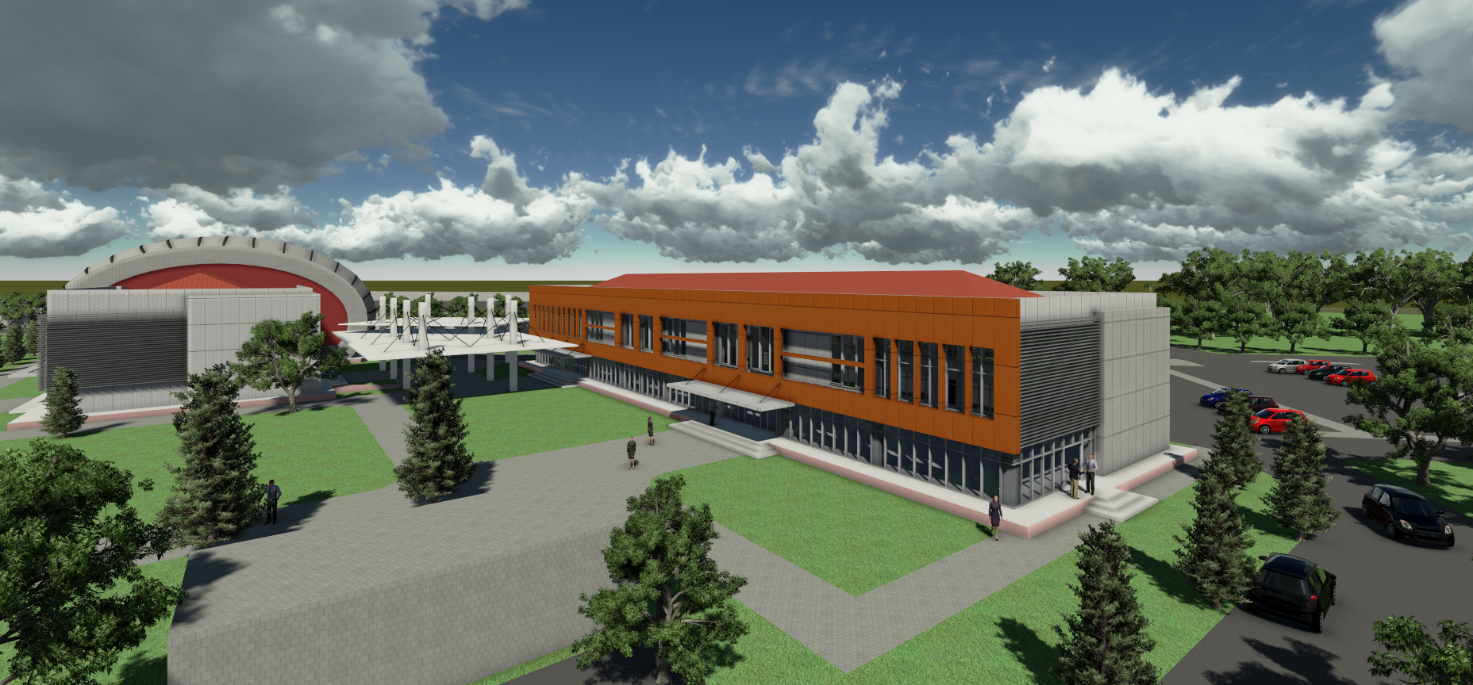
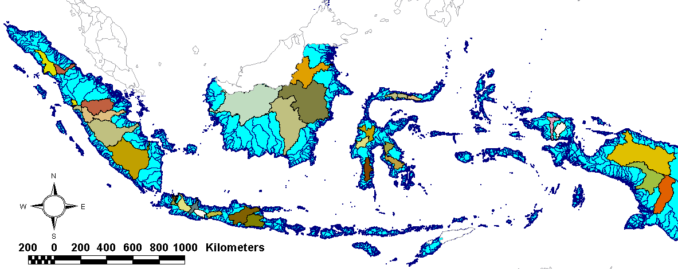


ASIA PACIFIC CENTRE FOR ECOHYDROLOGY
(APCE)
“Managing Water Systems through Ecohydrology and Cultural Values”
Cibinong, West Java
Research Centre for Lymnology Campus
Cibinong Sciences Centre – Jl. Raya Bogor Km 46
Cibinong – Bogor – West Java - INDONESIA
Tel.: 021-8757071 Email : ignasdas@yahoo.co.id

Slide 6
ASIA PACIFIC CENTRE FOR ECOHYDROLOGY
APCE – UNESCO CATEGORY II CENTRE
The Asia Pacific Centre for Ecohydrology (APCE) is a category II centre of the United Nations Educational, Scientific and Cultural Organization (UNESCO).
It focuses on ecological approaches to water resources management, to provide sustainable water for the people by harnessing science and technology, education and culture.
APCE is committed to contributing towards overcoming current and important issues of national, regional and global interest, such as poverty, disaster risk reduction and climate change mitigation & adaptation .
Research Centre for Limnology-LIPI & Asia Pacific Centre for Ecohydrology (APCE)

Slide 7
Organization Structure
Executive Director
Executive Secretary
Research Division
Training & Workshop
Information System
Public Awareness
Research Centre for Limnology-LIPI & Asia Pacific Centre for Ecohydrology (APCE)

Slide 8
Strategic Plan of APCE
“Managing Water Systems through Ecohydrology and Cultural Values”
VISION: To be an Internationally Reputed Asia Pacific Center in Urban and Rural Ecohydrology by 2021
  Mission: Develop understanding and practices of ecohydrology through research, training and knowledge exchanges, information systems and public awareness.
APCE will develop excellent expertise in the following fields:
  Relationships among ecological pattern and hydrological process;
  Disturbance and dynamics in natural and anthropogenic ecology and hydrology;
  Ecohydrological approaches to biodiversity conservation, environmental management, and ecological restoration;
  Integrating hydrology with ecological planning, design, and architecture, or reverse;
  Transdisciplinary studies of regional sustainability from scopes of ecohydrology, ecology, culture (society) or integration of them.
Research Centre for Limnology-LIPI & Asia Pacific Centre for Ecohydrology (APCE)

Slide 9
STRATEGIC GOAL of APCE
  To promote local resources base ecohydrological research
  To strengthen local capacity to adopt ecohydrological concept and approach
  To provide easy access to local resources based ecohydrological information and knowledge
  To enhance public awareness of local resources based ecohydrological practices
Research Centre for Limnology-LIPI & Asia Pacific Centre for Ecohydrology (APCE)

Slide 10
Water & Culture
Indonesia, it consists of
Mostly volcanic islands
More than 17000 islands
More than 400 ethnics
5 main religions (Islam, Christian, Hindu, Budha, Kong Hu Chu)
Popolution 222 million (100 million in Java)
Water and Culture:
“Due to its fundamental role in society’s life, water has a strong cultural dimension. Without understanding and considering the cultural aspects of our water problems, no sustainable solution can be found”
(Statement to the Ministerial Conference, 3rd World Water Forum, 22 March 2003)
Research Centre for Limnology-LIPI & Asia Pacific Centre for Ecohydrology (APCE)

Slide 11
Our Approach for Disaster Risk Reduction & Inland Waters Improvement
1. Quantification of Source
Need deep scientific understanding
2. Technological (Ecohydrology Concept) and Socio-Cultural Approach (Innovation)
Infrastructure (ecotechnology)
Social & cultural approach
Looking back the history (e.g. how
people use water)
Increasing Awareness
Mass campaign to people,
government & politician
Research Centre for Limnology-LIPI & Asia Pacific Centre for Ecohydrology (APCE)

Slide 12
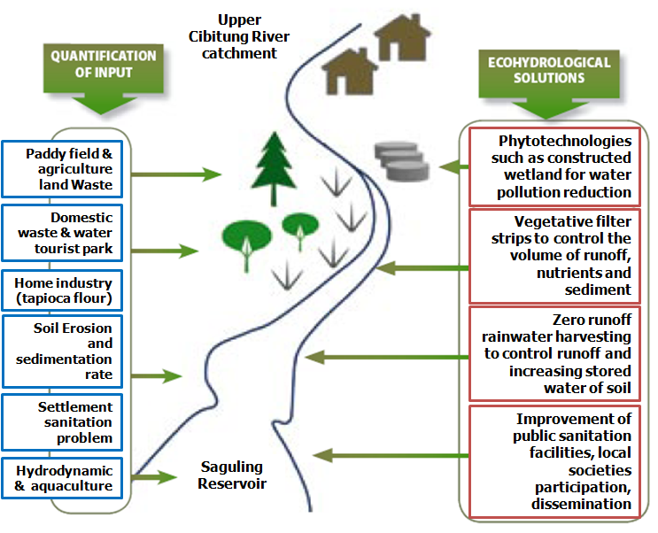
Hydrological
principle
basin as a framework for processes quantification
Ecological
principle
enhancement of absorbing capacity of ecosystem
(Zalewski, 2002)
ECOHYDROLOGY
Cultural
principle
To enhance the dynamic relationships
between hydrological, social,
and ecological systems
ECOHYDROLOGY - APCE
(APCE, 2011)
Ecotechnology
principle
use of ecosystem properties as management tool
Risk Reduction & Water Improvement
Modeling System
Ecohydrology Measures
Flood Risk =
Flood Hazards x
Flood Exposures x
Flood Vulnerabilities
Flood Control Measures
Zalewski , 2009
Research Centre for Limnology-LIPI & Asia Pacific Centre for Ecohydrology (APCE)

Slide 13
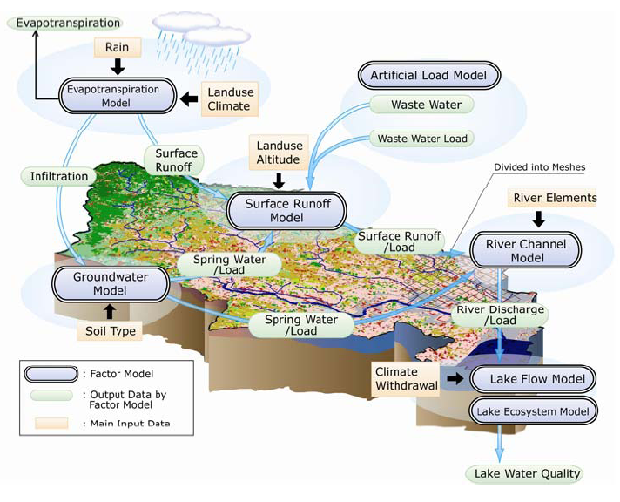

MODELING SYSTEM for Source Quantification:
Physically-Based Distributed Models for Water Disasters & Water Resources Management Developed in APCE
River basin sub model (1-D kinematic wave)
Hydraulic and hydrodynamic instream sub model (2-D diffusion wave)
Ecohydrological & aquatic habitat sub model
Research Centre for Limnology-LIPI & Asia Pacific Centre for Ecohydrology (APCE)

Slide 14
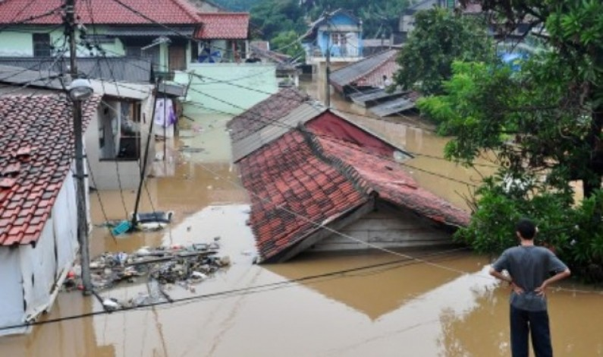
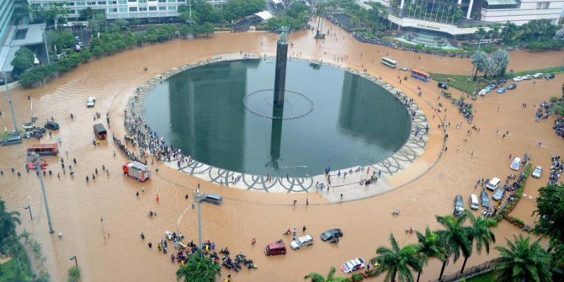
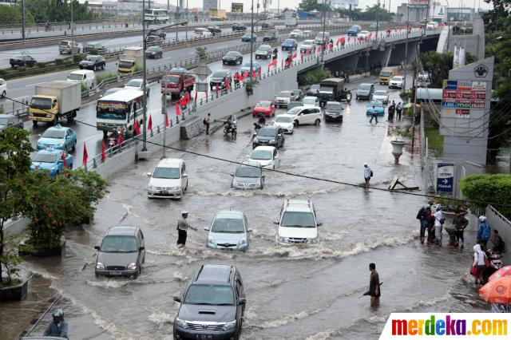
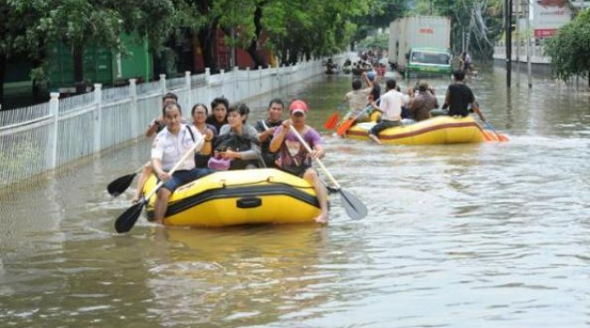
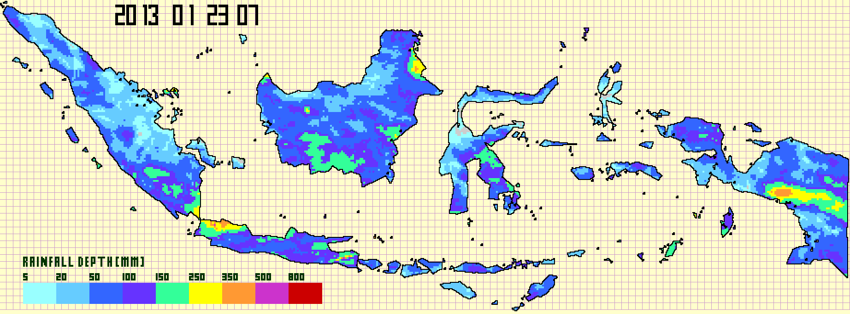
Model Application for Simulating Hydrologic Responses During Jakarta Flood
Spatial distribution of predicted cumulative rainfall during Jakarta floods 2013, Indonesia (13 January 2013 at 01 a.m to 23 January 2013 at 07 a.m)
Research Centre for Limnology-LIPI & Asia Pacific Centre for Ecohydrology (APCE)
Notes:
According to the rainfall duration and spatial distribution, the rainfall estimates well capture relatively higher cumulative rainfall depth over the Upper Citarum River and Jakarta Metropolitan Region region than other areas for each flooding case (see Figure 5). However, especially for high rainfall intensity, the rainfall estimates underestimate the magnitude of rainfall when compared with the observed data of specific stations, indicating a negative bias. In summary, these results indicate that the satellite-based rainfall product is reasonable ways by which to predict the spatial distribution of rainfall over this study region. The movement of satellite-based rainfall fields could be used to detect a particular extreme rainfall event and used it as the model input for flood-shallow landslide prediction and forecasting.

Slide 15
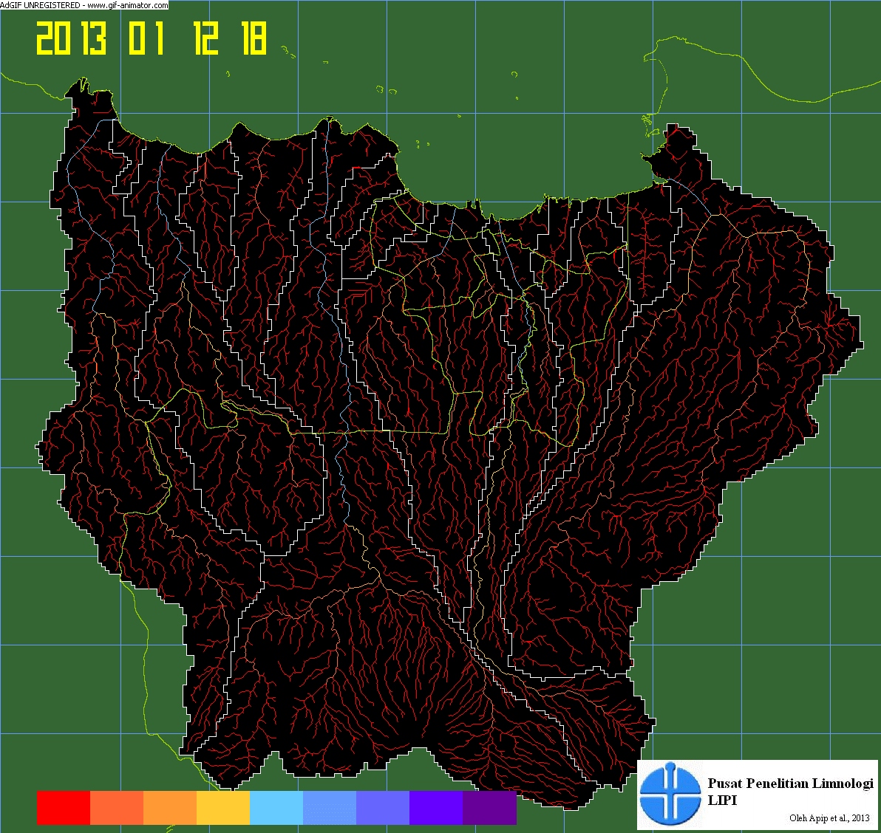
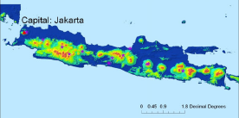

Bulan
Hari
Jam
Peak Time of Flood is January 17th
KOTA TANGGERANG
KOTA BEKASI
DKI JAKARTA
Model Application for Simulating Hydrologic Responses During Jakarta Flood
Animation: Dynamic Changes of Streamflow Discharge at Several River Catchments During Jakarta Flood in 2013
KOTA DEPOK
DAS Kali Bekasi
KOTA BOGOR
DAS Kali Cisadane
DAS Kali Ciliwung
Low Discharge
High Discharge
>300 m3/sec

Slide 16
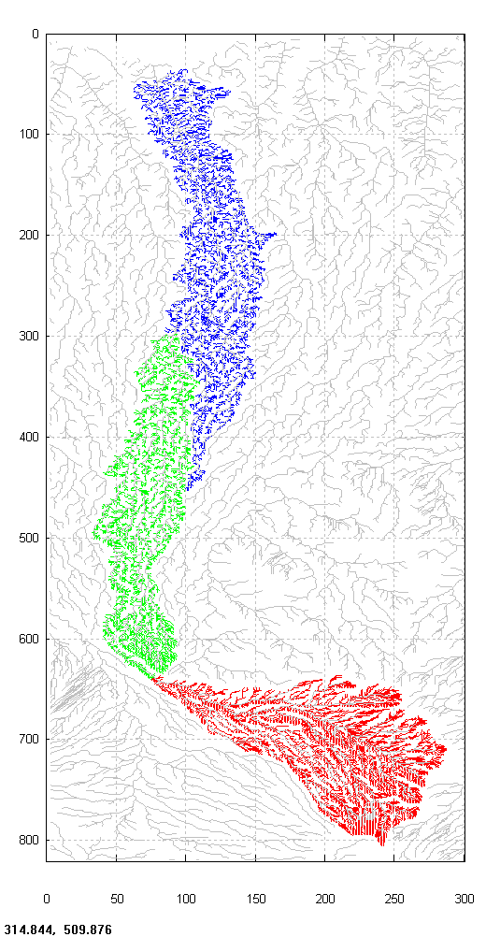
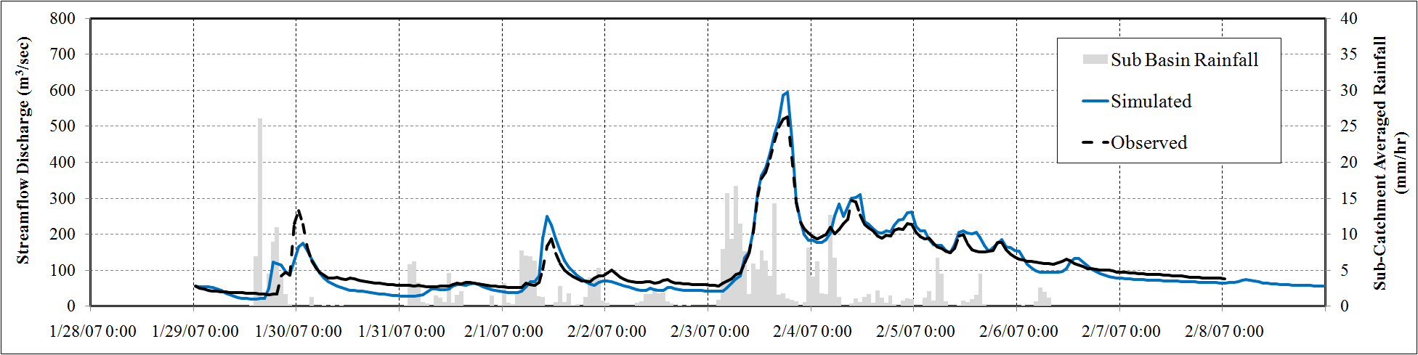
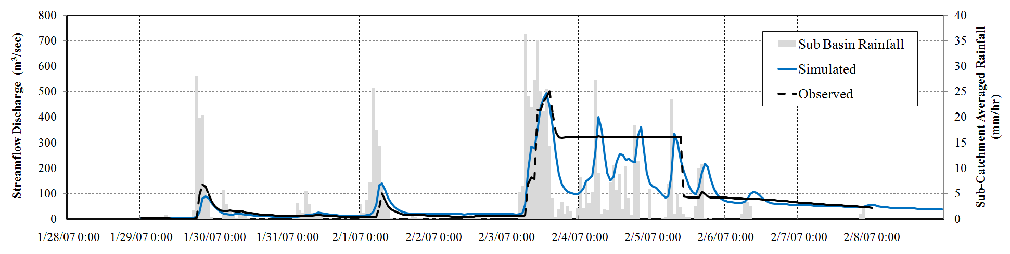
Model Application for Simulating Hydrologic Responses During Jakarta Flood
Simulated and Observed Hydrographs Comparisons At Katulampa-ciawi Station (Bottom Figure) and Depok Station (Top Figure), Ciliwung River Catchment during Jakarta Flooding On January-February 2007
At Depok Station
NSE = 0.94
At Katulampa Station
NSE = 0.73
Research Centre for Limnology-LIPI & Asia Pacific Centre for Ecohydrology (APCE)

Slide 17
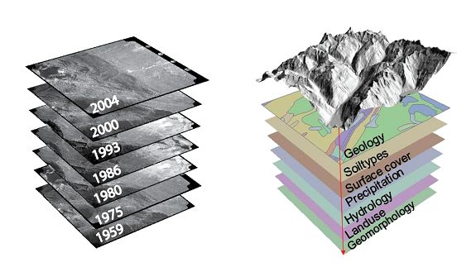
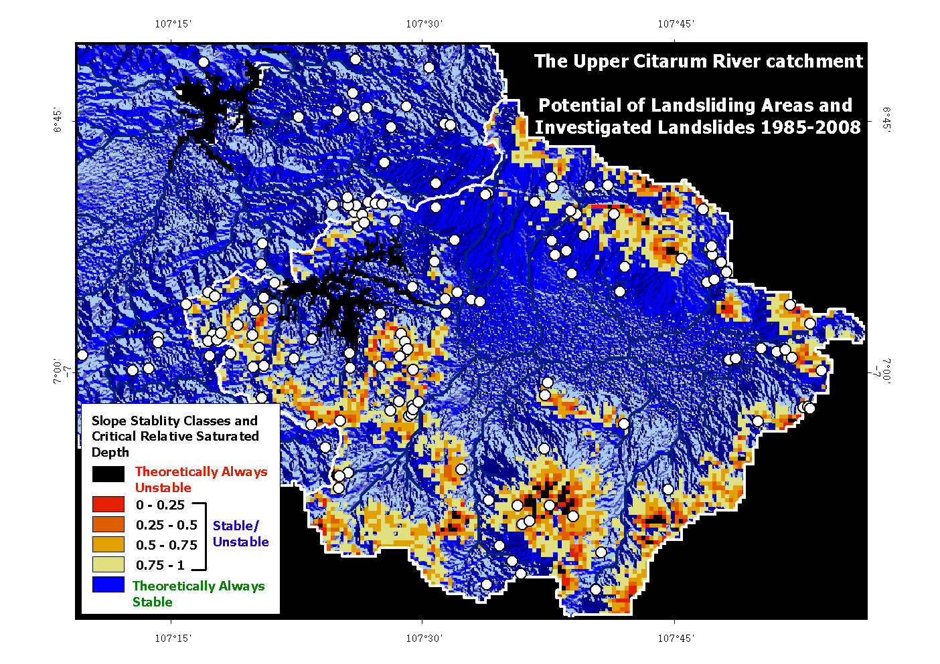
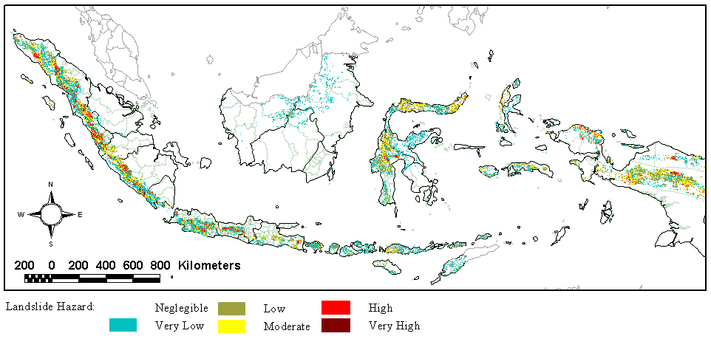
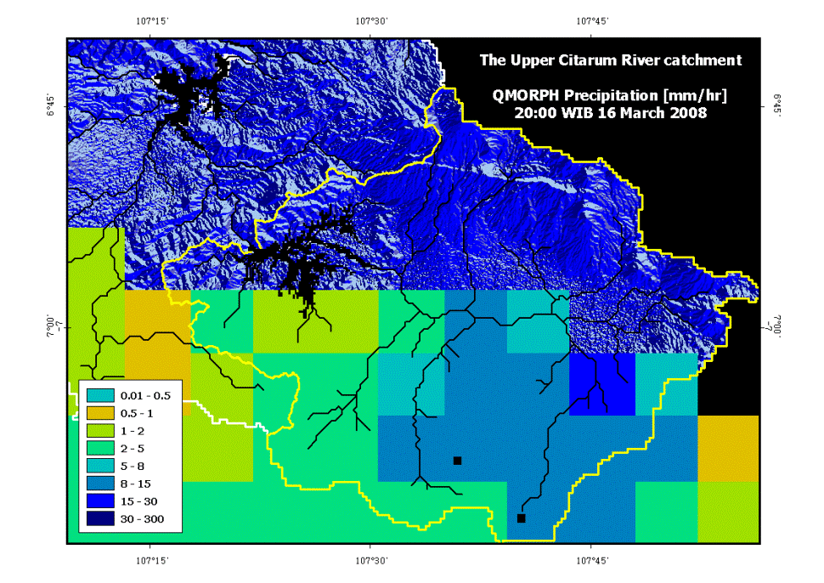

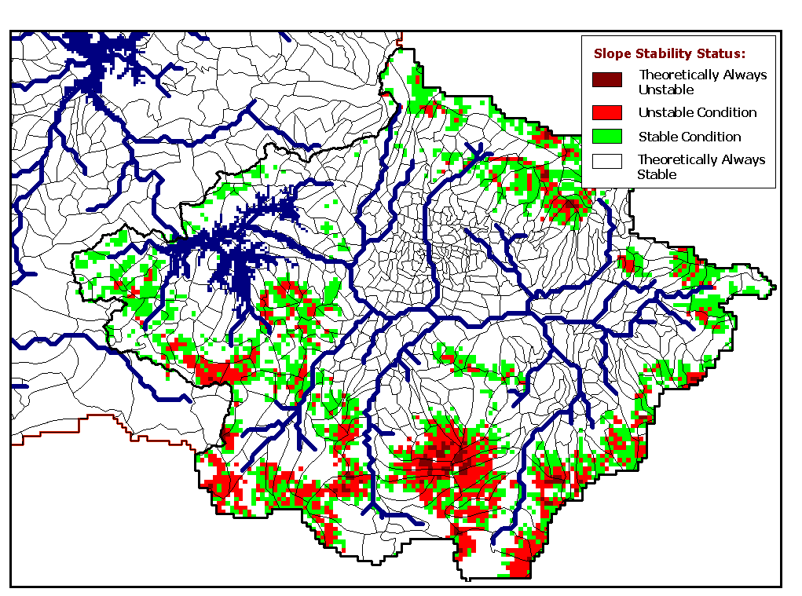
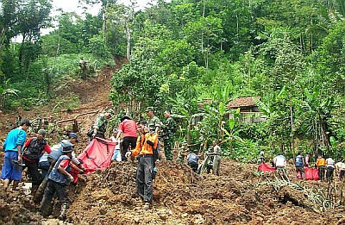
Model Application for Simulating Shallow Landslide Susceptible Area
−Pangalengan Landslide, Indonesia−
HydroTopo-graphic Data
Time-Invariance Shallow Landslide Probability Map
Distributed Hydrological-Geotechnical Model for Catchment Scale
Satellite-based Rainfall Estimates from QMORPH-NOAA on 15-16 March 2008 at the Upper Citarum River catchment
Pangalengan Landslide
The present results have showed a high potential applicability of the developed method forced by satellite-based rainfall data to detect (when?, where?) heavy rain-triggered shallow landslide events
15/3/2008:14
Spatio-Temporal Dynamics of Slope Instability over the Study Region

Slide 18
Recent Activities
1. Quantification of Source
Need deep scientific understanding
2. Technological Approach (Ecohydrology Concept) and Socio-Cultural (Innovation)
Infrastructure (ecotechnologies)
Social & cultural approach
Looking back the history (e.g how
people use water)
Increasing Awareness
Mass campaign to people,
government & politician
Research Centre for Limnology-LIPI & Asia Pacific Centre for Ecohydrology (APCE)

Slide 19
IFAS TRAINING COURSE
A technical course was organized based on the framework of the Flood Forecasting and Warning System which was attended by 10 countries (Australia, Cambodia, China, Indonesia, Lao People’s Democratic Republic, Malaysia, the Philippines, the Republic of Korea, Thailand and Vietnam).
This Integrated Flood Analysis System (IFAS) course was realized in collaboration with the International Centre for Water Hazard and Risk Management, the UNESCO Jakarta Office and LIPI.
Research Centre for Limnology-LIPI & Asia Pacific Centre for Ecohydrology (APCE)

Slide 20
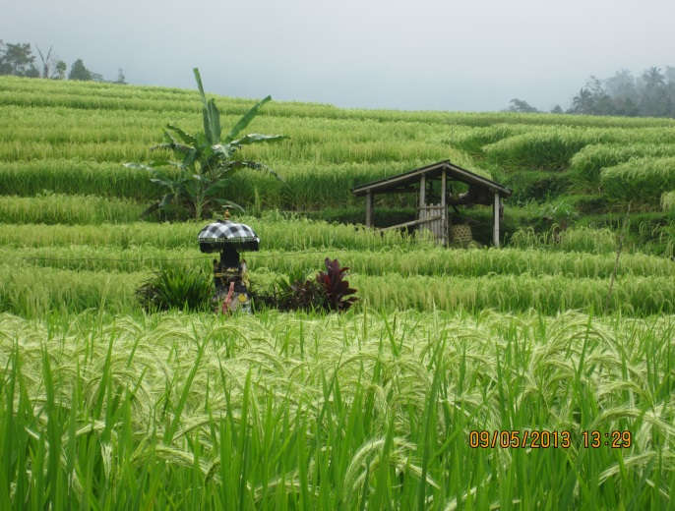
Cultural Landscape and Subak System in Bali
Subak is the name of the water management (irigation) system for paddy fields on Hindu Balinese community, Bali island, Indonesia, developed more than 1,000 year ago. There is around 3500 subak.
Traditional ecologically sustainable irrigation system has constantly adjusted to changing situations.
“Tri Hita Karana” Phylosophy:
Harmony among humans, harmony with nature, harmony with god
UNESCO’s World Cultural Heritage.
THREAT:
Compete with tourism
Increasing population & landuse conversion
“How to harmonize cultural value and economic activity”
Research Centre for Limnology-LIPI & Asia Pacific Centre for Ecohydrology (APCE)

Slide 21
Demo Site for Community-Based
Water Management
The objective is to act as a field station for the implementation of ecohydrology concepts in the field. The demo site ecohydrology campaign is expected to be significant in socializing the sustainable management of water resources in accordance with the concept of ecohydrology.
It will also serve as a natural laboratory for the future development of ecohydrology, especially as a tropical Indonesian concern.
Ecohydrology demo site development in Indonesia will be directed to a location demo site representing the concept of sustainable water resources management including disaster risk reduction and water pollution improvements.
Research Centre for Limnology-LIPI & Asia Pacific Centre for Ecohydrology (APCE)

Slide 22
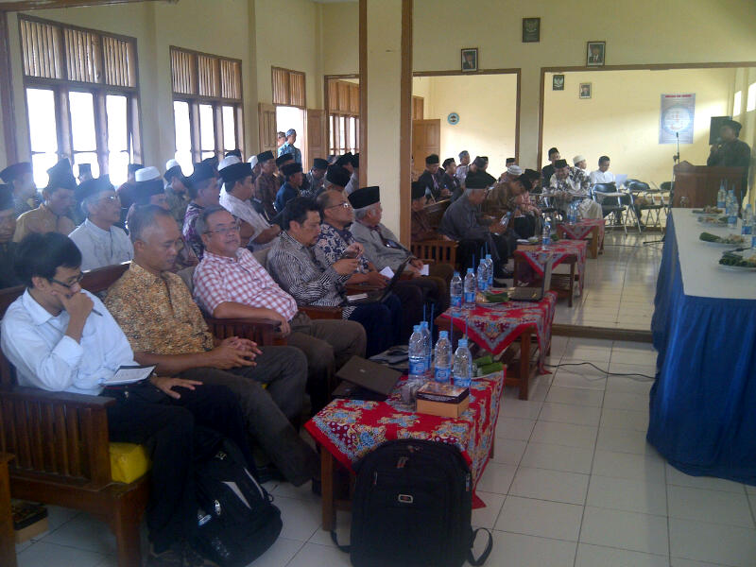
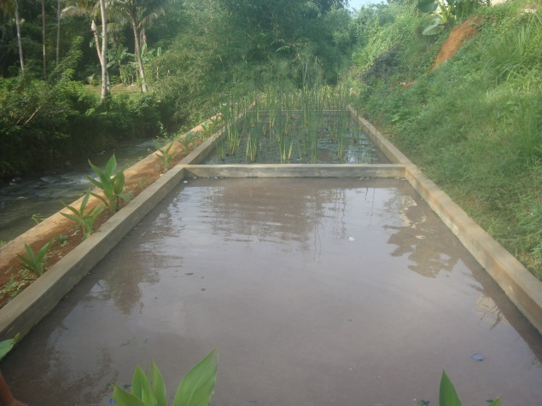
Islamic Boarding School as A demonstration site for the Application of Ecohydrology Measures
Water has particular position in Islam
For ablution before praying, at least 5 times daily
Our Prophet Muhammad used only 600 ml for ablution
Unfortunately the water is less respected
Traditional/Modern Islamic Boarding School (Pesantren)
26,000 Schools, lead by ulama/Kyai
Located at the rural area
From primary to senior high schools
Could empower up to 20 million people
How does empower “the Pesantren” as agent of change in water management
Meeting with “Ulama” in District Ciamis, West Java (above). Artificial wetland at Ar-Risalah Islamic Boarding School (Pesantren), Ciamis
Research Centre for Limnology-LIPI & Asia Pacific Centre for Ecohydrology (APCE)

Slide 23
IPAG60: Alternative Technology for Clean Water in Peatland Areas
The majority of areas in Riau Province and Central Kalimantan Province have land with peat surface water, which characteristically has: • low pH levels (2-4), making it highly acidic • high levels of organic matter • high levels of iron and manganese • yellow or dark brown colour.
Peat water treatment technology (developed by Prof. Ignasius Sutapa) enables peat areas to have peat water treatment facilities for the drinking water supply. A lot of territory in some areas in Indonesia – especially Sumatra and Kalimantan have clean water source issues. Implementation of this technology in the wider area is necessary to support the increase in water services in the region.
Research Centre for Limnology-LIPI & Asia Pacific Centre for Ecohydrology (APCE)

Slide 24
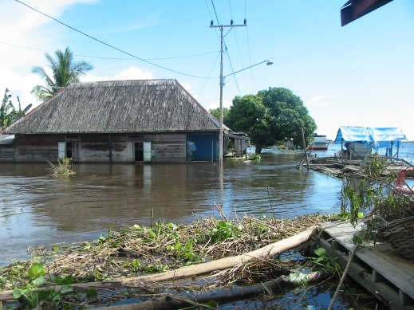
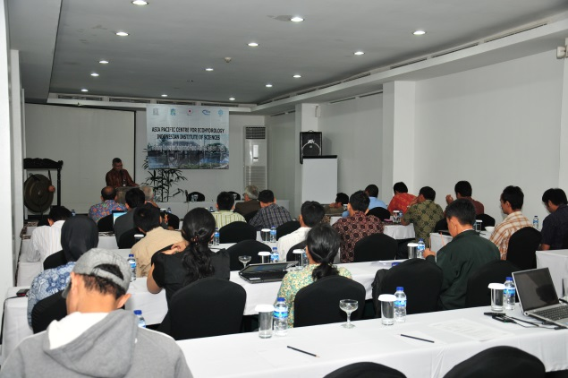
Flooding events in Indonesia
IFAS course activities
Discussing with Islamic
Leaders community
Artificial constructed wetland
Research Centre for Limnology-LIPI & Asia Pacific Centre for Ecohydrology (APCE)

Slide 25
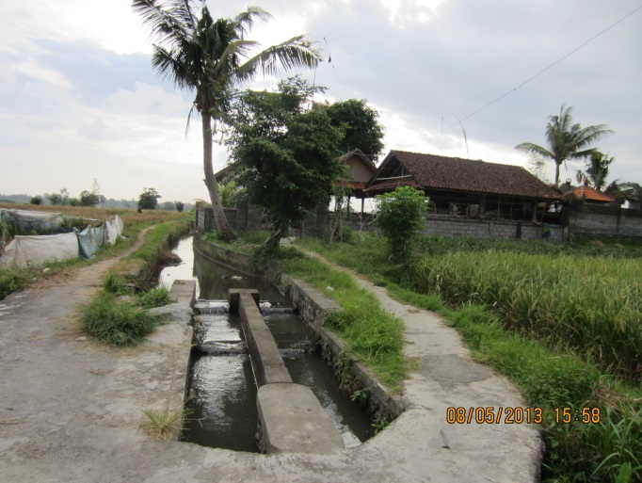
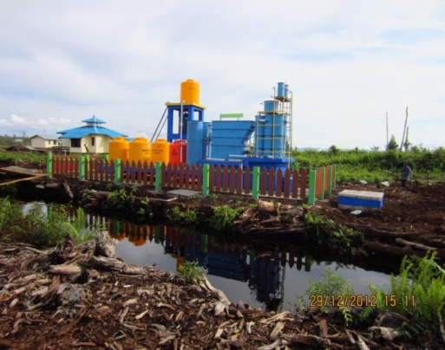
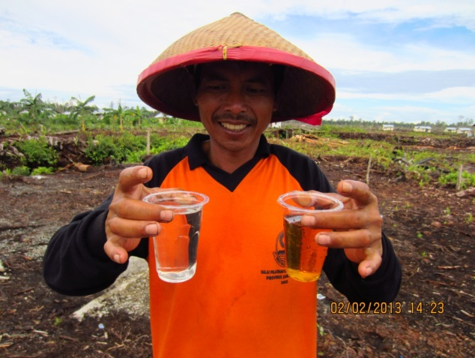
Rice Field in Jatiluwih
world heritage site
Subak system : Pura,
paddy field and water
IPAG 60 : from peatwater
to clean water
Clean water produced by
local people with IPAG60

Slide 26
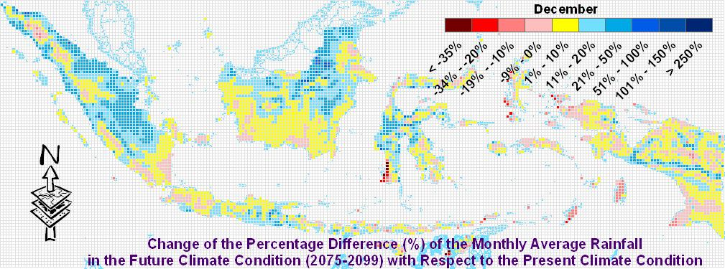
APCE:
Flood Risk Assessment and Its Mitigation Strategy under Climate Change
Simulated & Projected Climate Data: 1979-2004; 2015-2039; 2075-2100
Hydrotopographic, Socio-Economic, Land-use, Population Resilience, Education
Hydrologic Model (Rainfall-Runoff-Inundation)
Flood Exposure & Vulnerabilities
(Physical & Non-Physical Impacts)
Flood Hazards
(Flood Discharge, Flood Extent, Inundated Area, )
Flood Risk
(Damage Cost)
Ecohydrology-Based Mitigation Strategy for Flood Risk Reduction
Research Centre for Limnology-LIPI & Asia Pacific Centre for Ecohydrology (APCE)

Slide 27
Assessment & Evaluation of Cost-Benefit Adaptation Measures for Flood Risk Reduction Over Time
Reduced Flood Risk Due To Adaptation with Climate Change Impact on Water Disasters
No Adaptation with Climate Change
Damage Cost
Ecohydrology- Based Investment
Flood Risk Reduction as Adaptation Strategy to Climate Change Impacts
Baseline (Present Condition)
t_{o}
t_{p}
Time
Research Centre for Limnology-LIPI & Asia Pacific Centre for Ecohydrology (APCE)

Slide 28
Summary
Obviously that ecohydrology theory and concepts can provide integrative science base solution to Asia-Pacific water resources problems.
Such effective solution needs to be introduced through capacity building and water education at the different levels enhanced with deep scientific understanding on hydrological & ecological processes and interaction as well as socio-cultural-technology innovation.
Research Centre for Limnology-LIPI & Asia Pacific Centre for Ecohydrology (APCE)

Slide 29
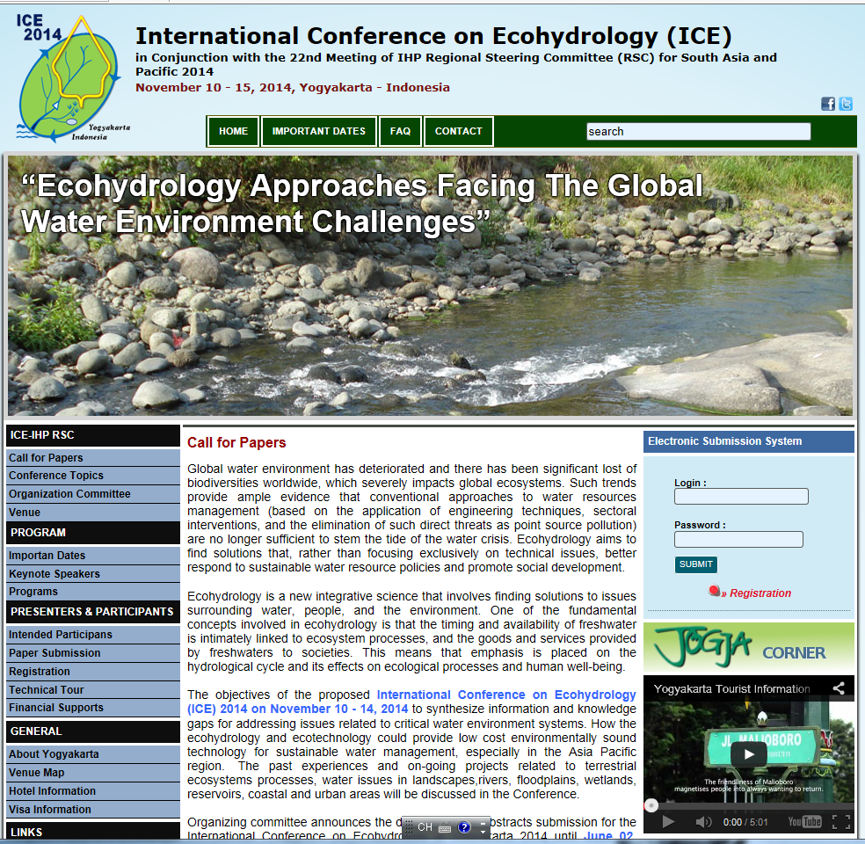
  Scope of Topics
  Development of Ecohydrological Concepts and Implementation Issues
  Ecotechnology for water, food and energy security
  Sustainability issues in water environment
  Ecohydrology in Lakes and reservoirs
  Ecohydrology in Wetlands
  Ecohydrology in karst and terrestrial ecosystems
  Hydroinformatics and modelling
  Human & water environment
  Local tradition, knowledge , wisdoms and cultural values
  Water environment related disasters
  Governance and management challenges
  Biodiversity and water environment
  Public participation
http://ice2014.apce-unesco.or.id/

Slide 30
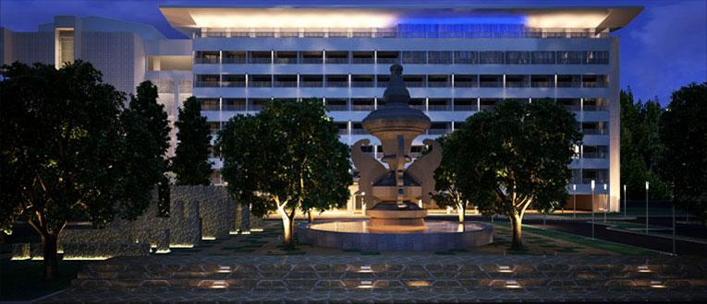
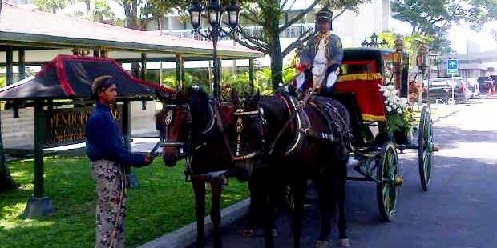
Date and Venue
Dates :
  IHP Training Course : November 8 – 9, 2014
  ICE Event : November 10 – 11, 2014
  Field Trip : November 12, 2014
  RSC Meeting : November 13 – 14, 2014
Venue : Hotel Royal
Ambarrukmo, Yogyakarta
Research Centre for Limnology-LIPI & Asia Pacific Centre for Ecohydrology (APCE)

Slide 31
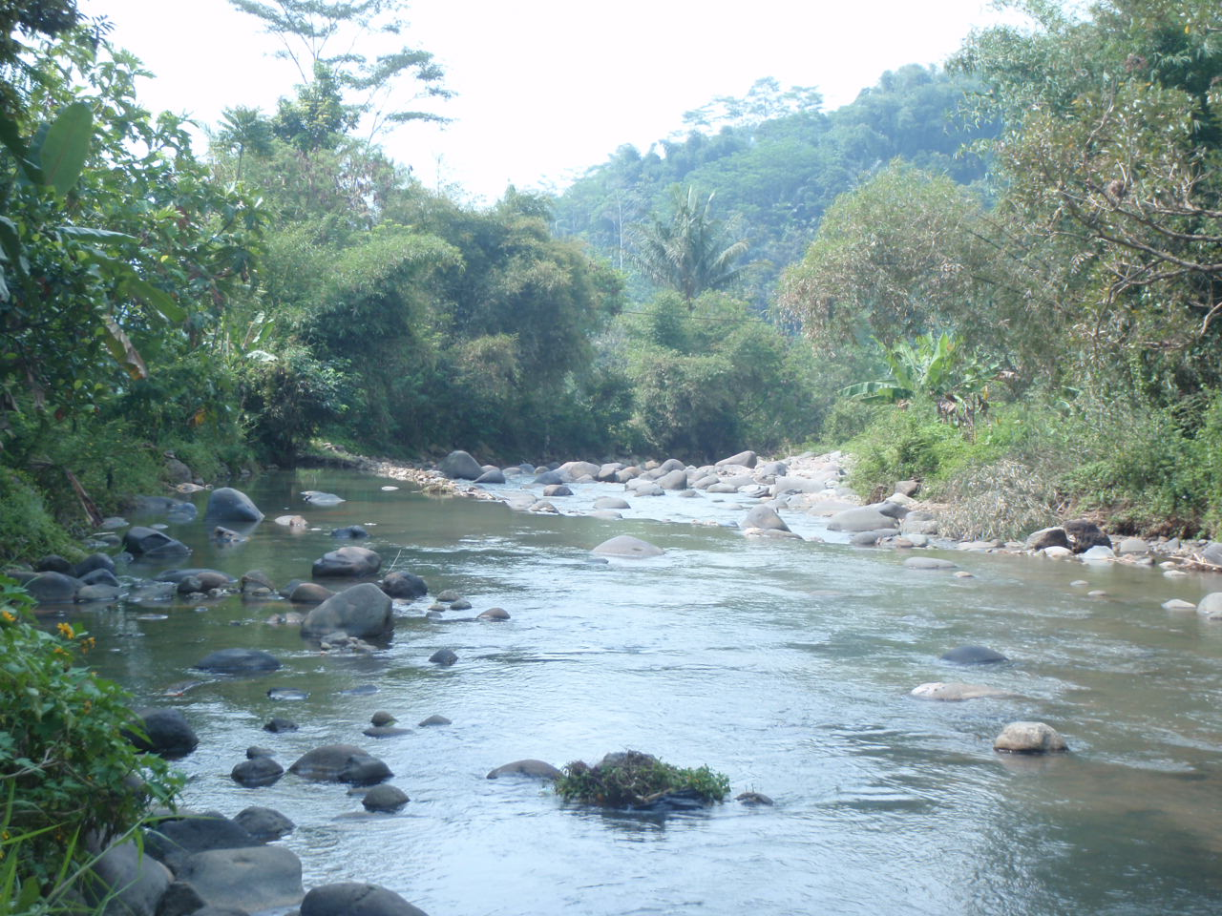
Contact
Prof (R). Dr. Ir. Hery Harjono
Executive Director, Asia Pacific Center for Ecohydrology (APCE), Catagory II Center of UNESCO, and Research Center for Limnology, Indonesian Institute of Sciences (LIPI), Indonesia.
E-mail: hery.harjono@gmail.com
Tel: +62(21) – 875 7071 and +62 – 811214304
Fax: +62(21) – 875 7076
Thank you for your attention and interest!

