Slide 1
Storm Surge Hazard Mapping
AGM 2009
Win Naing Tun, Soe Thura Tun, San Hla Thaw,
Saw Htwe Zaw, Than Myint
&
Natural Disaster Mitigation and Preparedness Research Group

Slide 2



About Me
Win Naing Tun
B.Sc.(Geology), D.B.L, D.I.R, Dip. GIS
Pgdip. (Arch), M.A (Archaeology), M.Res (Archaeology), MPA-I
Mobile: 95-9-5196758
Email: kokowinnaingtun@gmail.com
Director (Myanmar Environment Institute)
EC Member (Myanmar Geosciences Society)

Slide 3
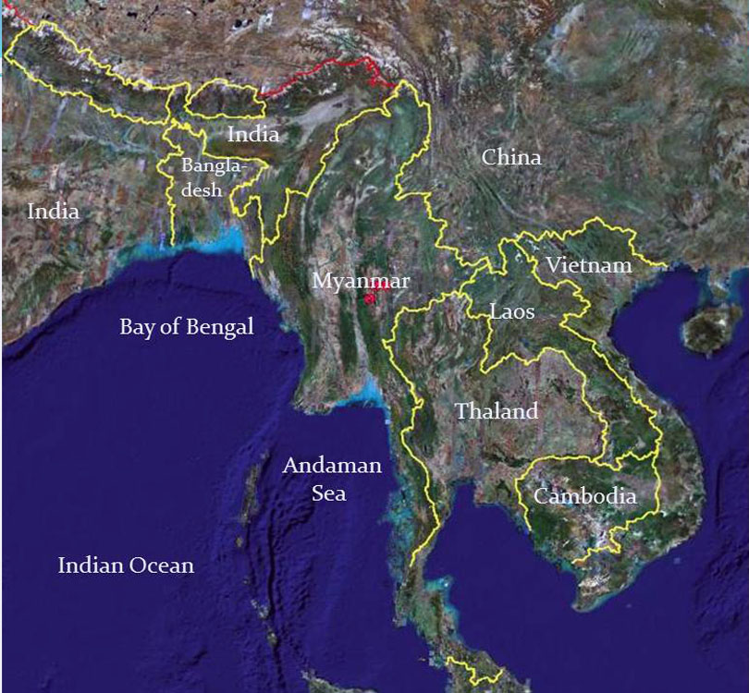

Myanmar at a Glance
Located between latitudes 09° 32'N and 28° 31'N and longitudes 92° 10'E and 101° 11'E in SE Asia, 676,557 Km² in area
Coastline from north to south 2,228 kilometers (1,385 miles)
Population 52 Millions (2014)
70% Rural population
42% lives in upland areas
Agricultural-based Economy
Three seasons: (Summer, Rainy Season, and Winter)

Slide 4
Climate, Average Weather of Myanmar
Of the land area,
  13.6% has a tropical rainforest climate (Af),
  11.4% has a tropical monsoon climate (Am),
  15% has a tropical wet and dry/ savanna climate (Aw),
  35.8% has a temperate/ mesothermal climate with dry winters (Cw),
  24.2% has a alpine/ highland climate (H)
Of the population,
  21.9% live in a tropical rainforest climate (Af),
  18.5% live in a tropical monsoon climate (Am),
  21% live in a tropical wet and dry/ savanna climate (Aw),
  33.7% live in a temperate/ mesothermal climate with dry winters (Cw),
  4.9% live in a alpine/ highland climate (H)
http://www.myanmar.climatemps.com/

Slide 5
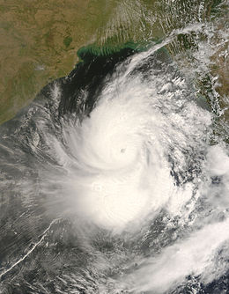
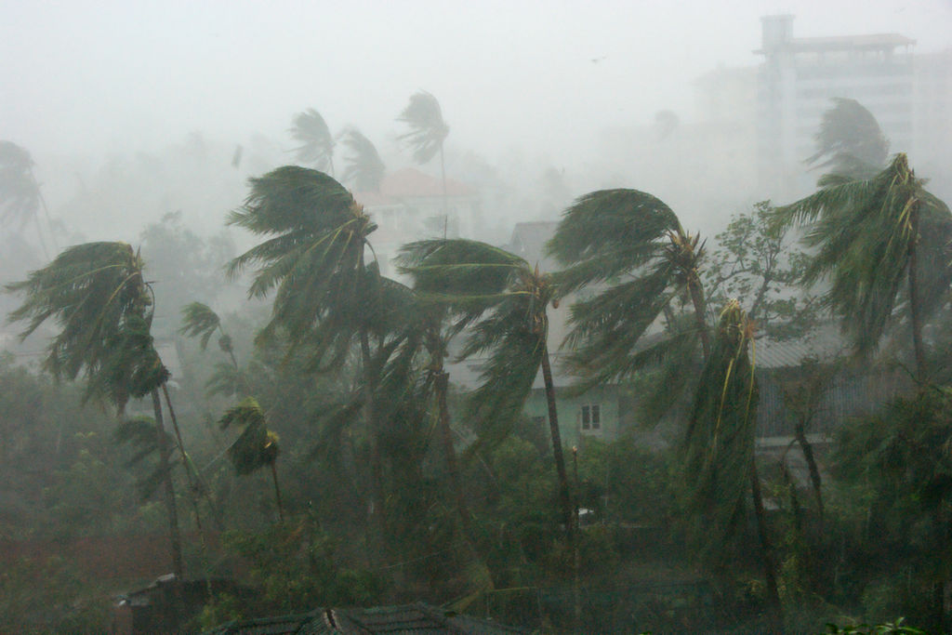
Nargis (2008)
Formed | April 27, 2008 (2008-04-27)
Dissipated | May 3, 2008 (2008-05-04)
Highest winds | 3-minute sustained: 165 km/h (105 mph) 1-minute sustained: 215 km/h (130 mph)
Lowest pressure | 962 mbar (hPa); 28.41 inHg
Fatalities | 138,366 total
Damage | $10 billion (2008 USD)
Areas affected | Bangladesh, Burma, India, Sri Lanka
7 Years from now……..

Slide 6
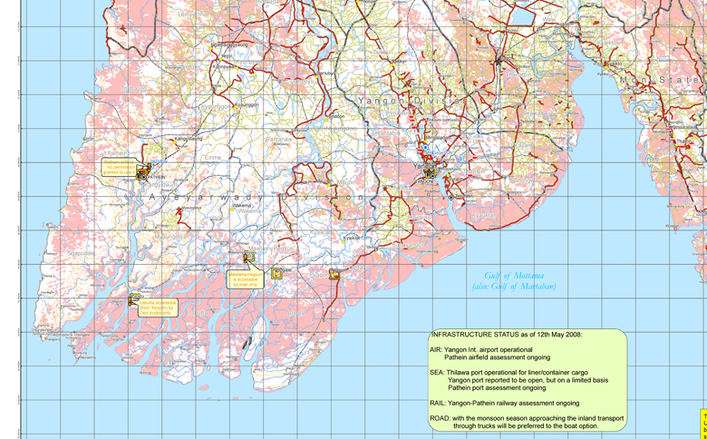
Objectives
Saving lives for (possible) future natural disaster, mainly for storm and storm surge
Reestablishment of infrastructure
Building emergency shelter
Ayeyarwaddy Delta Region, comprising Ayeyarwaddy and Yangon Divisions from Mawdin Cape to Sittaung River mouth

Slide 7
Relied largely on
Flood level information collected from damaged schools under Ministry of Education immediately after the Nargis Cyclone
Digital elevation models in 2 meter interval (3 DEM and SRTM provided by Kyoto University in 2007)

Slide 8
Principal factors
Altitude above mean sea level (MSL)
Distance from the sea
Water volume of nearby Source of Surge
Nature of River Mouth
Possible routes of storm and interaction with tributaries
Activity of water mass based on previous event and future possibilities

Slide 9
A Simple Model
Storm Path
15’
Water Volume
15’
Distance from the Sea
Size and Shape of
River mouth

Slide 10
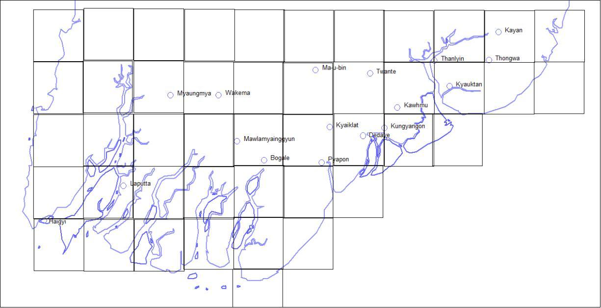
45 Grids of Lat/Long
0.25 degree intervals

Slide 11
Ayeyarwaddy Division River Mouths
(Generally Along 16 Deg N)
No | River mouth | Width (km)
1 | Pathein | 15.20
2 | Thetkechaung | 12.00
3 | Yway | 20.00
4* | Pyinsalu | 6.00
5 | Ayeyawady | 6.00
6 | Bogale | 16.00
7 | Setsan | 32.00
8 | Pyapon | 2.00
9 | Thandi | 16.00
10 | Toe | 6.00
Total 131.20 km
(Hnin Hnin Swe et al. (2008)

Slide 12
Sea water intrusion due to
“Nargis” Cyclone
Total width of river mouths = 131.20 km
  Sea level above the seasonal level intrude inland with onshore wind
  Flow along off-shore wind is neglected
Sea water intrusion ( million cubic meters ) = 3,435.034
(Hnin Hnin Swe et al. (2008)

Slide 13
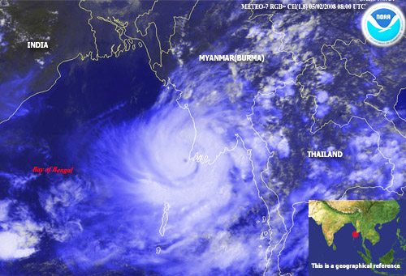
Tun Lwin et al. (2008) calculation
Storm NARGIS (2008)
Vm: 120mph ~ 53ms⁻¹
Angle θ : 30°
Maximum peak surge height: 5.65m (or) 18.5 feet

Slide 14
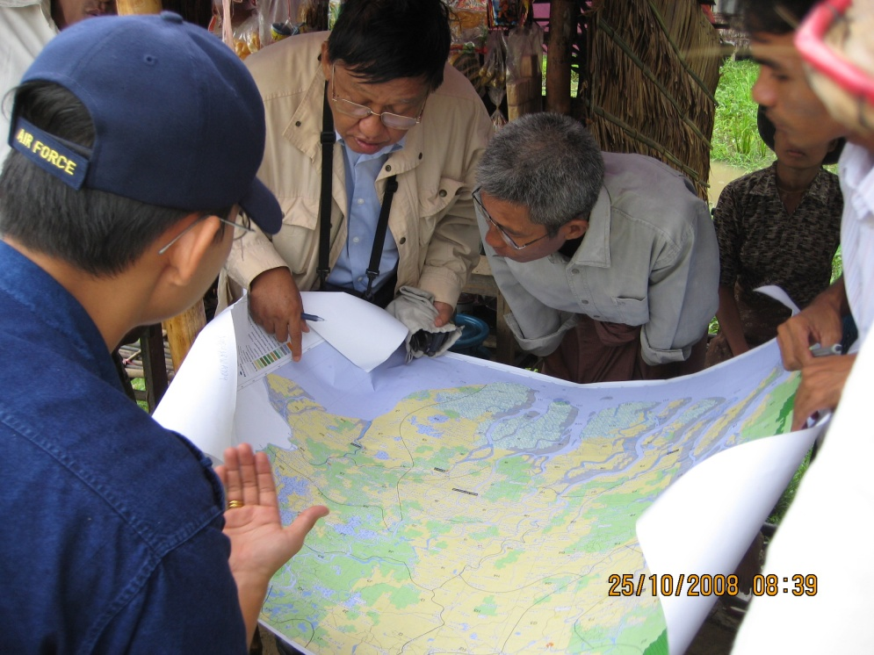
Flood data from schools
About 500 out of 3,888 damaged schools in Ayeyarwaddy Division reported flooded level (from ground)
Locations (Lat /Long) were depicted from the map and x, y, z information was transformed to contours

Slide 15
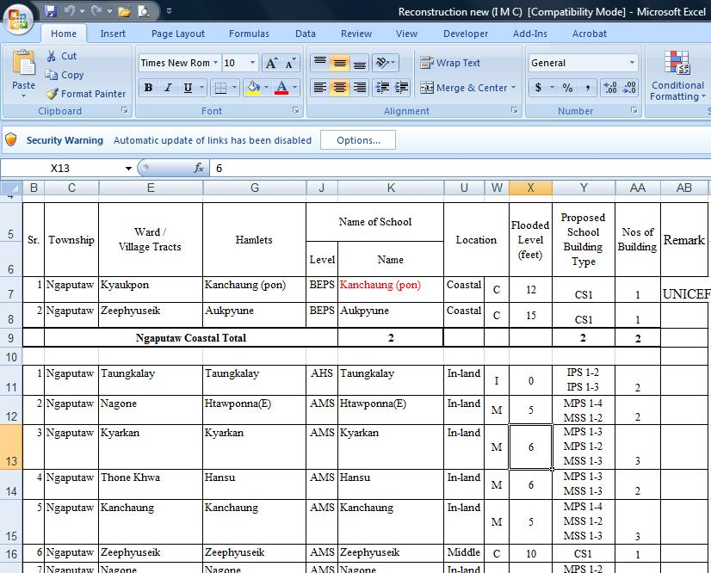
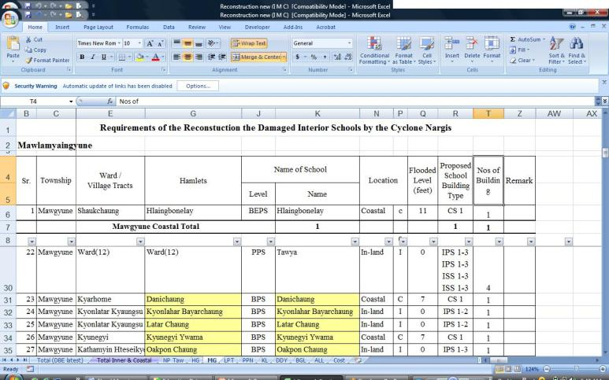
3,888 Schools reported

Slide 16
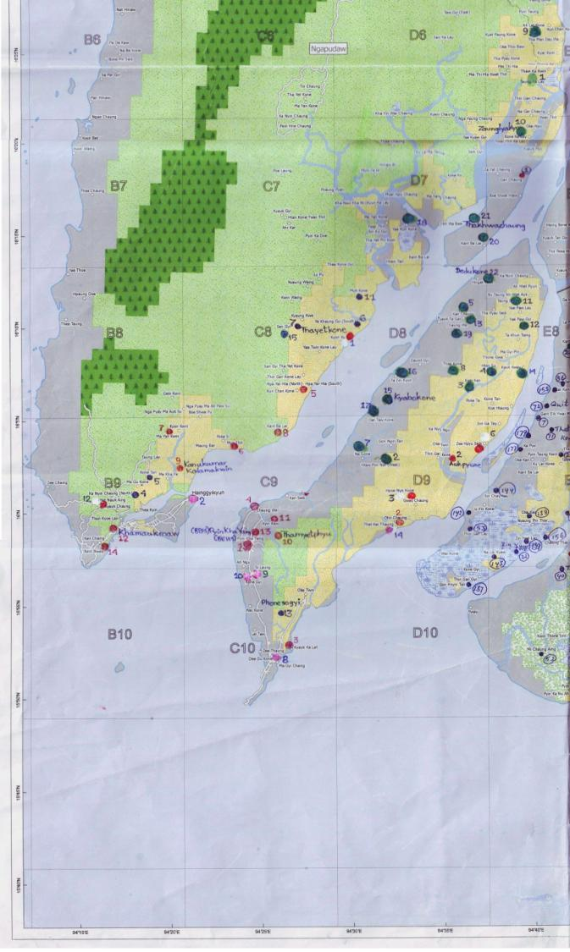
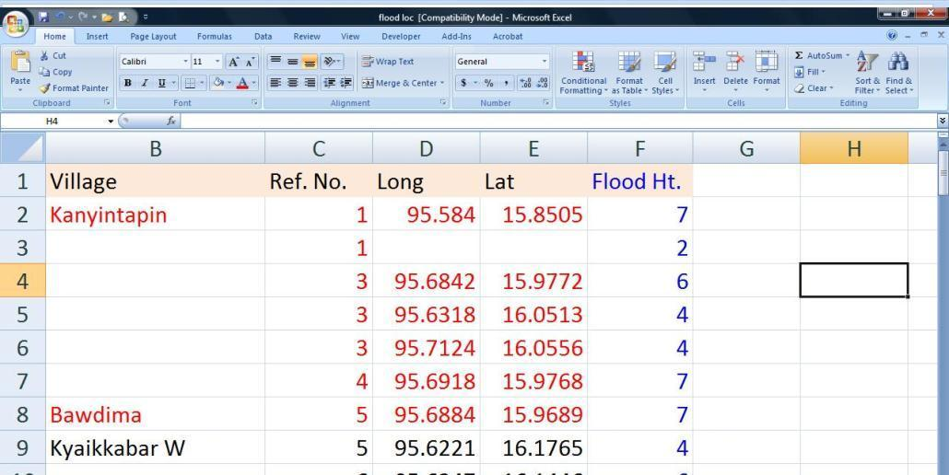
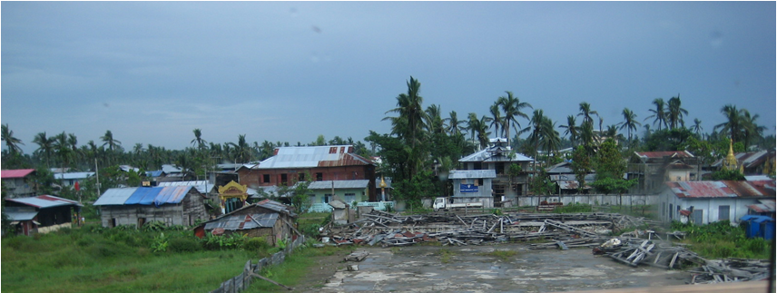

Slide 17
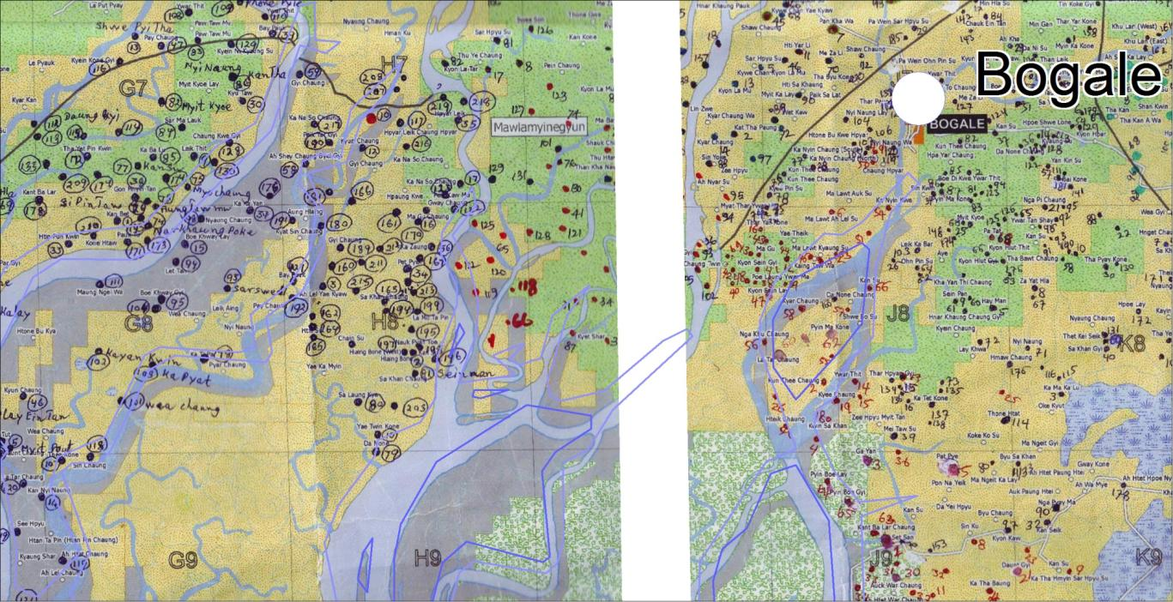
Drafted Locations of Schools

Slide 18
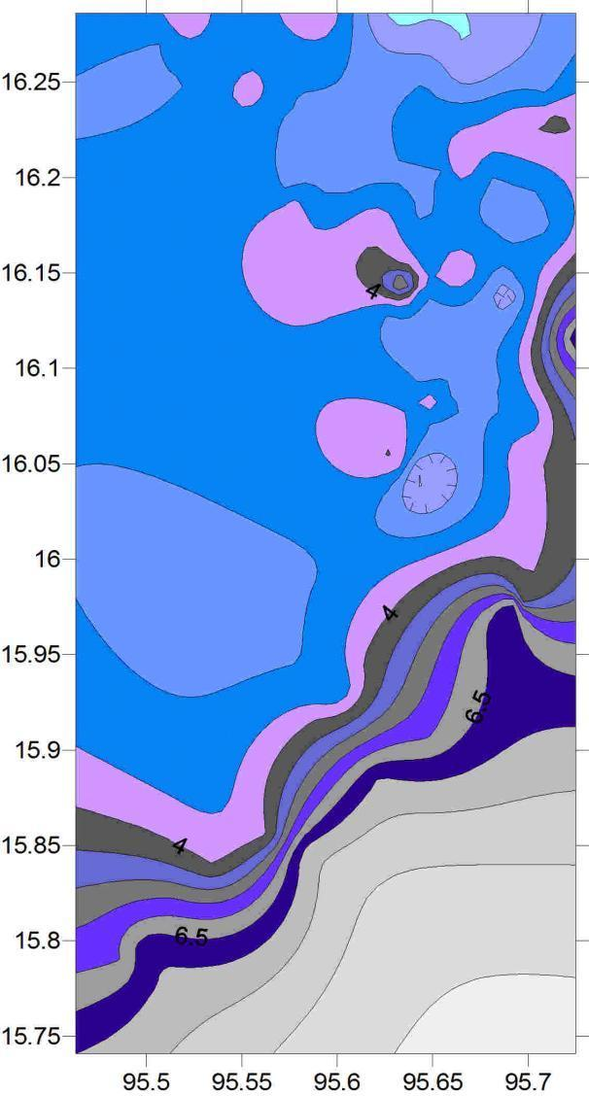
0.5 meter contours
Example:
Pyapon Township South

Slide 19
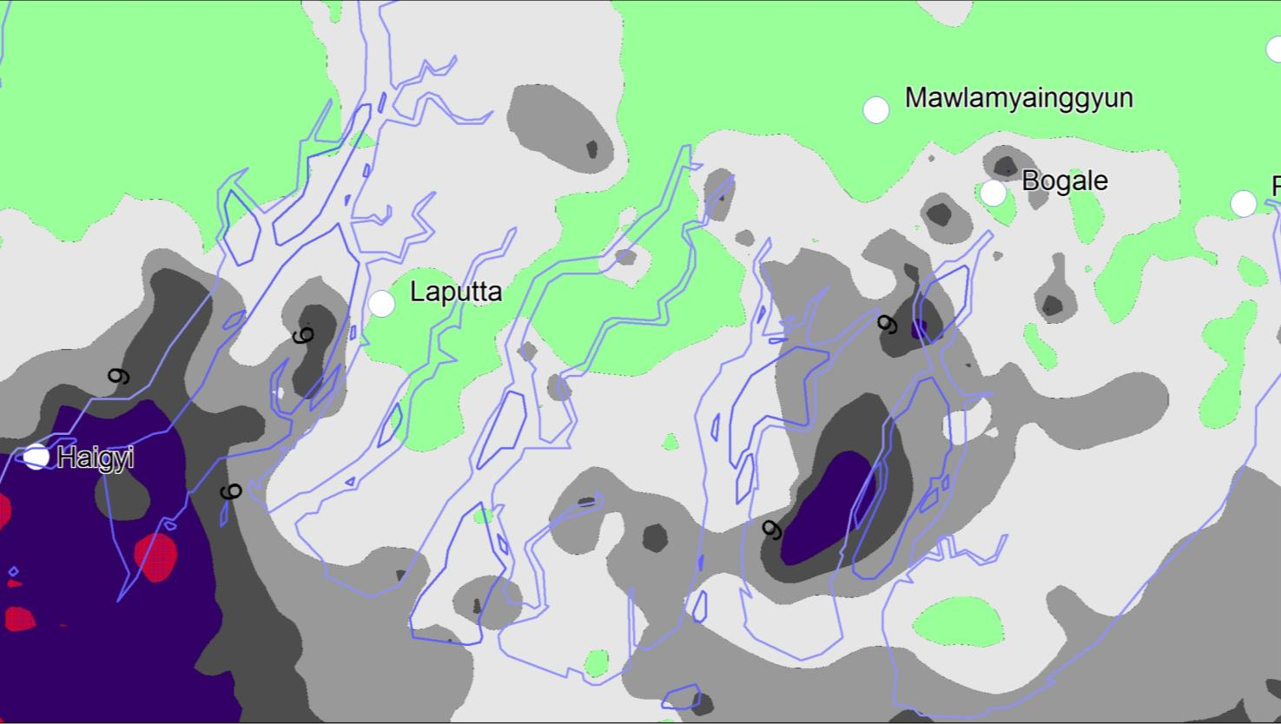
3, 6 and 9 Meter Contours

Slide 20
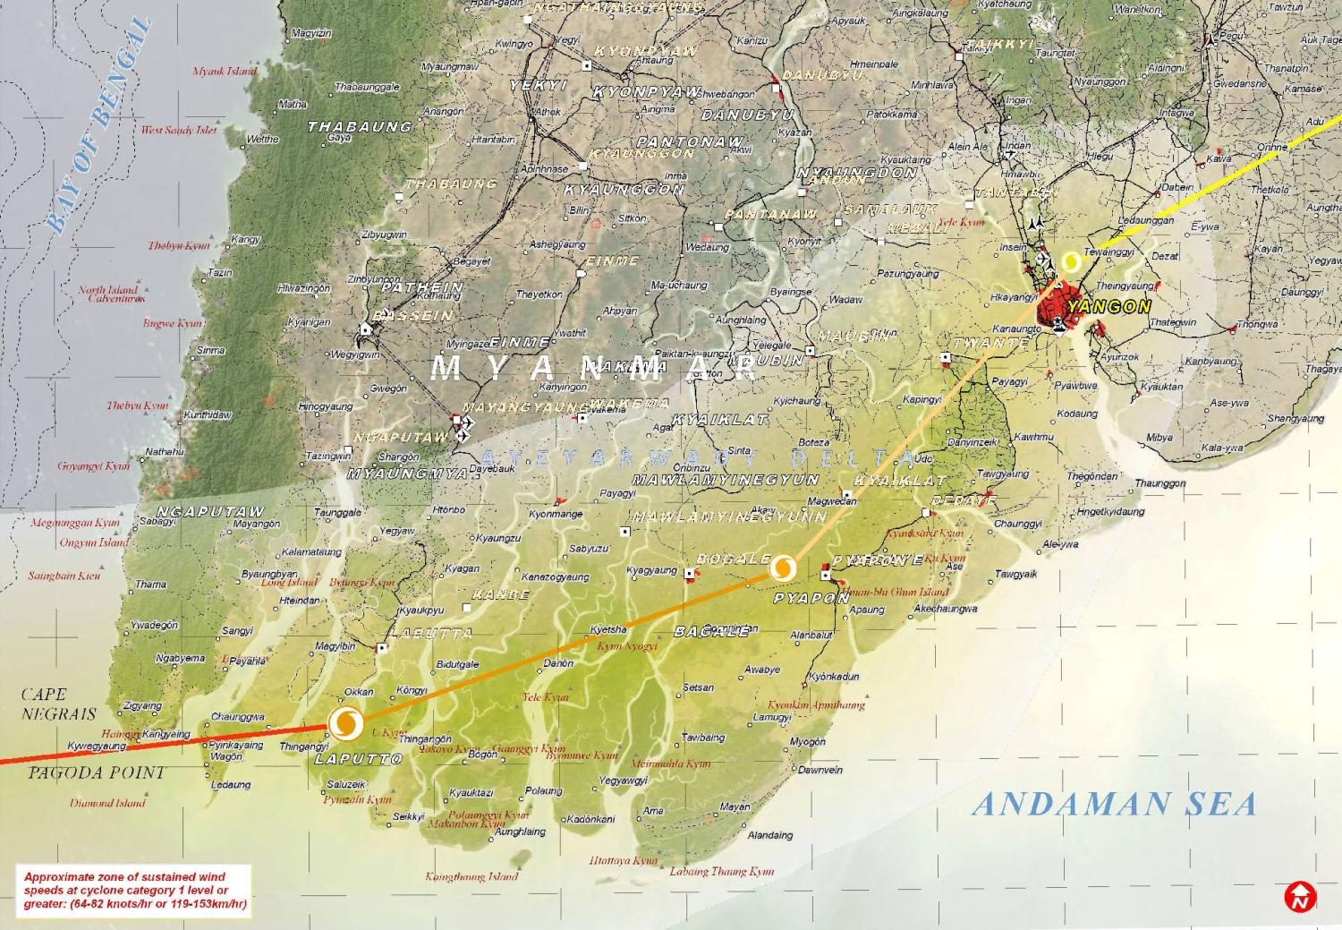
Department of Meteorology and Hydrology Data
23
22
20
20
17
10
15
Mawlamyinegyunn
Bo ka Lay
Kyonkadun
Laputta
Pyinkayaine
Haingyi
Pyinsalu
Kadonkani (20’)

Slide 21
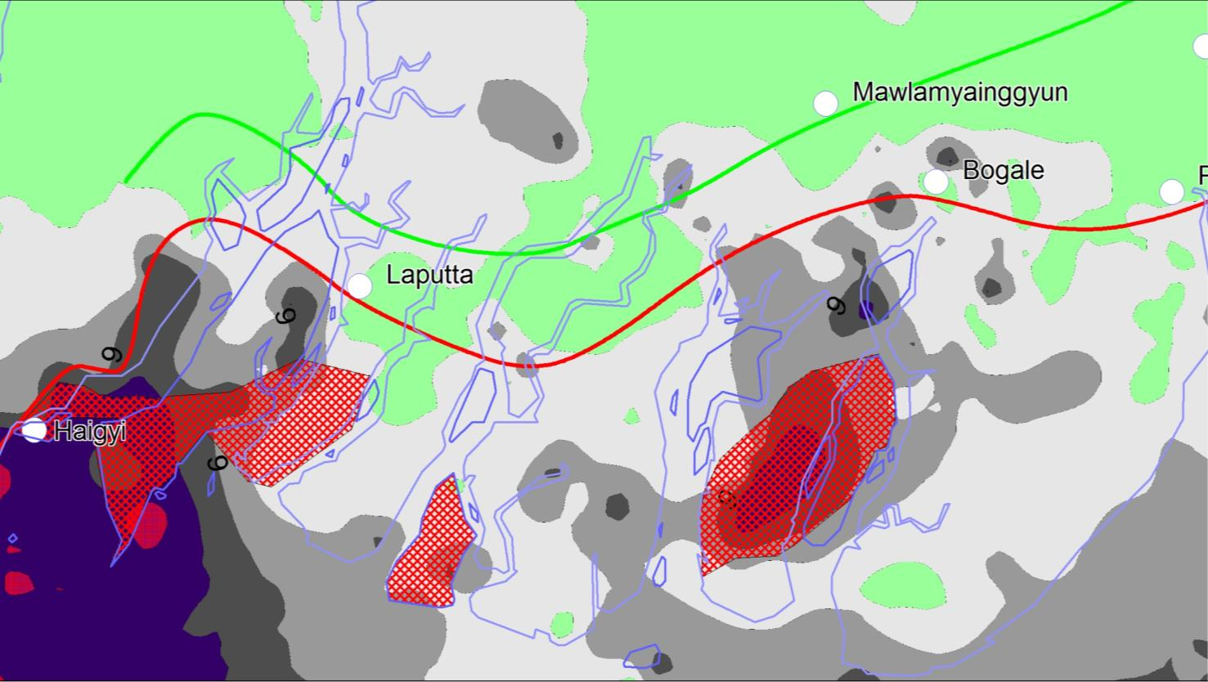
Risk line as first draft

Slide 22
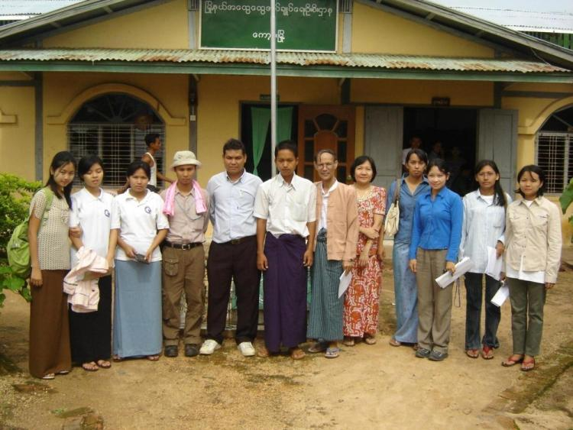
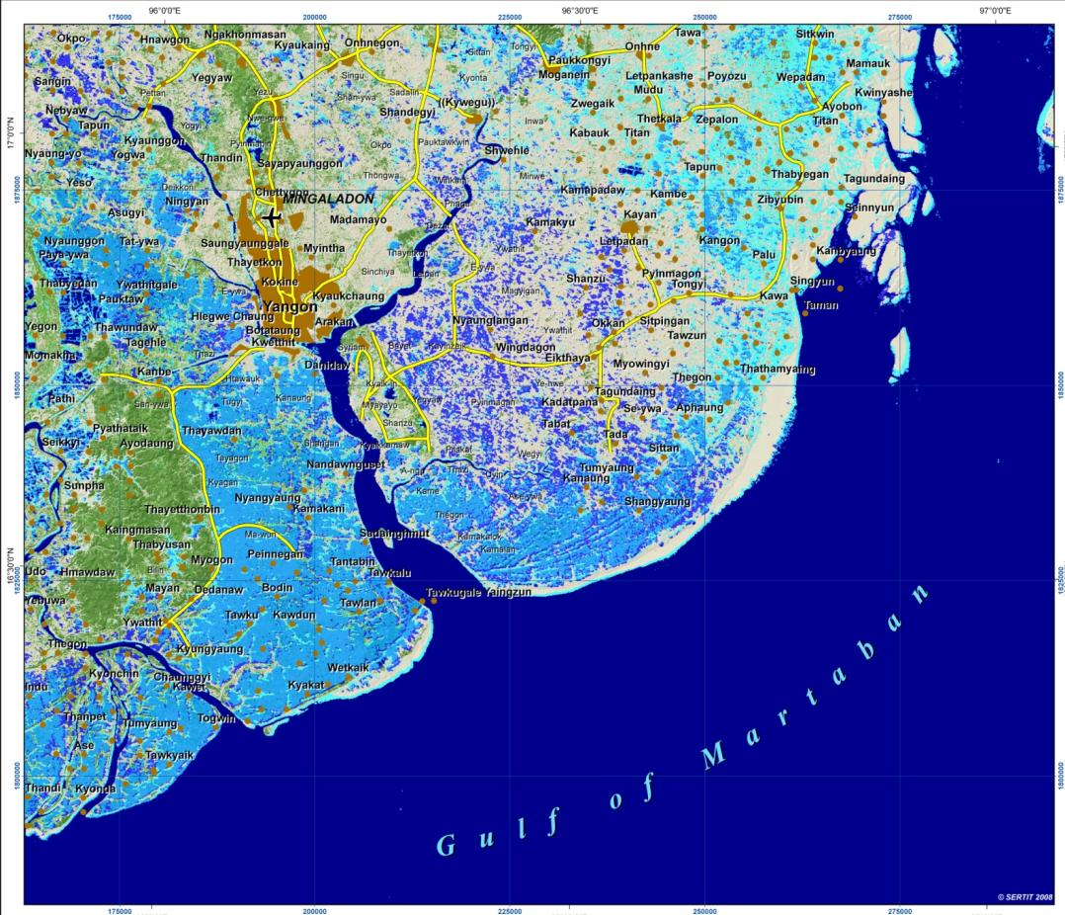
Field survey - 1
Natural Disaster Mitigation and Preparedness Research Group

Slide 23
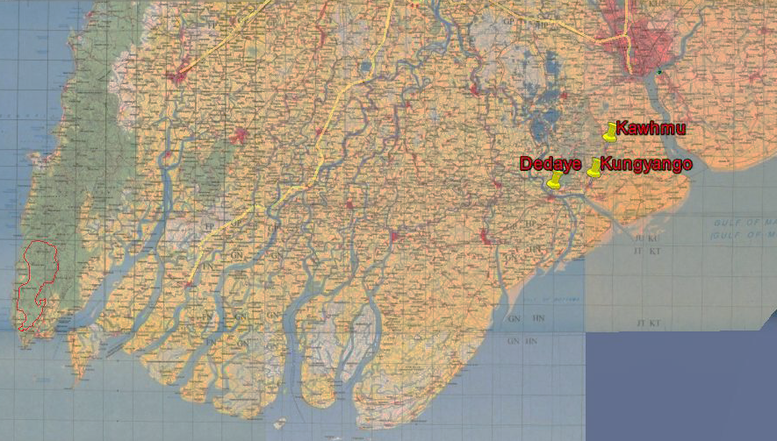
Yangon Division
Emphasized on Damage and Community Response
A day light field trip was launched on 28 June 2008
14 members participated
Study visit to
  Kawhmu - 09:30 - 10:45
  Dedaye - 11:15 - 12:30
  Kungyungone 14:30 - 15:30

Slide 24
Analysis of Questionnaire
Statement | Kawhmu | Kungyungone | Dedaye
Population (before) | 122,513 | 112,471 | 211,353
Death | 130 | About 1000 | 3812
Houses Damage % | 95 % | 95 % | 95 %

Slide 25
Finding
Questionnaires are satisfactorily filled up by government staff
With respect to storm wind and surge:
  Those without knowing the crossing of storm suffered much.
  Those received the warning and necessary measure are safer.
  Far from sea, but closed to the river and creeks suffer from storm surge
  Those living isolated in the fields did not find places for refuge and faced death.
  Those running desperately away from shelter end in death

Slide 26
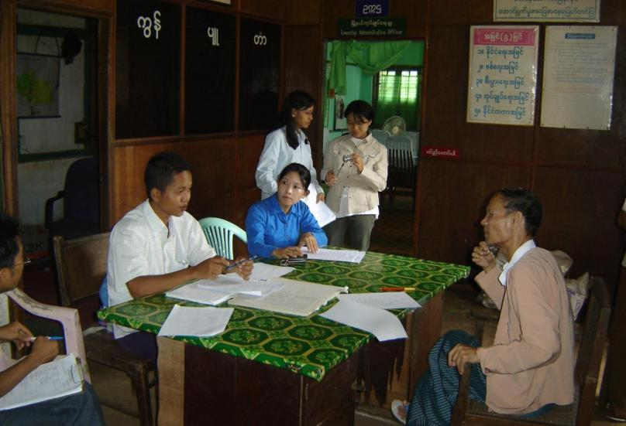
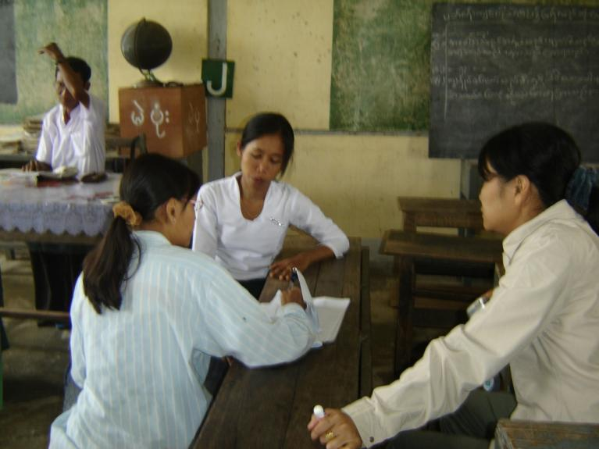
Interview at a primary school, Banbwegon, Kungyangone on 28-6-08
Interview with a staff of the Township SPDC, Kawhmu, on 28-6-08.
Notes:
Interview with a staff of Township SPDC, Kawhmu on 28-6-08

Slide 27
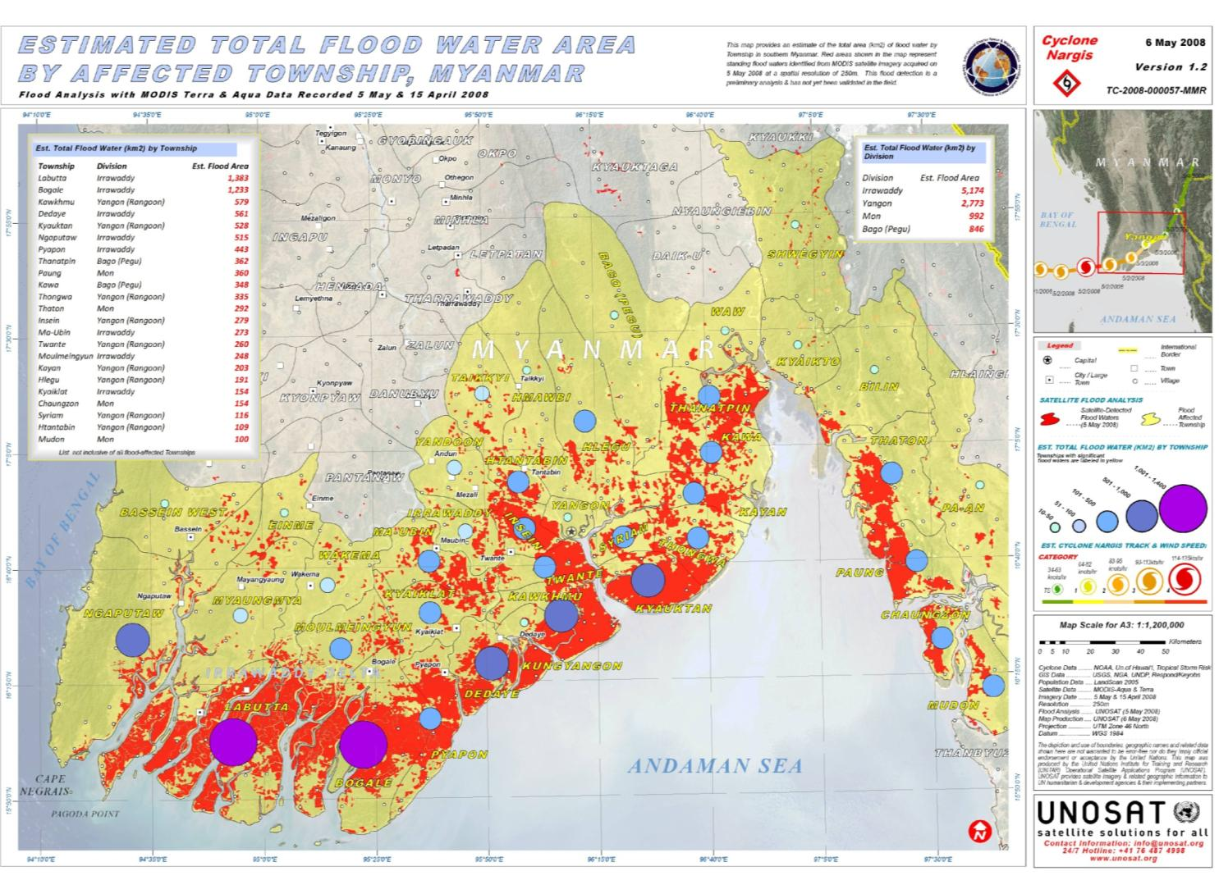
UNOSAT Data

Slide 28
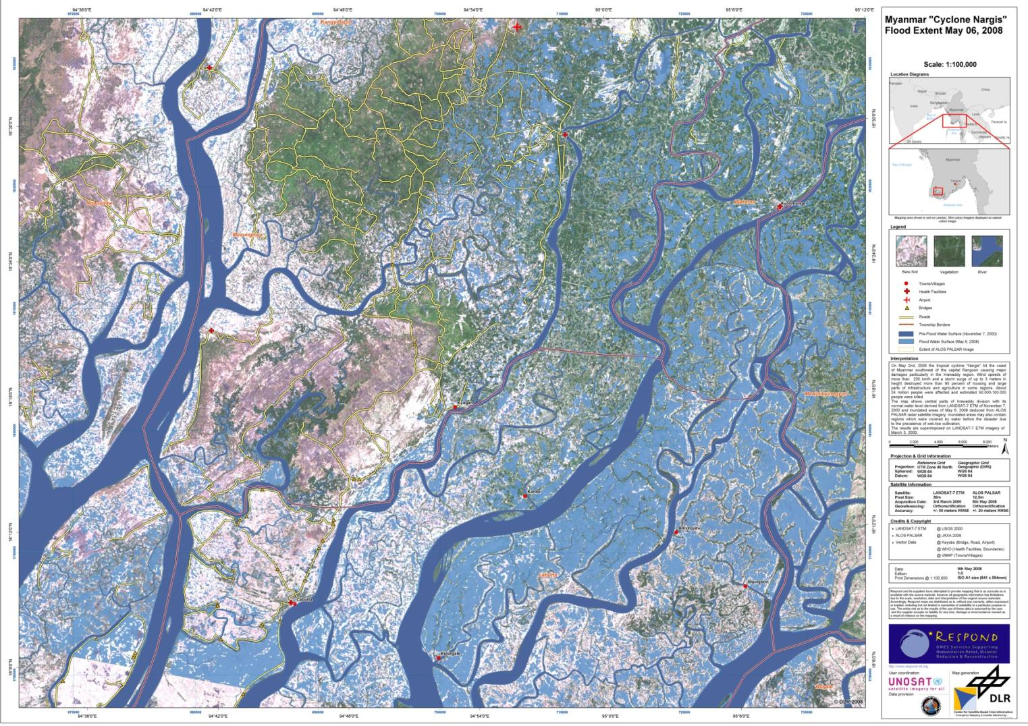
ALOS Palsar Radar Image of inundation supersimposed on Landsat-7 ETM (DLR)

Slide 29
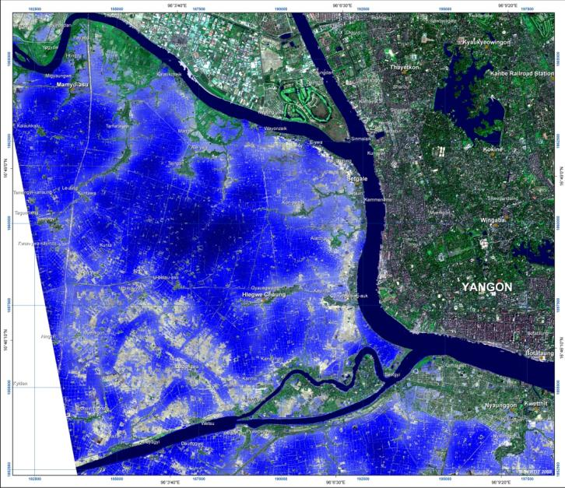
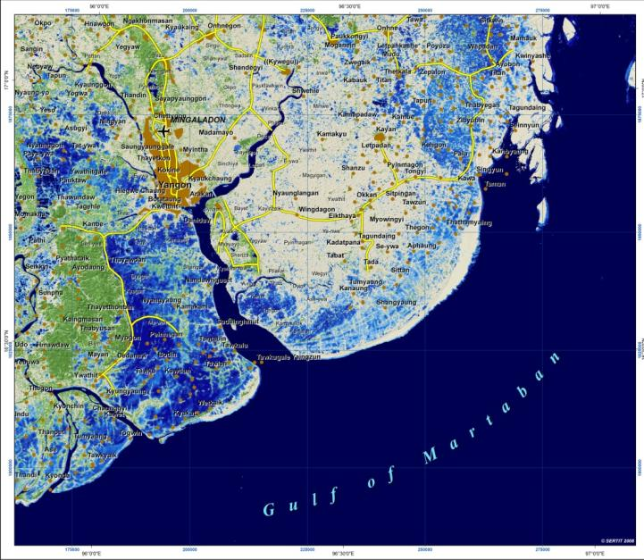
ENVISAT interpretation (UNOSAT - SERIT)

Slide 30
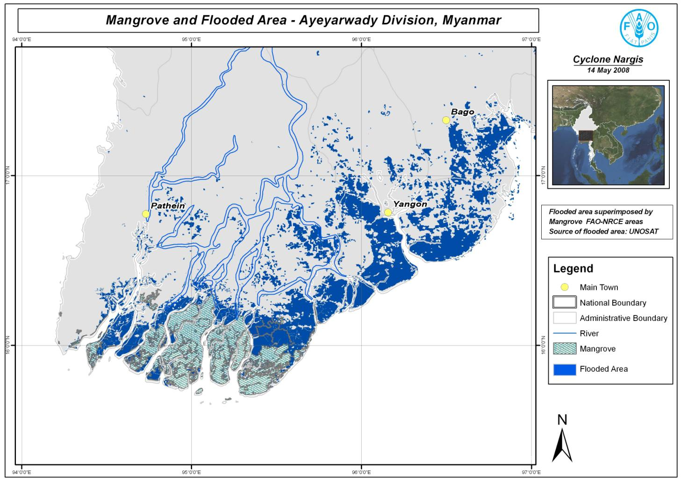
FAO Mangrove and Flood

Slide 31
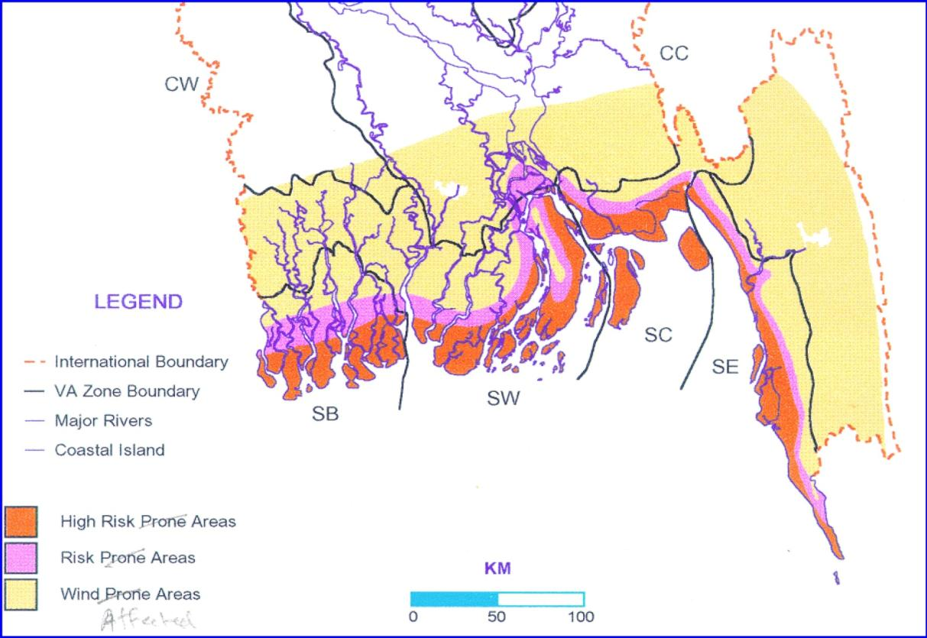
Bangladesh Strom Prone Areas Model
Credit: Mozaharul Alam (BCAS)

Slide 32
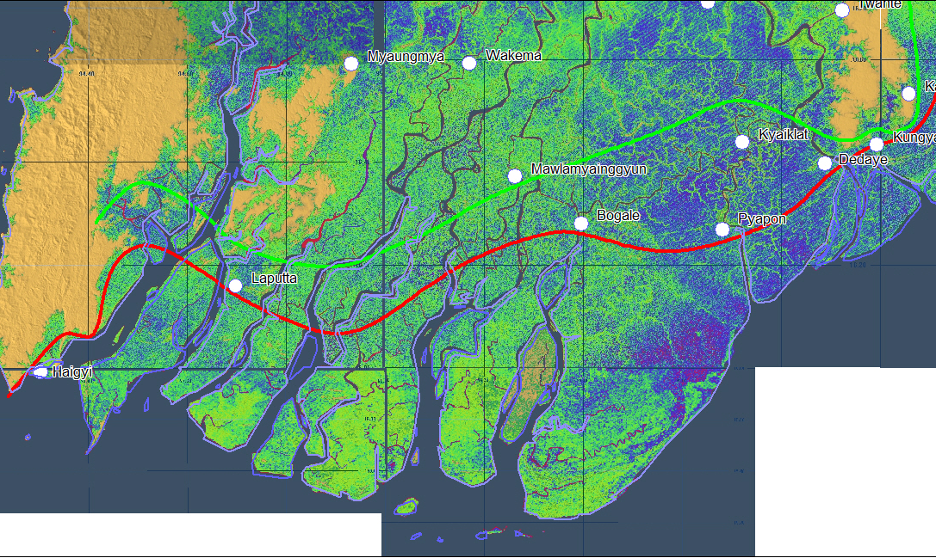
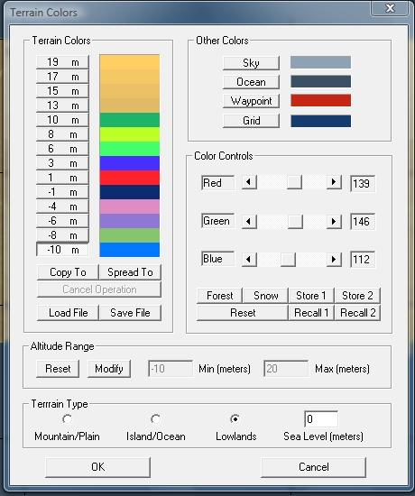
Digital elevation model
2 meter interval

Slide 33
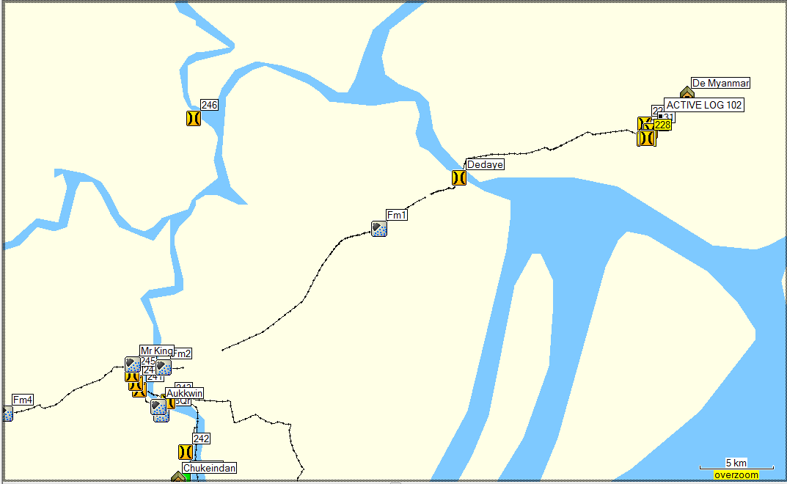
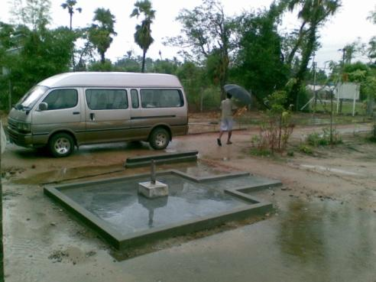
Checking the line between High and Moderate Zones
October 2008

Slide 34
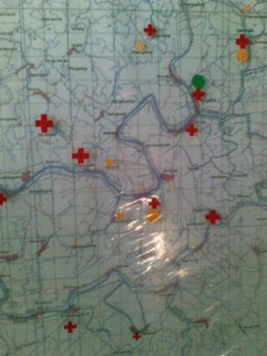
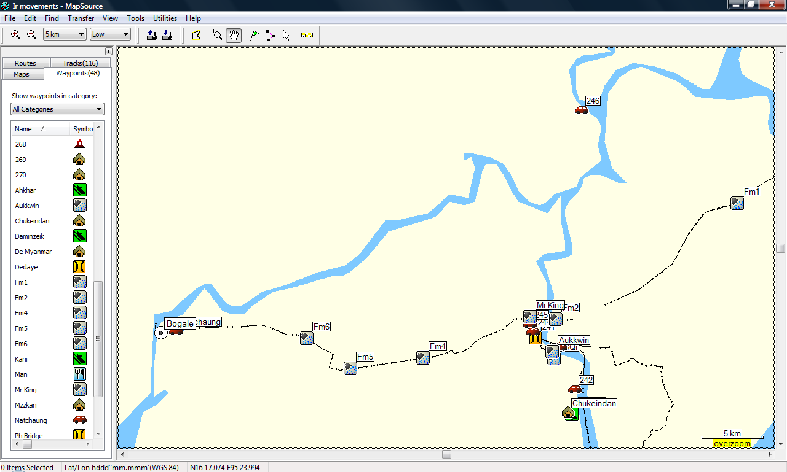
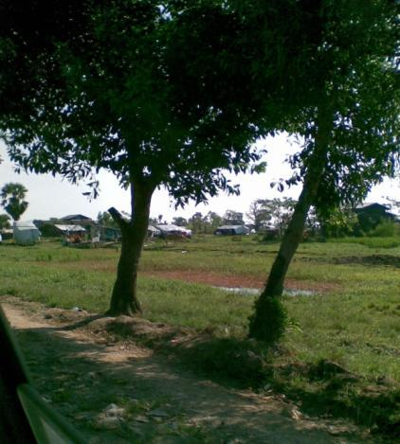
Yangon - Bogale

Slide 35
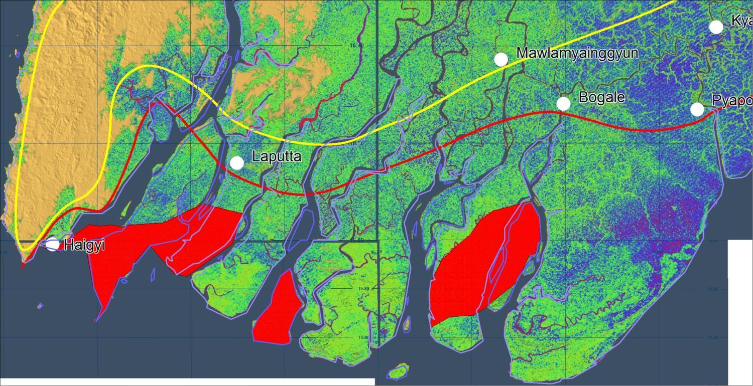
Checked and Modified

Slide 36
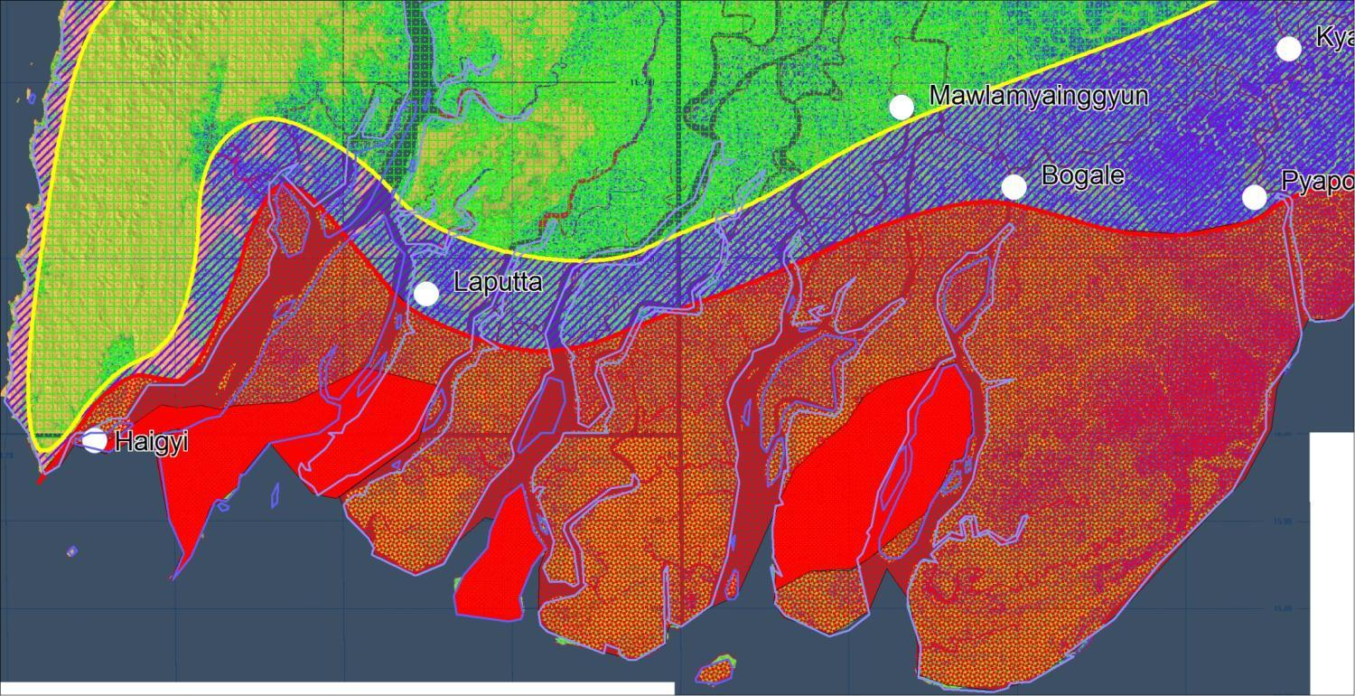
4 levels classified

Slide 37
4 Strom Surge Potential Zones
Low Zone
  (4 ft Max flood with avg. 2 ft), only susceptible to wind)
Moderate Zone
  (4 to 6 ft Max flood), probable places of escape even at homes. Most Ayeyarwaddy cities fall in this zone
High Zone
  (> 6 ft), all buildings should be storm/surge resistant, emergency shelter to be installed, emergency equipments (life safety dress, first aids) and drill is essential
Very High
  Not recommended for normal livelihood/settlement, only reserved for special projects with fully equipped emergency procedures and apparatus

Slide 38
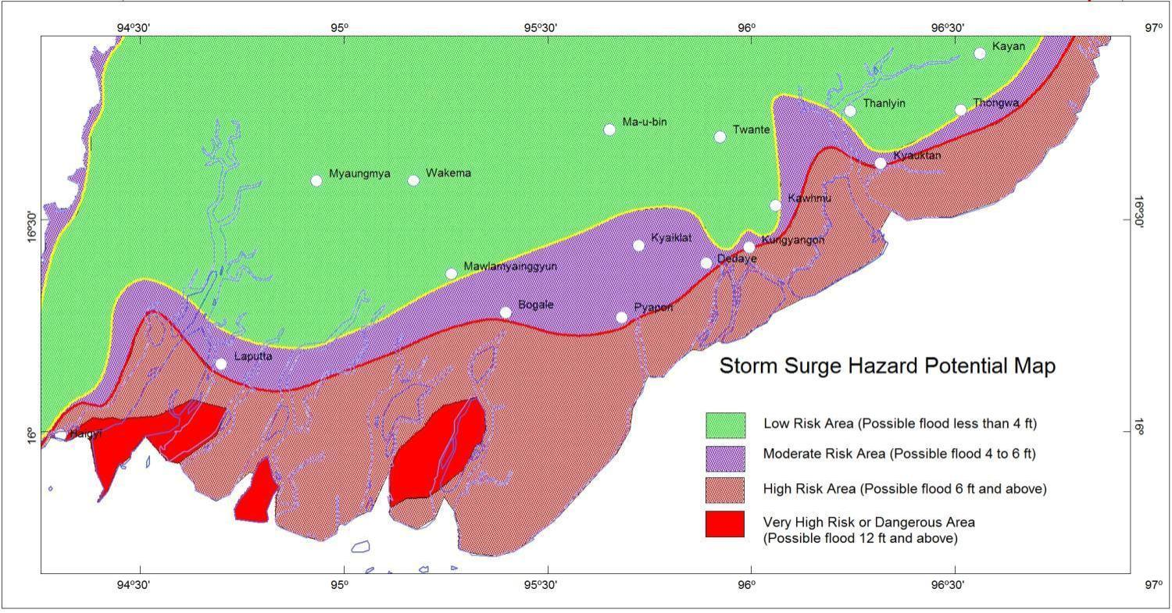
Version 1

Slide 39
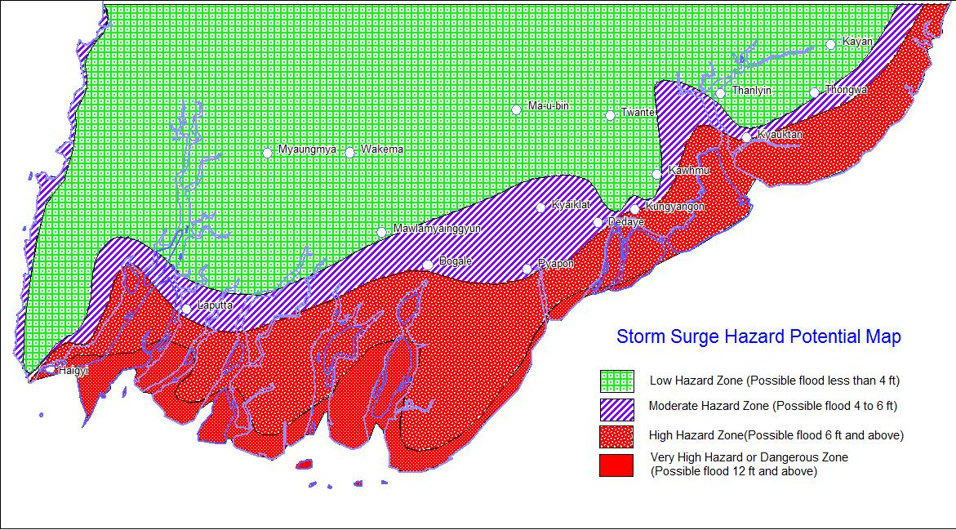
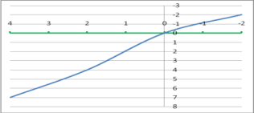
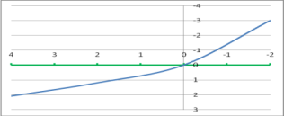
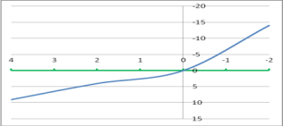
Version 1.1
Comparison with calculated storm surge information based on bathymetry and coastal contour configuration
(Hnin Hnin Swe et al. (2008)

Slide 40
Numerous Constraints
We have only one event for case study; Information of flood level during previous event in more detail
Information on regular/ seasonal flood level
Groundwater (soil/water interaction) data
Topography Data
  Non-availability of maps at appropriate scale or maps not available for entire study area.
  May use 1:5000 maps where 1:2500 not available ➔ less accurate.
  Up to 1:10000 scale maps have been used ➔ problems in determining river geometry ➔ generalized result.
Hydrology Data/ Hydraulic Analysis
  Difficult to determine some parameters.
  Well defined river channel difficult to determine for some flood prone areas.
  Roughness coefficient of channel.

Slide 41
To become a Risk Map
Risk = f(Vulnerability x Hazard x Exposure)
We need vulnerability data like
  Population/ distribution of human settlement
  State’s or private properties, pattern of their distribution
  Environment
Anyway, we hereby applied all available information for urgently requiring storm-surge potential map for reconstruction and rehabilitation plans before next cyclone season

Slide 42
Data Requirements for
Integrated Strom Surge Management
Hydrological/ Hydraulic Modelling
Flood and Strom surge hazards data, Inventory of Hydrological data, Meteorological data, River discharge and cross section data, Dam data, Inventory of Dikes, Irrigation and Drainage canals, Inventory of Pumps, Land Elevation, Land use/ Land cover, Tide data, Strom surge analysis, GIS data, Road / Railways data, Topography Maps
Data/ Information for Risk Assessment
Disaster Record, Natural conditions (river system, swamp), Social conditions (Administration, Housing, Population, Statistics, etc.), Infrastructures (roads and railways networks, urban drainage system/ sewerage system, pumping, water supply facilities, sewerage facilities, water treatment plants, gas supply, main roads, transport networks, incineration plant etc.), Disaster prevention (Roles/ Responsibilities of organizations, Evacuation/ Recovery, Planning), Agriculture (Statistics, Cropping pattern, Irrigation), Legal system (Building, Disaster Management), Flood control/ Management facilities, Flooding water utilization..
ADB

Slide 43
We are walking alone for decades……
The gap between public and private organizations
There is no national data sharing policy…
There is no Metadata or descriptive data …
Everything we have to start from sketch…
A lot of things to do….

Slide 44
Needs for Integrated Management on
Strom Surge (SS) in Myanmar
To set up the Warning system for SS in Myanmar
To develop the forecasting techniques and capacity building for SS
To set up a Task force including authorities and experts of Administration, Relief, Water resources, Agriculture, Forestry, DMH, other concerned depts. , NGOs, INGOs & CBOs
To conduct SS risk assessment
To promote education and public awareness for SS mitigation
To encourage community level plans for SS Mitigation.
To cooperate, coordinate and collaborate the concerned departments and organizations in Myanmar and also INGOs and CBOs for SS management in Myanmar
To develop the concerned departments’ activities for SS mitigation
To develop the SS policy and strategies for SS management in Myanmar
To set up the SS Management System in Myanmar
DMH

Slide 45
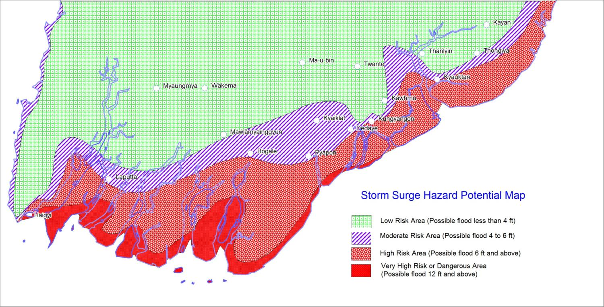
Storm Surge Potential Map – MES Ver. 1.1
What’s next….

Slide 46

Brief Introduction to
Myanmar Environment Institute

Slide 47

Myanmar Environment Institute (MEI)
Established in 2010 as non-profit private Institute
85% of Members are Ex-university Teachers from multidisciplinary fields
The first and only Institute for Environmental Education in Myanmar
Our Research partners ..
  Geography Institute of Cologne University, Germany
  James Cook University (JCU), Australia
  Stockholm Environmental Institute (SEI), Sweden
  Wollongong University
  Washington University
  University of Yangon (YU)
  INGOs (Action Aid, Plan International, World Vision, BBC Media Action, RIMES, UNHabitat, etc.)
  CBOs (MES, MEC, MGS, etc..)
Environmental investigation and auditing works for Lepadaung Taung copper mine project

Slide 48
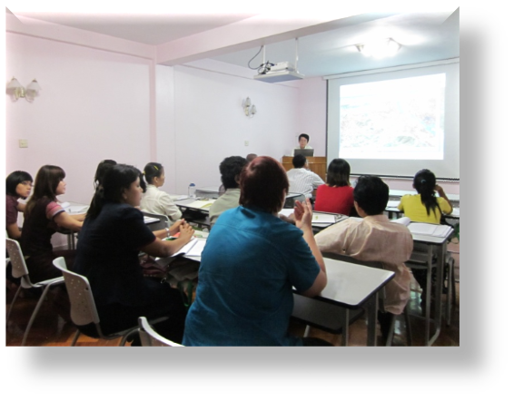
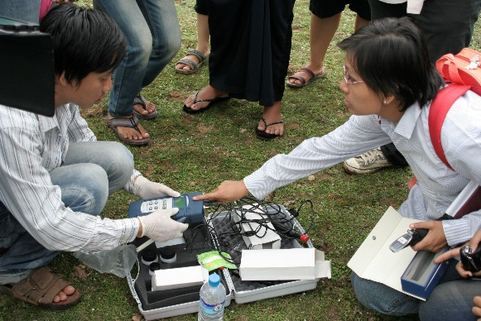
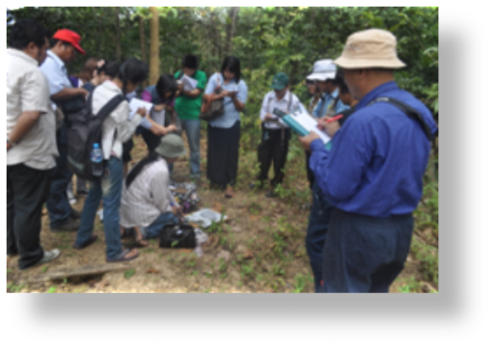
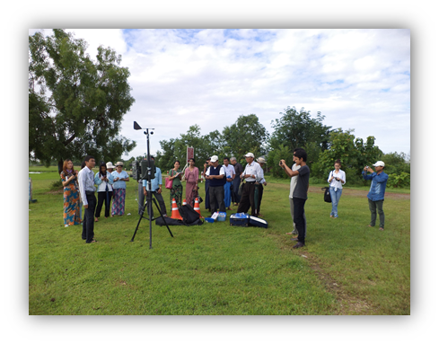
Myanmar Environment Institute
Curriculum for Environmental Science
Ecosystems; Terrestrial and aquatic ecosystems
Biodiversity and its conservation(fauna)
Introduction to Environmental Geology
Environmental pollution and Urban environment
Human population, Social issues, Health and Environment
Environmental Management, Planning and Law Enforcement
Climate Change
Cultural Heritage & Indigenous Peoples
Habitat Mapping (GIS/RS)
Post graduated 2 months certificate course
Trainees from Government Agencies, CBOs, INGOs, NGOs, Private Sectors

Slide 49
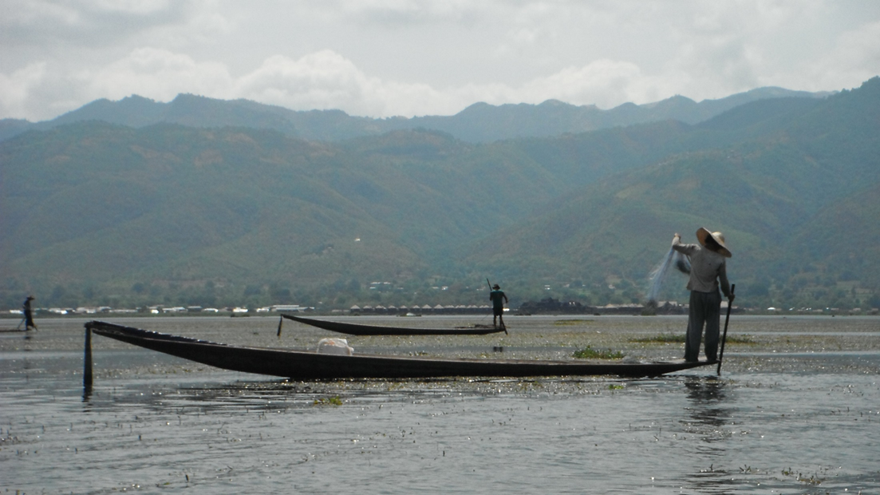

We invite for
collaboration researches
on disasters management and climate change…..
Thank You
Myanmar Environment Institute
Win Naing Tun
C005, Delta Plaza, Shwegondaing Road
Bahan Township, Yangon, Myanmar.
Tel: 95-9-73013448 Fax: 95-1-552901
Mobile: 95-9-5196758
Email: winnaingtun@enviromyanmar.net
Website: www.enviromyanmar.net

