Slide 1
ASEAN Academic Networking in Water Disaster Management and Climate Change RID Actions towards enhancing preparedness for future climate ADISORN CHAMPATHONG Royal Irrigation Department, Thailand
23 September 2014

Slide 2
Presentation Outline
Introduction to RID
Climate Change : IPCC (AR5)
3. What are RID actions for future climate?
4. What does RID require for future CC ?

Slide 3
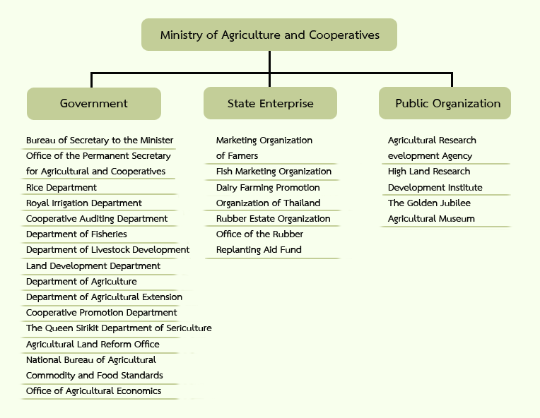
http://eng.moac.go.th/ewt_news.php?nid=12

Slide 4
1.Introduction to RID
B.E.2470 (A.D.1927)
B.E.2457 (A.D.1914)
B.E.2445 (A.D.1902)
”The 1st Director General
of Canals Department”
“Barrages Department”
(1ST Barrage in Thailand)
“Royal Irrigation Department”

Slide 5
Irrigation in Thailand:
Large-scale Proj. : ….
Medium-scale Proj. : …
Total Irrigation Area: 30.309 rai

Slide 6
1.Introduction to RID
Mission:
To develop WR and to increase irrigated area according to their potential and natural balance;

Slide 7
1.Introduction to RID
Mission:
To develop WR and to increase irrigated area according to their potential and natural balance;

Slide 8
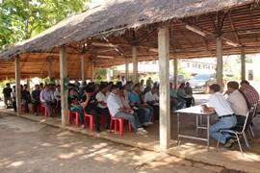
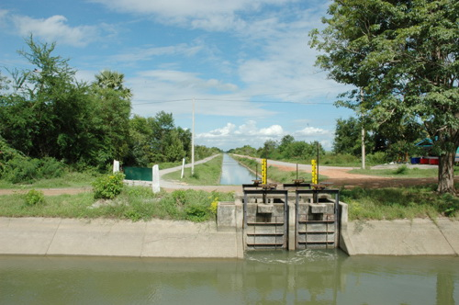
1.Introduction to RID
Mission:
To manage water allocation in equitable and sustainable manners;

Slide 9
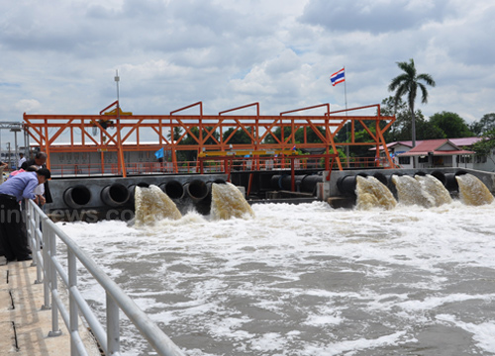
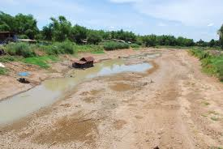
1.Introduction to RID
Mission:
To prevent and mitigate water hazards as appropriate mission;

Slide 10
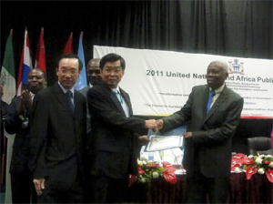
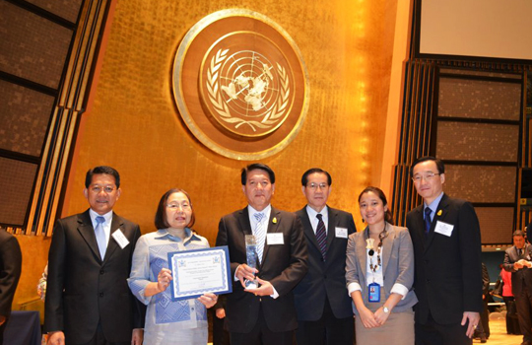
1.Introduction to RID
Mission:
To encourage people participation in WRM and WRD.
United Nations Public Service Awards : Fostering participation in policy-making decisions through innovative mechanisms
2nd Place Winner: Participatory Irrigation Management,: Kra Siew Operation and Maintenance Office , 2011
1st Place Winner: Integrated Drought Prevention and Mitigation: The Mae Yom Operation and Maintenance Office , 2012
http://www.unpan.org/dpadm/unpsdayawards/unpublicserviceawards/tabid/1522/language/en-us/default.aspx

Slide 11
2. Climate Change :
IPCC Fifth Assessment Report (AR5)
The AR5 (esp.WG-II) are very important to guide adaptation measures for agencies

Slide 12
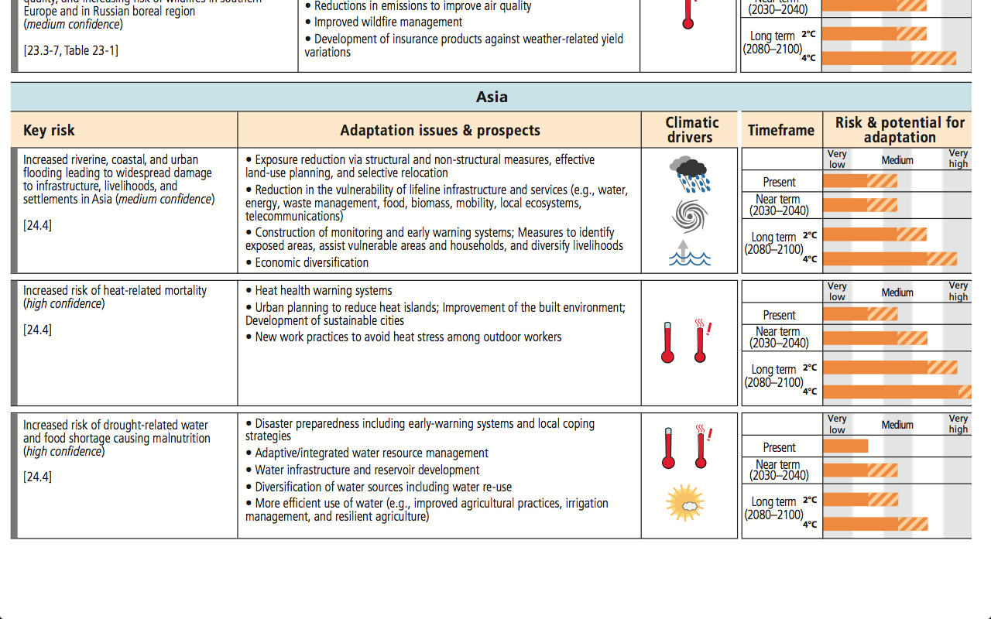
Key Risks and Adaptation in ASIA
“Land-use planning, early warning systems, etc.
“Flood”
“Heat health warning systems, urban planning etc.
“Heat”
“Disaster preparedness, IWRM, Irrigation management, etc.”
“Drought”
IPCC (2014): WG2AR5_SPM

Slide 13
2. Importance of Irrigation under future climate
http://www.eco-business.com/news/what-will-world-look-like-2100/

Slide 14
3. What are RID actions for future climate?
JIID
Japanese Institute of Irrigation and Drainage
IMPACT
ASSESSMENT
OFFICE OF NATURAL RESOURCES
AND ENVIRONMENTAL POLICY AND PLANNING
POLICY FORMULATION
ADAPTATION
MEASURES
JIID
Japanese Institute of Irrigation and Drainage

Slide 15
3.1 Climate Impact on irrigation water & GW : JIID (Plai Chumpon O&M Project in Lower North, TH)
Consumptive water demand
in the irrigation project [MCM]
J F M A M J J A S O N D
1982-2005
2015-2039
2075-2099
Koontanakulvong et al. (2010)

Slide 16
3.1 Suggestion on irrigation water & GW (Plai Chumpon O&M Project in Lower North, TH)
WM in dry season should be carefully monitored because precipitation in the upstream tends to decrease.
Consumptive water demand in the irrigation project under study will increase .
More irrigation water will be needed in the dry year which will cause water shortage.
Irrigation officers and farmers will need more supplement water (from borrow pit and conjunctively use with GW)
Koontanakulvong et al. (2010)

Slide 17
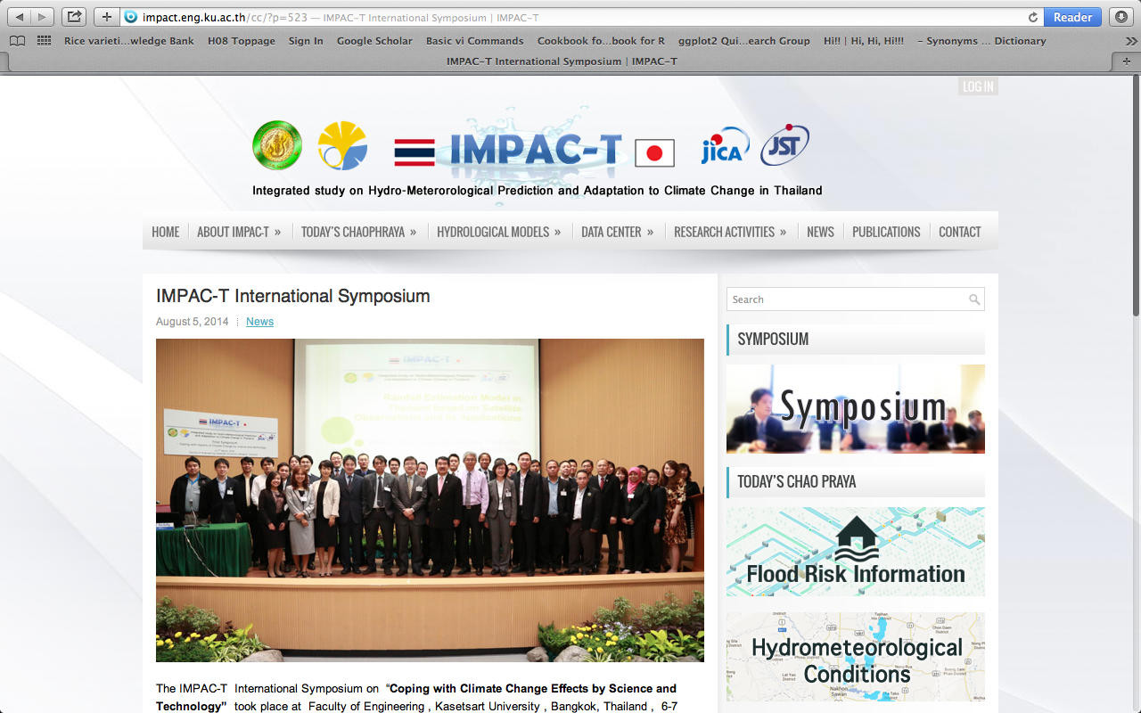
3.2 IMPAC-T Project: (2008– Mar.2014)

Slide 18
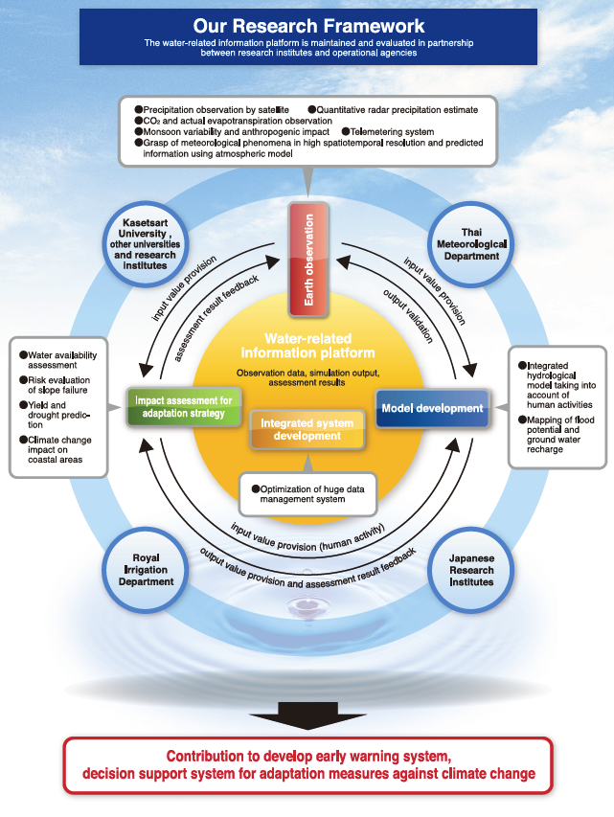

Slide 19
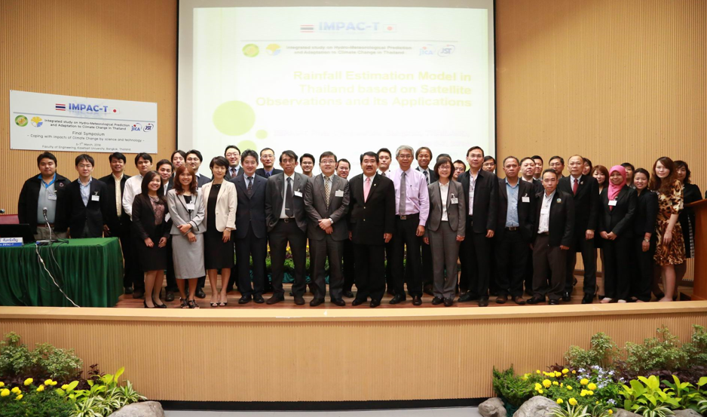
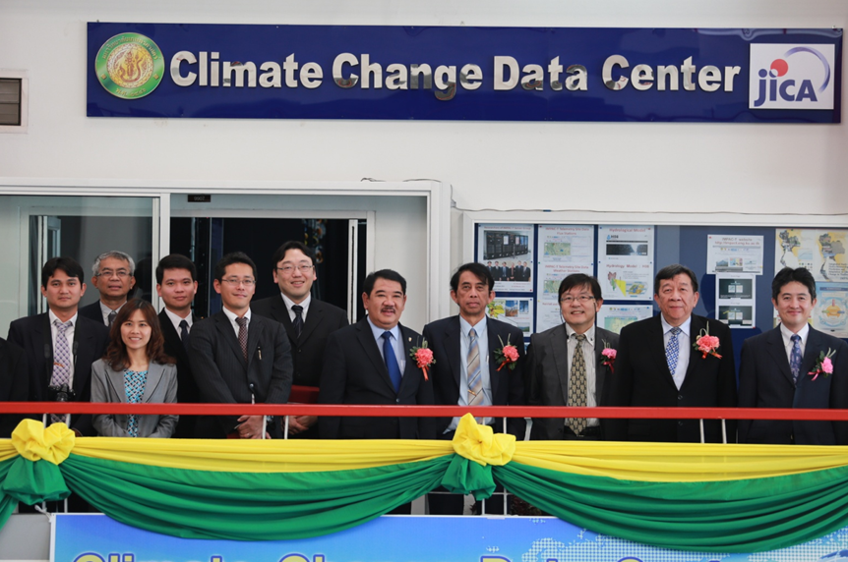
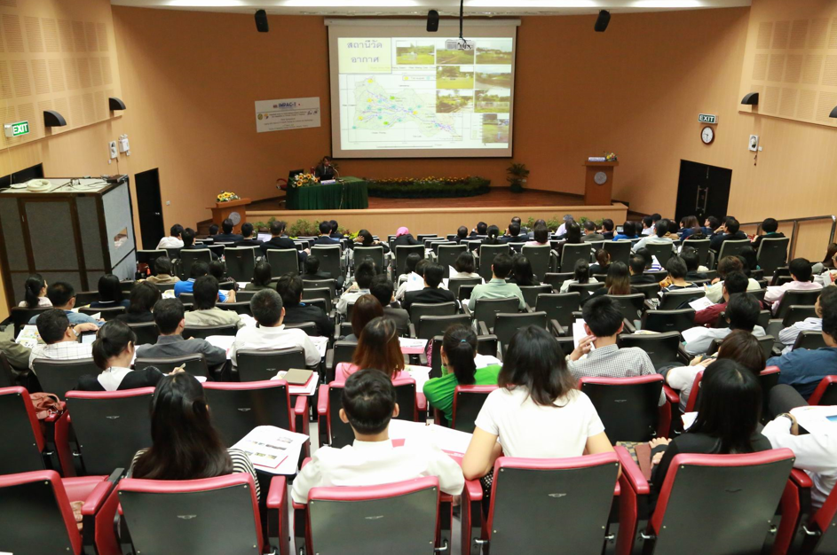
3.2 IMPAC-T Activity

Slide 20
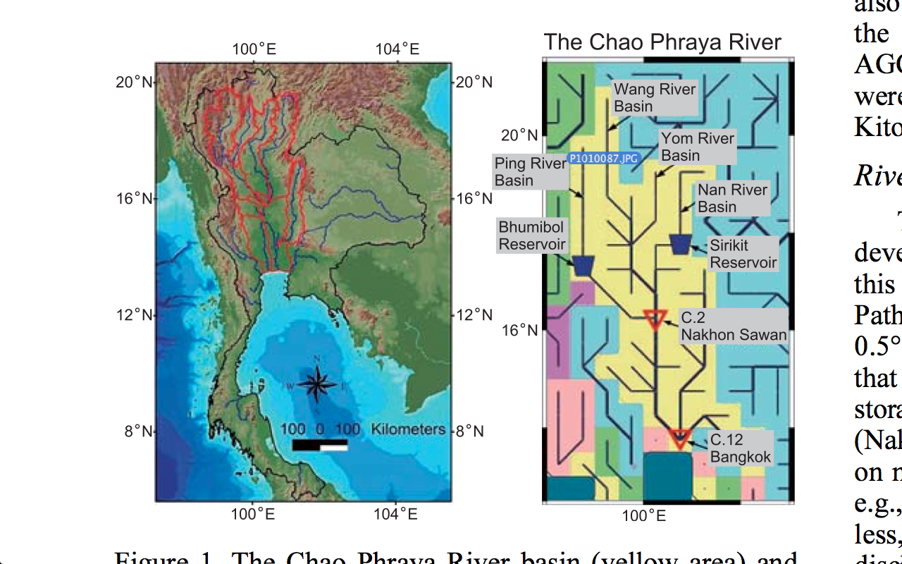
3.2 Projected change in discharge
Champathong et al. (2013)

Slide 21
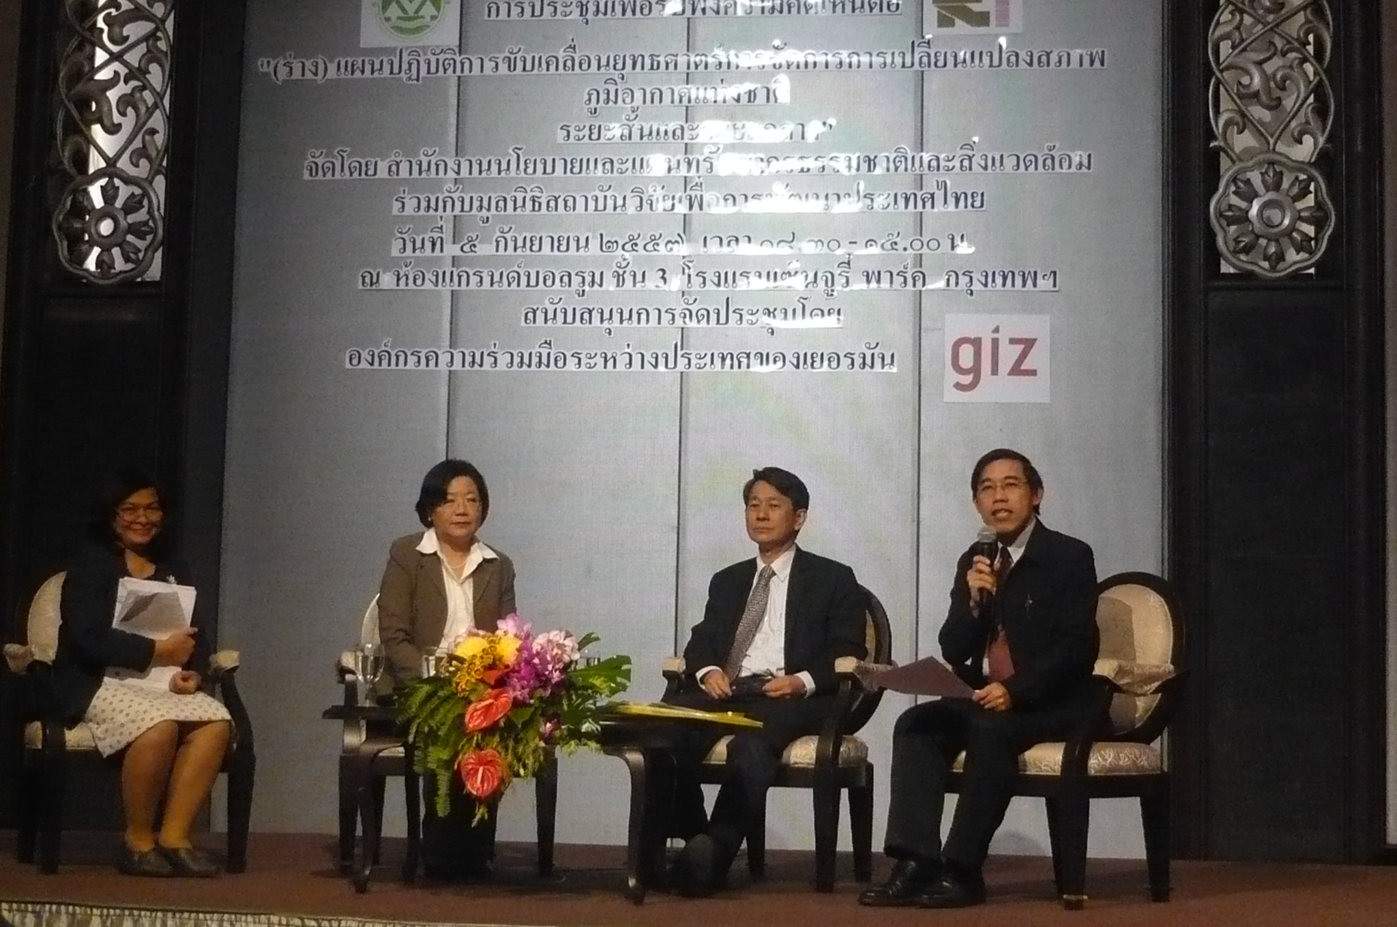
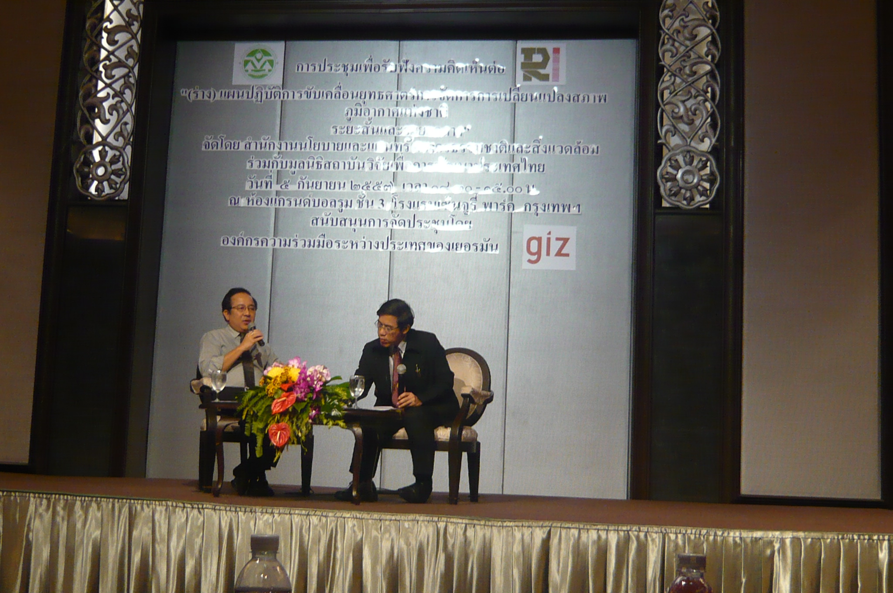
3.3 CLIMATE POLICY
(Draft) Action Plan on Climate Change Strategy as short and medium goal of national climate change policy (2013-2050)
Part 1: Adaptation:
Improvement of existing irrigation systems to cope with CC
Part 2: Mitigation
Part 3: Capacity building
R & D on water management under CC

Slide 22
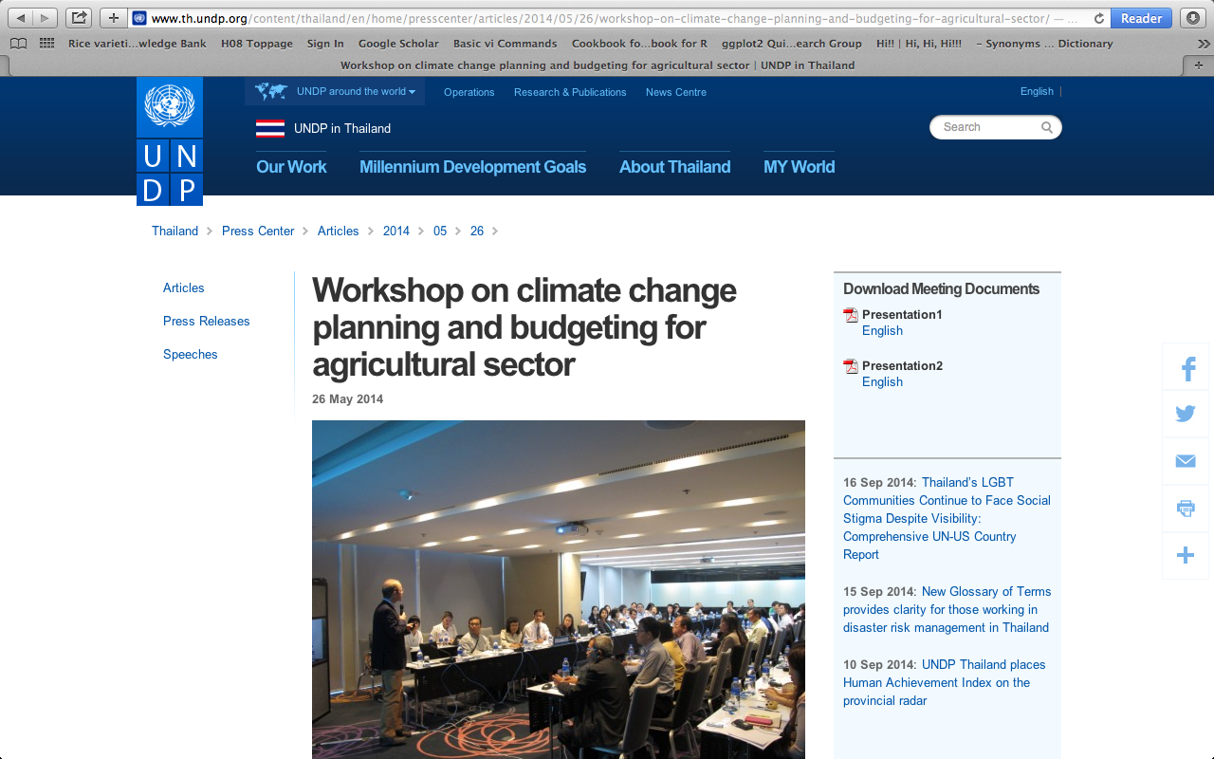
3.4 UNDP: CC planning and budgetting

Slide 23
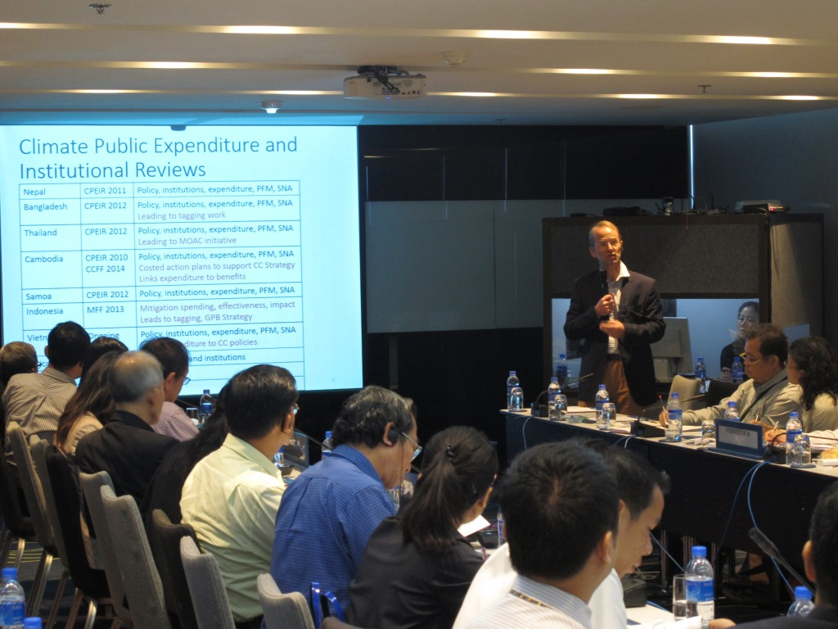
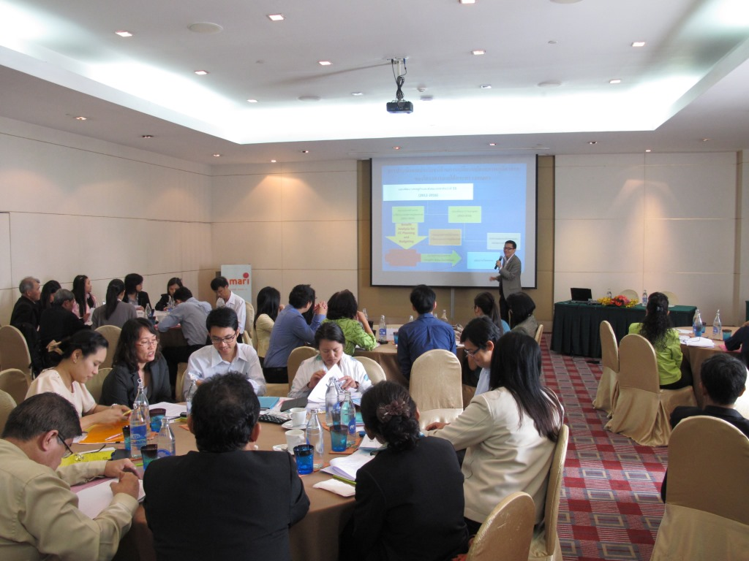
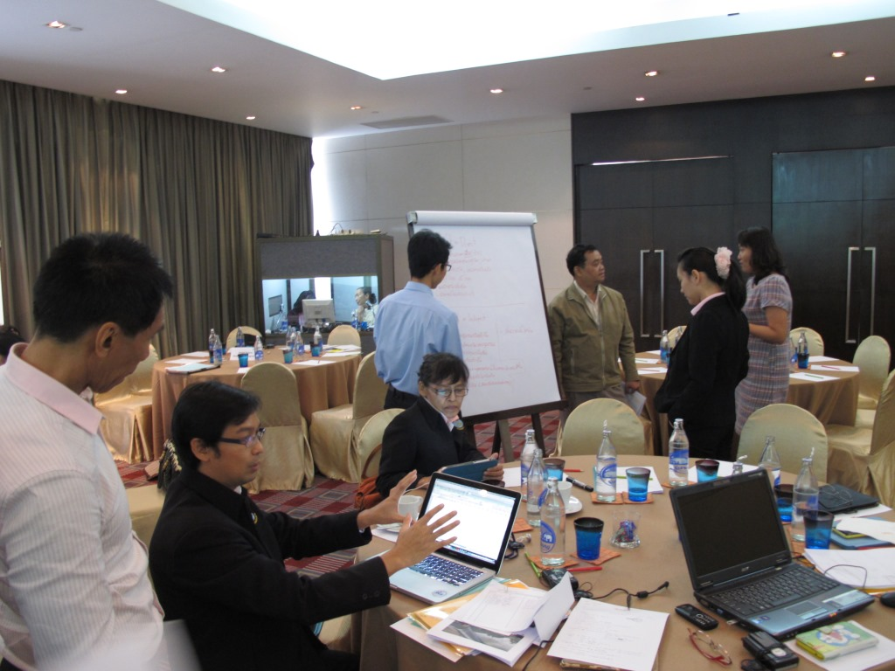
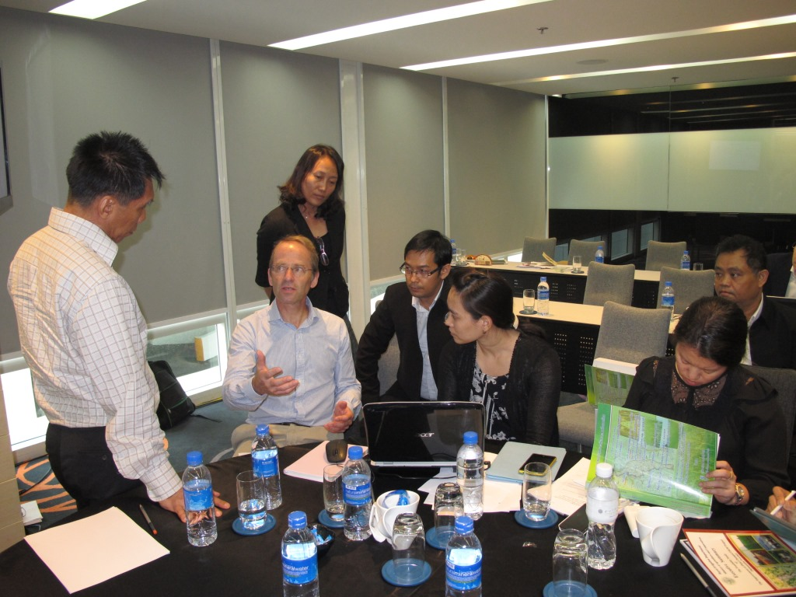
UNDP: CC planning and budgetting (Plai-Chumpon Irrigation Project)

Slide 24
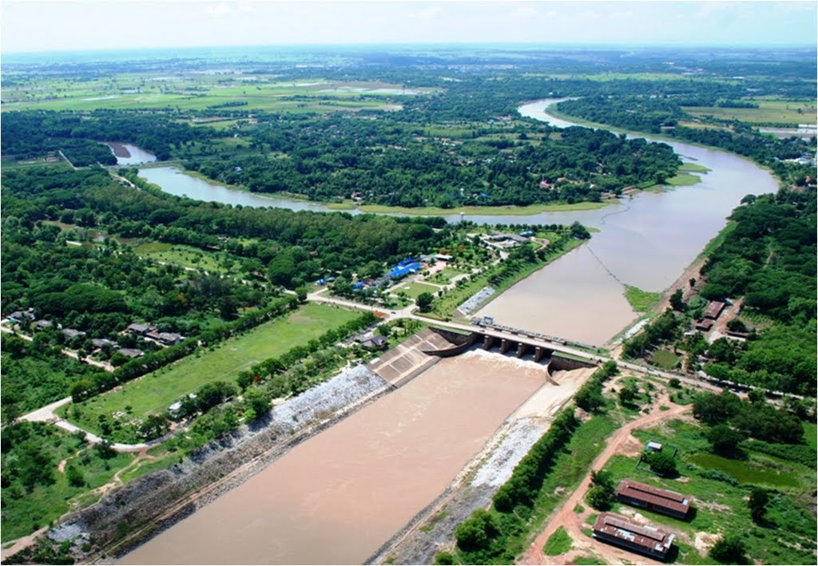
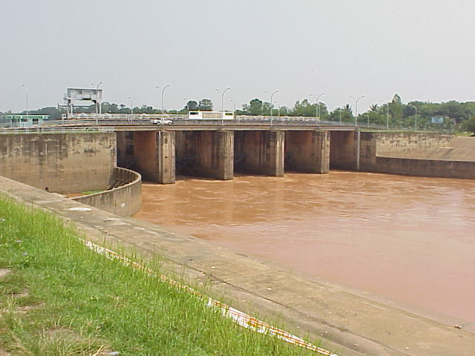
Cost Benefit Analysis
The Phlai Chumpol O&M Project (PC-O&M)
(tentative)
Computed by: Office of Project Management, Royal Irrigation Department, Thailand

Slide 25
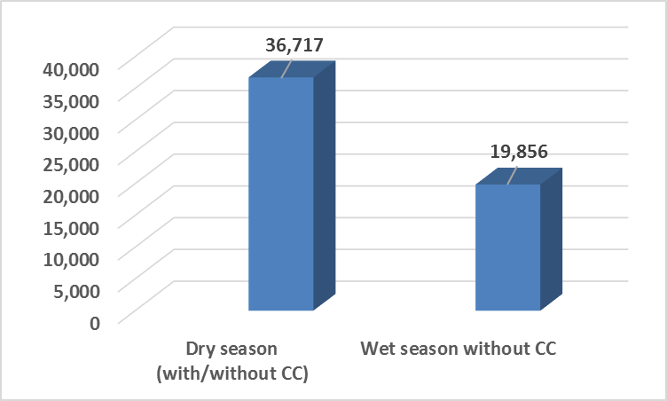
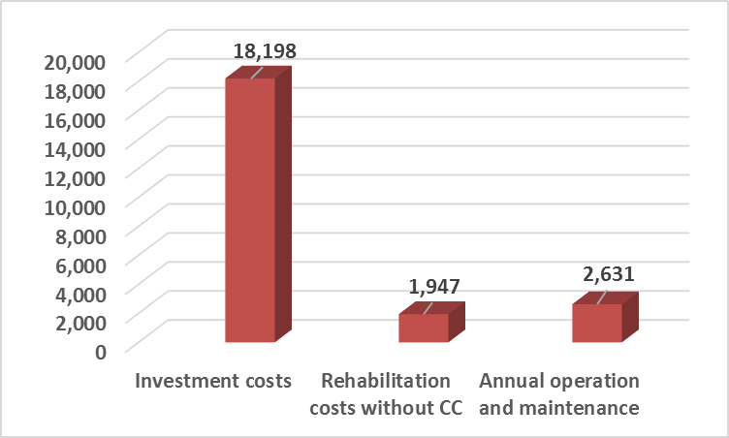
w/o CC
millions baht
millions baht
Total benefits
(NPV)
56,573
millions baht
BCR = 2.48
Total costs
(NPV)
22,776
millions baht

Slide 26
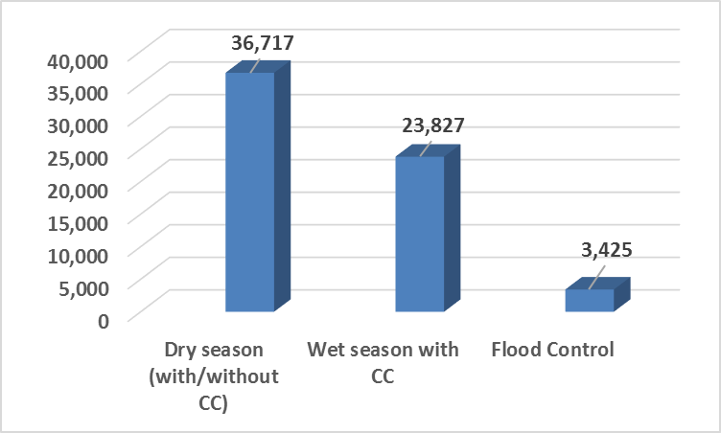
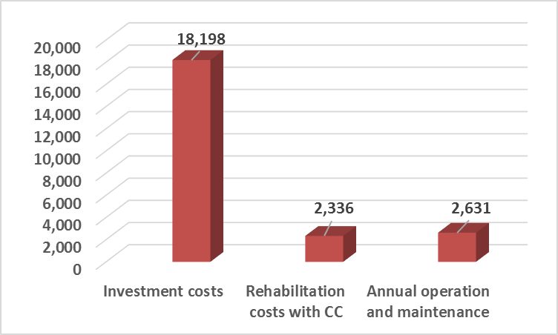
with CC
millions baht
millions baht
Total benefits
(NPV)
63,969
millions baht
BCR = 2.76
Total costs
(NPV)
23,165
millions baht

Slide 27
4. What does RID require about CC ?
4.1 Adaptation measures of CC on WRM
4.2 Link climate impact to adaptation policy
Climate Model Intercomparisons: Preparing for the Next Phase
Meehl et al. (2014)

Slide 28
Thank you very much

Slide 29
Champathong et al. (2013) (being reviewed)

Slide 30
Champathong et al. (2013) (being reviewed)

Slide 31
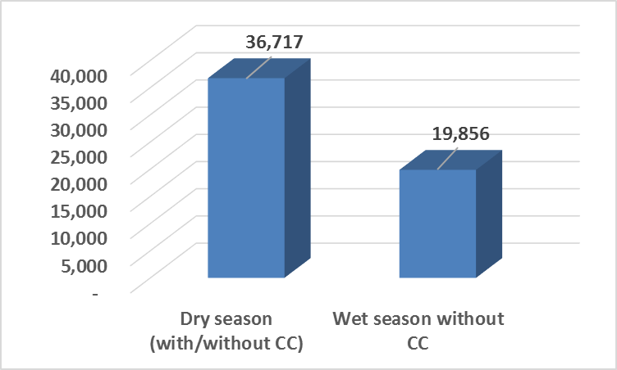
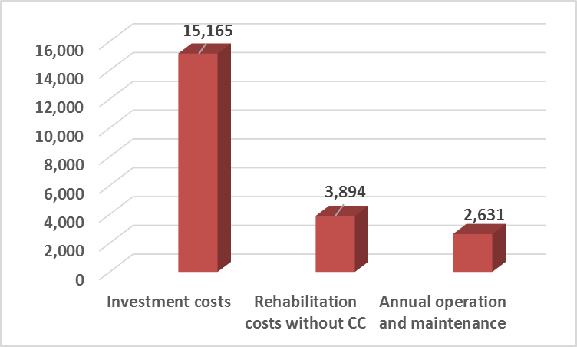
No Proofing
millions baht
millions baht
Total benefits
(NPV 1976-2012)
56,573
millions baht
BCR = 2.61
Total costs
(NPV 1976-2012)
21,690
millions baht

Slide 32
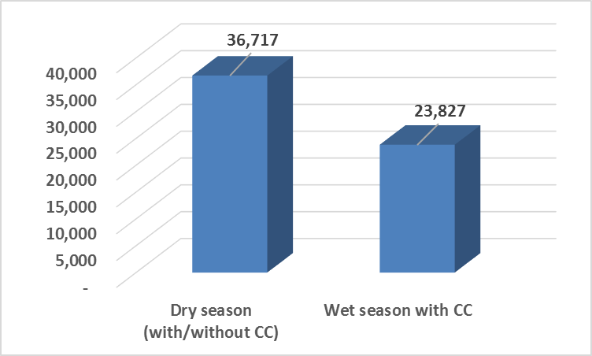
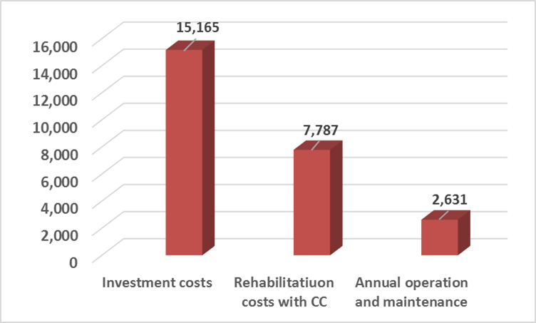
No Proofing
millions baht
millions baht
Total benefits
(NPV 1976-2012)
60,544
millions baht
BCR = 2.37
Total costs
(NPV 1976-2012)
25,583
millions baht

Slide 33
Proofing
millions baht
millions baht
Total benefits
(NPV 1976-2012)
56,573
millions baht
BCR = 2.48
Total costs
(NPV 1976-2012)
22,776
millions baht

Slide 34
Proofing
millions baht
millions baht
Total benefits
(NPV 1976-2012)
63,969
millions baht
BCR = 2.76
Total costs
(NPV 1976-2012)
23,165
millions baht

Slide 35
BCR
CC Relevance measure
Proofing
Without CC
2.61
2.48
-5%
With CC
2.37
2.76
17%
CC Relevance measure
-9%
11%

