Slide 1
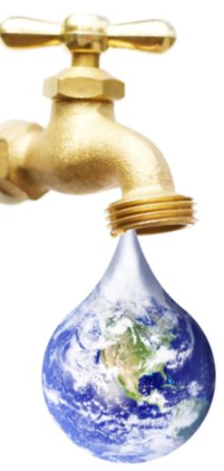
Climate Change Adaptation and IWRM
Dr. R. Jayakumar
UNESCO Bangkok
r.jayakumar@unesco.org

Slide 2
Hydrological System
DEPENDENCIES
Geo-Political Changes
Technological Changes
Population Growth and Life Style
Climate Change
Poverty
Governance
HYDROLOGICAL CYCLE
Ecosystems
at risk
Social
Challenges
SOCIETAL
RESPONSES
STRESS

Slide 3
Geo-Political Issues
Trans-boundary Waters
90% of worlds population lives in countries sharing international rivers
more countries are experiencing water stress (supply < 1700m3/person annually)
as water scarcity faces high demands transboundary competition for shared rivers and water resources grow

Slide 4
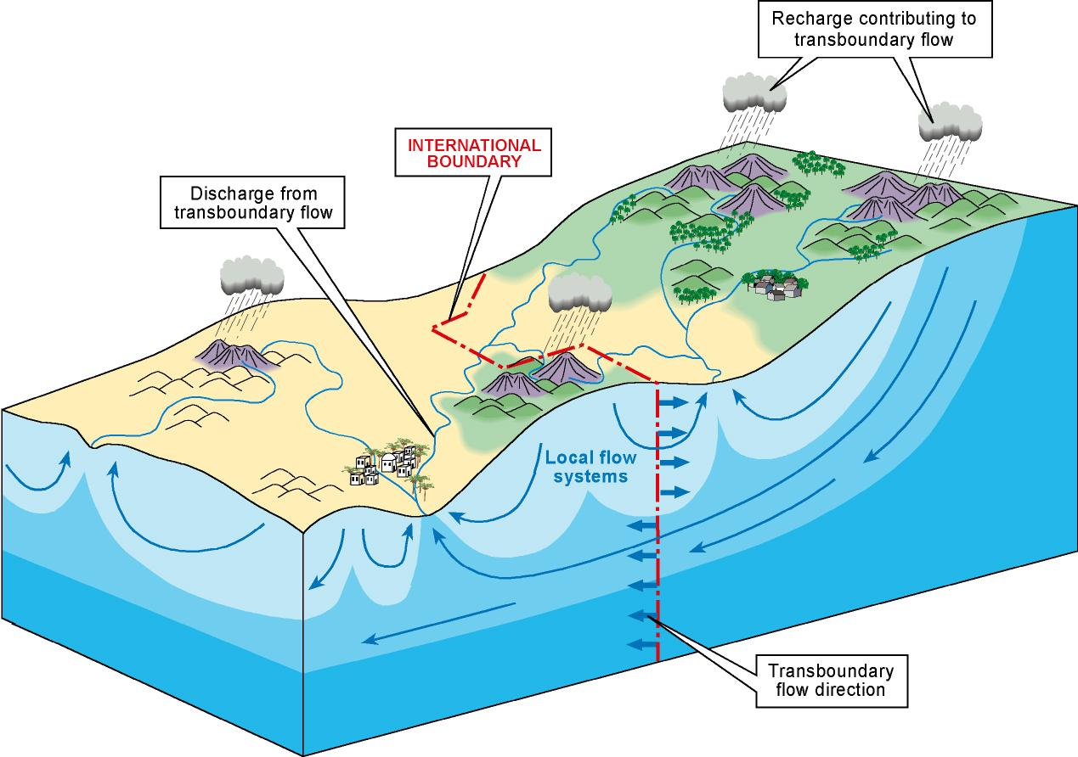
Trans-boundary Aquifers

Slide 5
Technological Changes
Uncertain Climate Futures
Increased Emission a reality
Crop Yield Vs Climate Change
Agricultural Vs Domestic Vs Industrial
Living with extremes

Slide 6
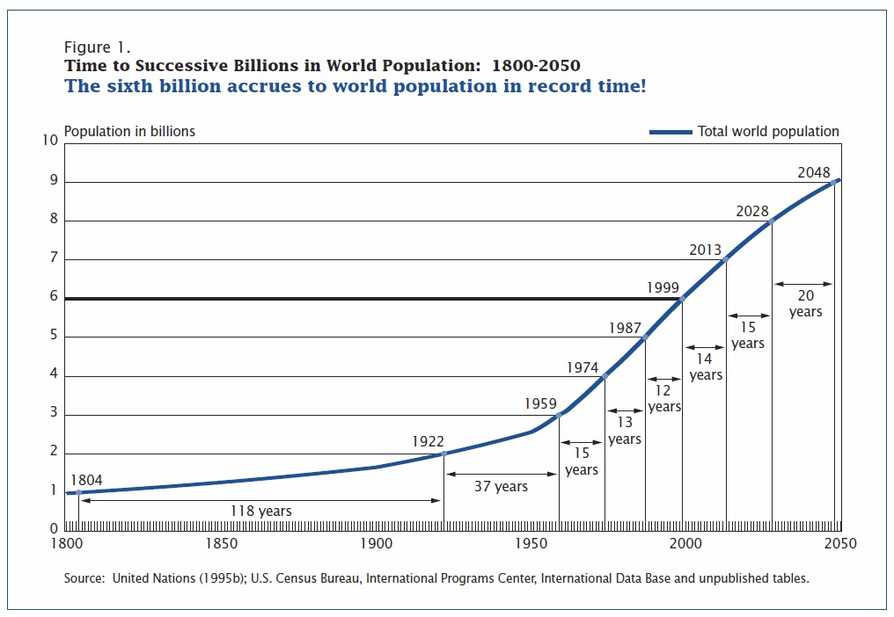
World Population Crisis

Slide 7
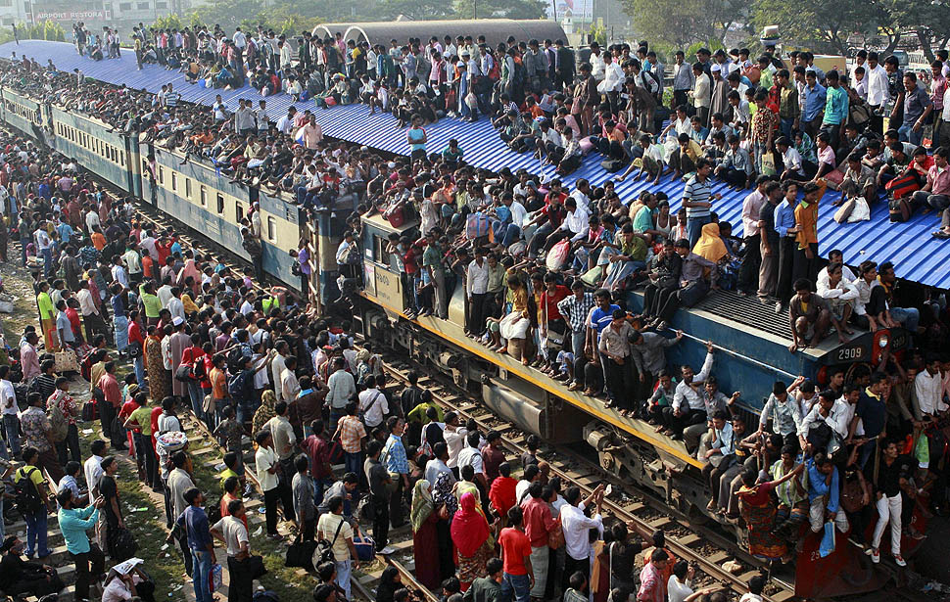
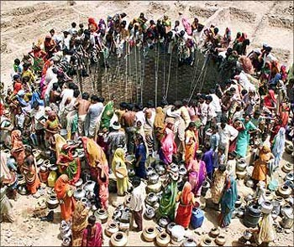
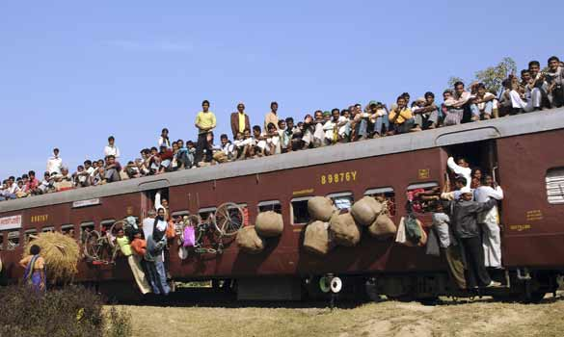
Population

Slide 8
Increasing Demands = Increasing Competition
“Competition for water exists at all levels and is forecast to increase with demands for water in almost all countries. In 2030, 47% of world population will be living in areas of high water stress.”
WWDR3, Chapter 9

Slide 9
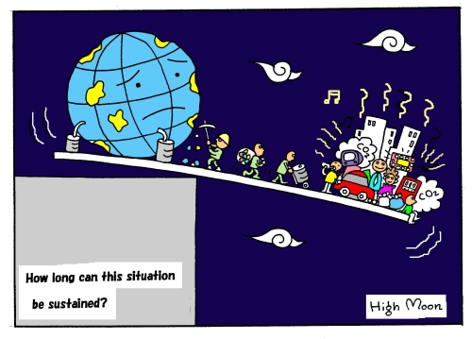

Slide 10
The cycle is changing?
Increased risks?
Growing vulnerability?
More disasters ?
Less water for people?
Crisis is looming?
What crisis?
Global or local?
Notes:
10

Slide 11
Water – Essential to sustain human life, environment, but…..
Competition for scarce water resources is already a source of conflict and it to escalate!
Urban vs Rural
Upstream vs Downstream
Human activities vs Environmental needs
National vs International

Slide 12
Drivers of Climate Change

Slide 13
What is Climate Change
When we use the term 'climate' what we actually mean is the average weather experienced in a region over a long period of time.
The climate on earth has undergone many changes in the past and this is entirely natural.

Slide 14
However, the rate at which the climate has been changing over the past 50 years has led to a consensus amongst scientists that this recent change is likely to be as a result of human's activities.
This is what we refer to as 'Climate Change'.

Slide 15
Climate change is a global phenomenon, but the problems will be very local and we will have to adapt and plan locally.

Slide 16
Main Drivers of climate Change
Changes in:
Sun’s output
Earth’s orbit
Drifting continents
Volcanic eruptions
Greenhouse gases
Land-use pattern
NATURAL

Slide 17
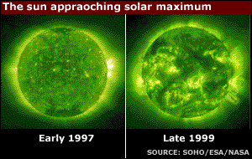
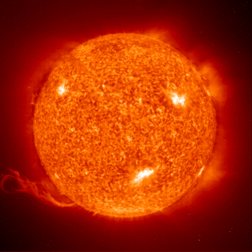
Dr Paal Brekke from the European Space Agency

Slide 18
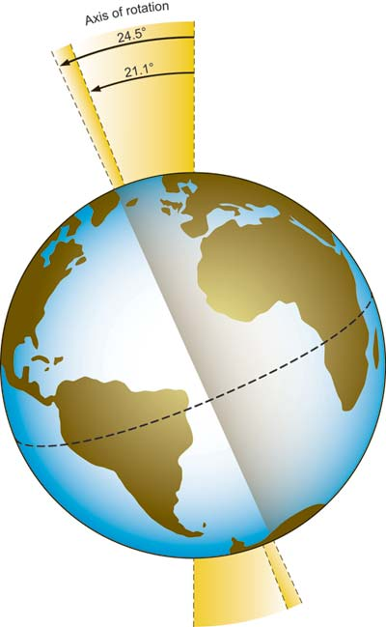
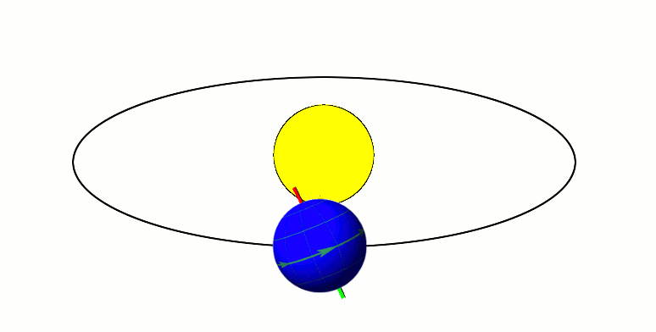
The Earth showing angle of axis of rotation. When the angle increases the summers become warmer and the winters become colder.

Slide 19
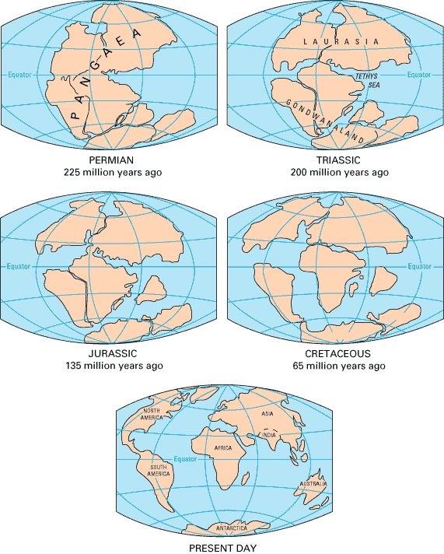
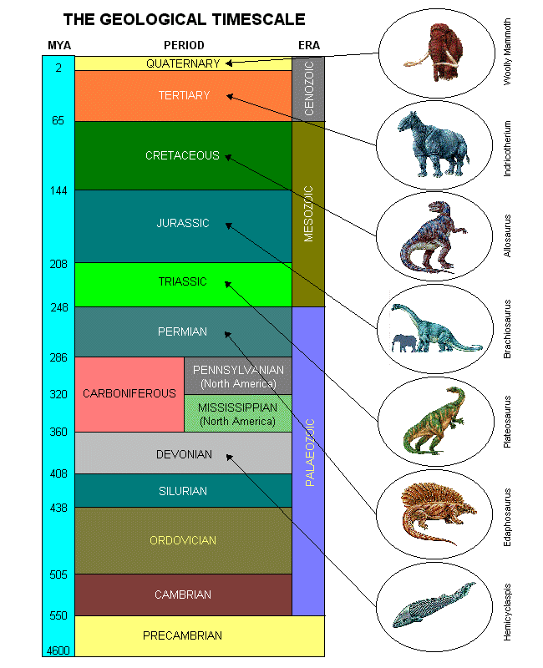

Slide 20
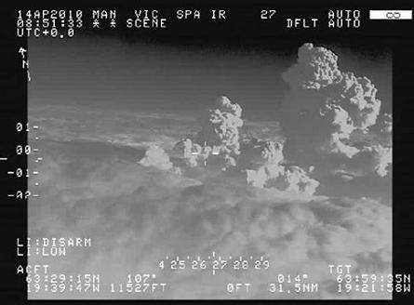
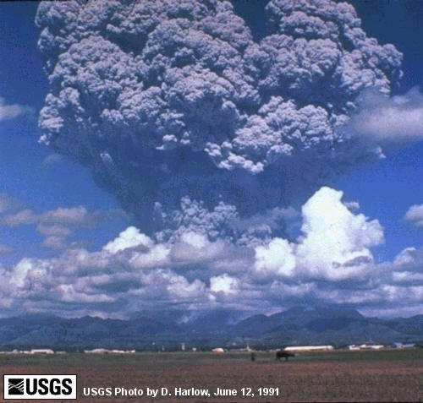
2010 Iceland Volcanic Eruption –
A Q300 surveillance aircraft which has captured images of the volcanic plume breaking the cloud layer

Slide 21
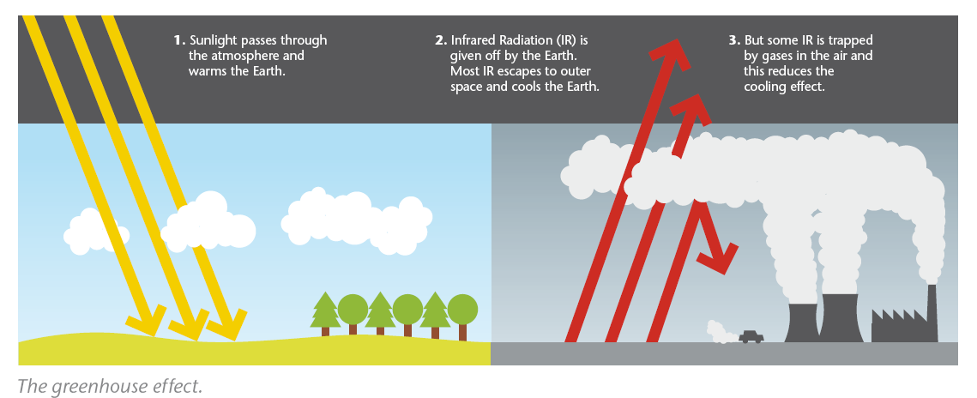
Increasing greenhouse gases trap more heat

Slide 22
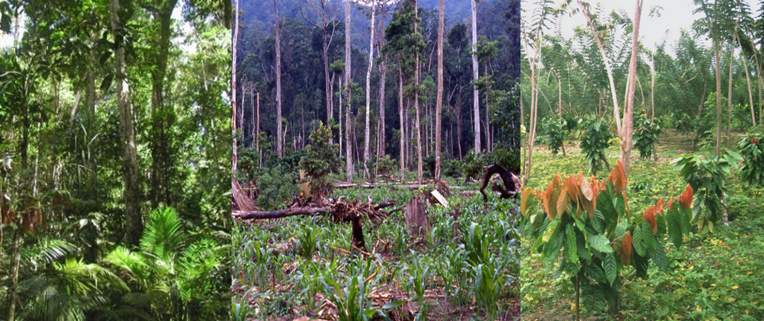
Chronosequence of land-use change: tropical rainforest - corn - cacao agroforest - Dr. Marife D. Corre

Slide 23
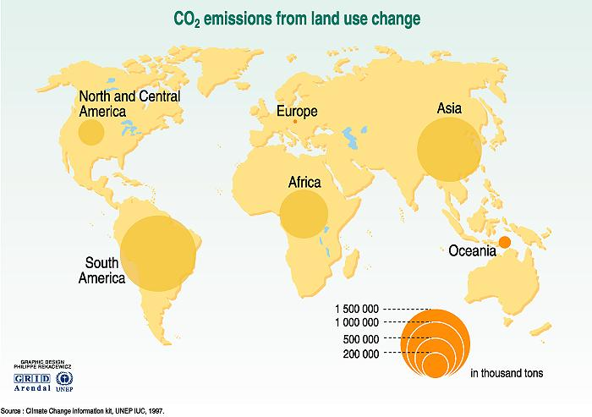
Emissions of carbon dioxide due to changes in land use mainly come from the cutting down of forests.

Slide 24
Observed Global Temperature record

Slide 25
Natural Variability

Slide 26
Human intervention

Slide 27
Adaptation v Mitigation
Mitigation:
reducing greenhouse gas emissions
carbon trading / taxes
renewable (and low carbon)energy
land use planning
protecting and enhancing natural carbon sinks

Slide 28
Adaptation v Mitigation
Adaptation – its about managing:
physical impacts (e.g. changes to extreme weather, climate drivers, slow change);
economic impact & market shift;
health & wellbeing;
insurance affordability & availability;
understanding and implementing climate legal risk (regulatory changes, litigation, due diligence, contracts etc)
constant monitoring and evaluation

Slide 29
Adapting to what?
Global climate system is complex, understanding how it may change is more complex - links back to mitigation, population growth, technology uptake, environmental feedbacks
Although there is a high demand to simplify down the science it is critical to recognise that doing so imposes risks and even a false sense of security

Slide 30
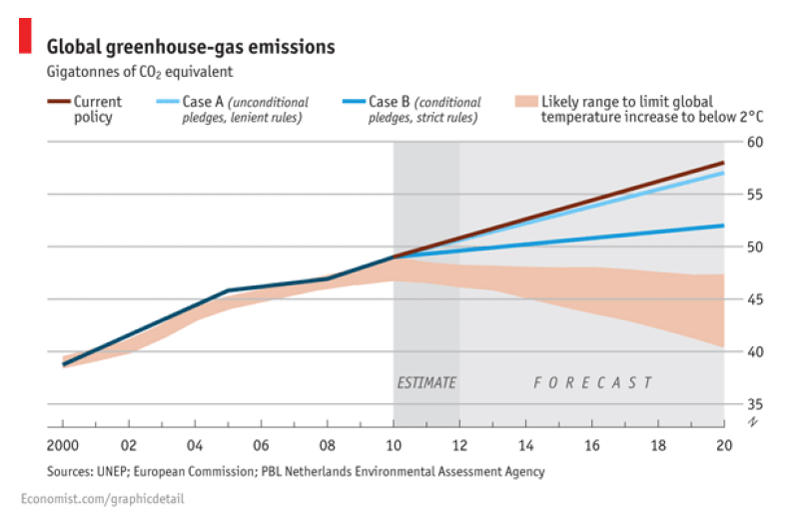
Heading in the wrong direction

Slide 31
Not only the climate is changing….
Changes with natural and human/social dimensions
Global changes but with local, regional and global impacts
Constellation of changes with numerous feedbacks!

Slide 32
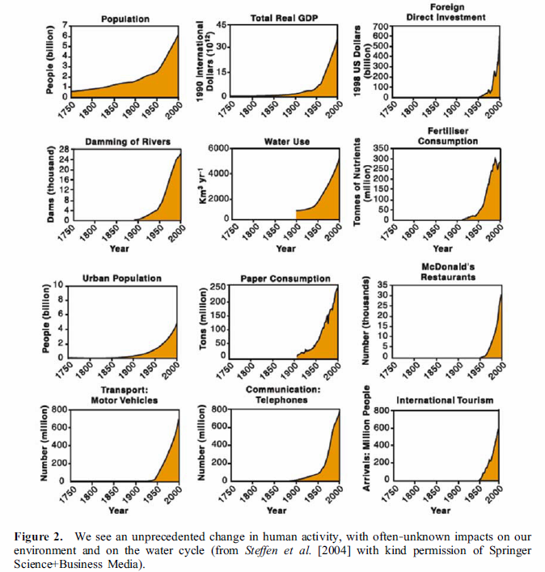

Slide 33
New Paradigm

Slide 34
Failure with Past Approaches
Sectroal, limited coordination, fragmented, uncoordinated development – inadequate to meet global challenges!
Top-down management, lack of demand management
Crisis of Governance
or Physical Scarcity?

Slide 35
Globally Realized that:
Business as usual no longer works
There are urgent need for reform…., for a significant shift… in the way water resources are managed, water services are provided

Slide 36
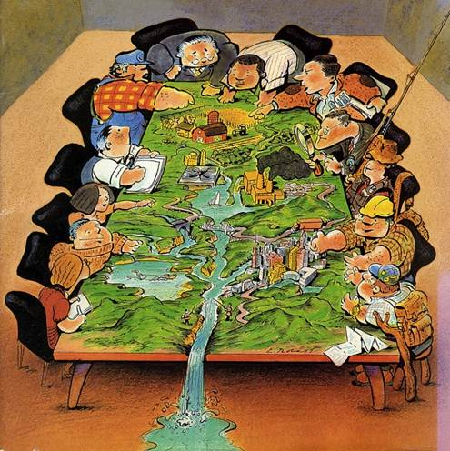

Slide 37
Definition of IWRM
“A process which promotes the coordinated development and management of water, land and other resources, in order to maximize the resultant economic and social welfare in an equitable manner without compromising the sustainability of vital ecosystems” GWP, 2000

Slide 38
What is IWRM
The GOAL is the sustainable management and development of water resources.
The basis of Integrated Water Resources Management (IWRM) is that different uses of water are interdependent.
Integrated management means that all the different uses of water resources are considered together.
Water allocations and management decisions consider the effects of each use on the others.
They are able to take account of overall social and economic goals, including the achievement of sustainable development

Slide 39
Why IWRM
Water governance crisis
Sectoral approaches to water resources management have dominated in the past and are still prevailing. This leads to fragmented and uncoordinated development and management of the resource.
Increased competition
Increased competition for the finite resource is aggravated by inefficient governance.
Securing water for people
One fifth of the world’s population is without access to safe drinking water and half of the population is without access to adequate sanitation.
Securing water for food production
Over the next 25 years, food will be required for another 2–3 billion people.
Protecting vital ecosystems
Aquatic ecosystems depend on water flows, seasonality and water table fluctuations and are threatened by poor water quality.

Slide 40
Advantages of IWRM
Coordinated activities rather than amalgamated programs
Top-down meeting bottom-up management
Strategic planning : targeting and prioritizing
Integrating goals rather than planning for single goals.
Proactive : identify problems before they occur
Cooperative work environment , inclusiveness
Encouraging commitment –Empowering local decision making rather than centralizing decisions
Providing appropriate and relevant information
Using equitable management methods sensitive to cultural needs, gender issues, poverty eradication…

Slide 41
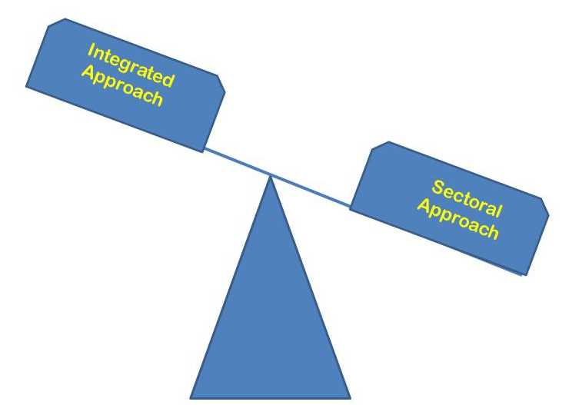
Risks of fully sectoral approach
Overlooking negative impacts on environment and other sectors
Inefficient use of resources-natural and financial

Slide 42
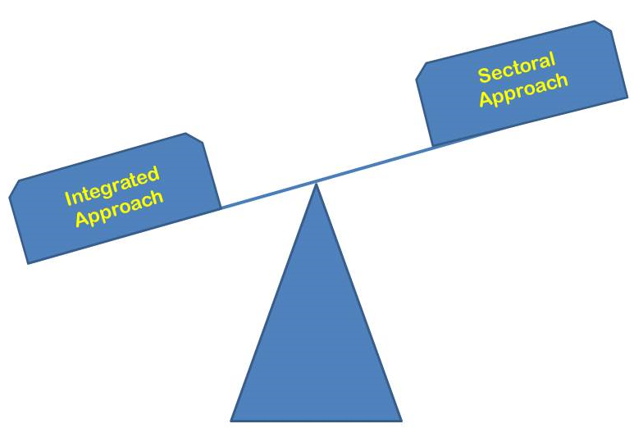
Risks of fully integrated approach
Getting mired in complexity.
Not making good use of specialist expertise.

Slide 43
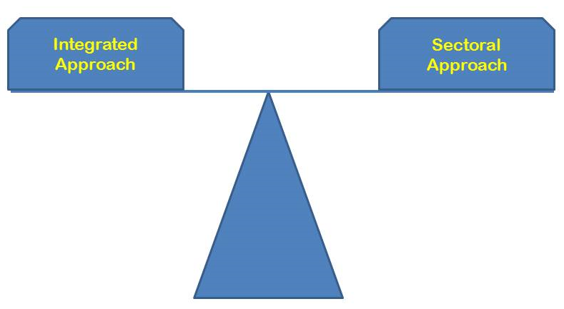
Finding a balance
Each country needs to decide where integration makes sense based on its social, political and hydrological situation.

Slide 44
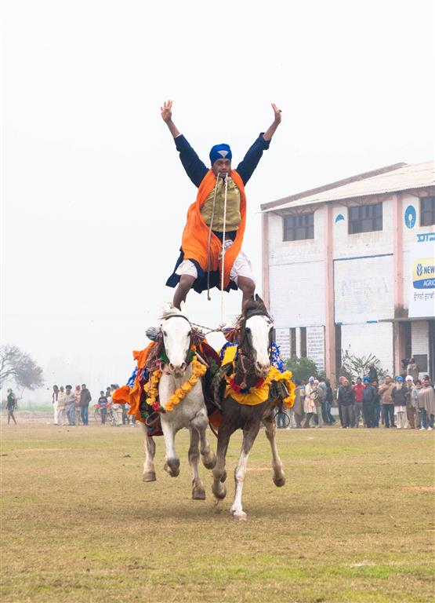
Practicing IWRM
Concept
Practice

Slide 45
IWRM – Process not product Tool not Blueprint
Is a coordinated process to bring together all stakeholders
Emphasizes on economic, social welfare, equity and protecting ecosystem
Is based on scientific data / tools for judgment / decisions
Promotes good governance, with democratic participation

Slide 46
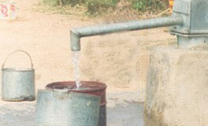
IWRM can help adaptation to climate change
Better water management makes it easier to respond to changes in water availability.
Basin planning allows for risk identification and mitigation.
Stakeholder participation helps in mobilization for action, risk assessment.
Good management systems allows the right incentives to be passed on to water users.

Slide 47
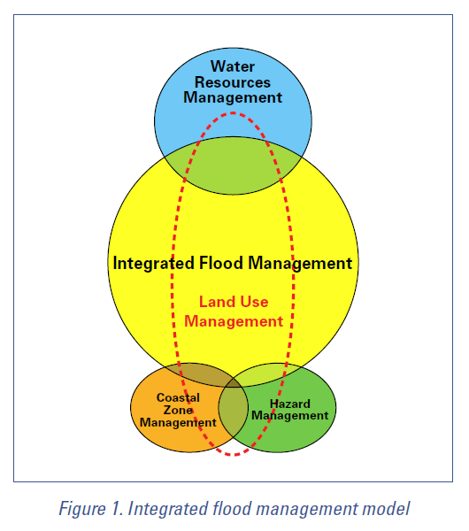
Manage the water cycle as a whole;
Integrate land and water management;
Manage risk and uncertainty;
Adopt a best mix of strategies;
Ensure a participatory approach
WMO-No. 1047

Slide 48
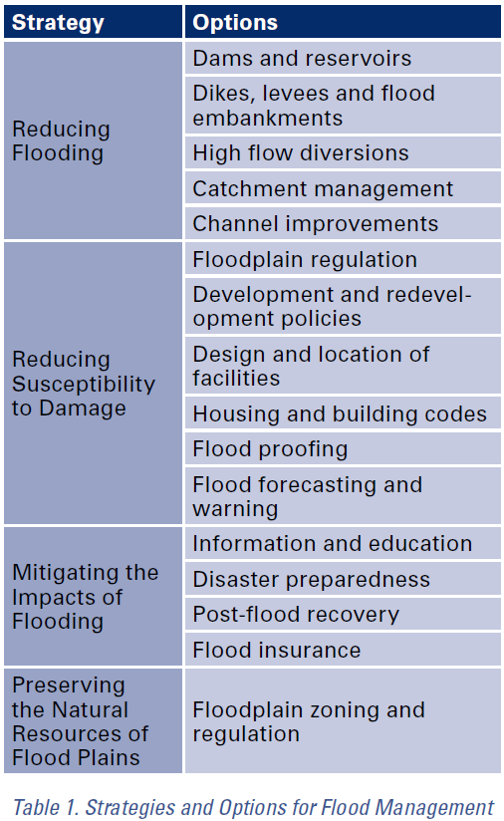
The adoption of a strategy depends critically on the hydrological and hydraulic characteristics of the subject river system and region.

Slide 49
Dealing with uncertainties

Slide 50
Uncertainties
One thing is certain:
Nothing is certain
Uncertainty and climate change
How to deal with uncertainties
Types of uncertainties
Adaptation to climate change under uncertainty:
Prediction-oriented approaches
Resilience-oriented approaches

Slide 51
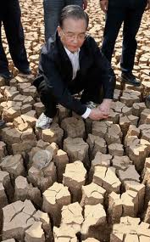
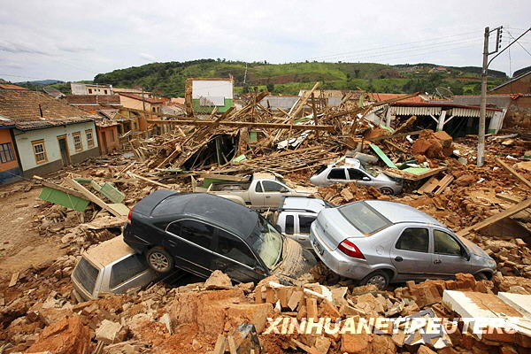
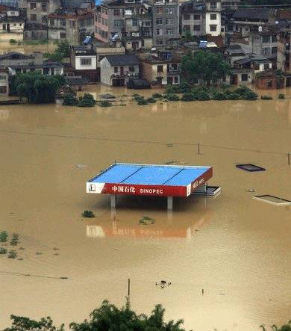
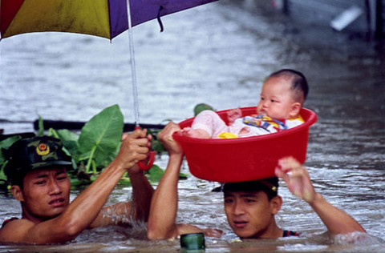
South China during 2010 classical example – drought followed by flood

Slide 52
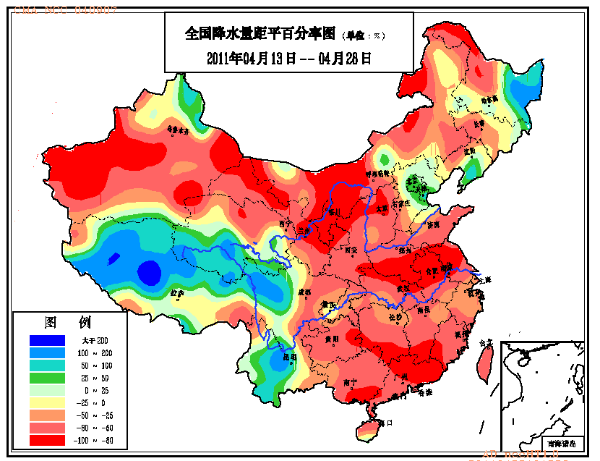
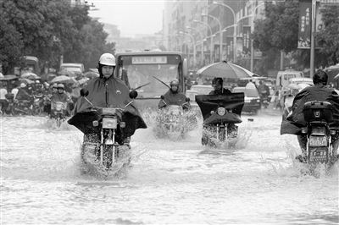
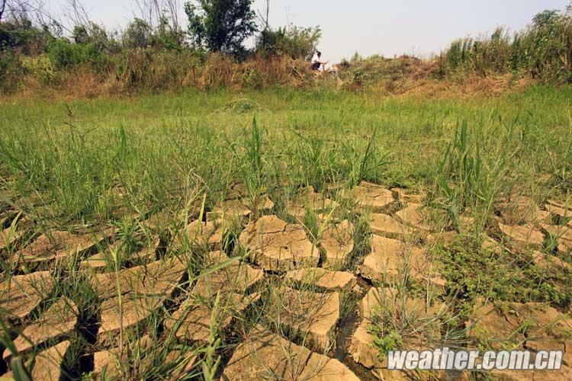
2011’s Extremely Droughts during spring in southern China, late flood disaster
Only for flood disaster until July, directly economic loss reaches 43.2 Billion RMB,
Impacted 27 provinces and regions and 36.7 Million population, 239 victim …
中国旱涝气候公报
Precipitation change on April in China

Slide 53
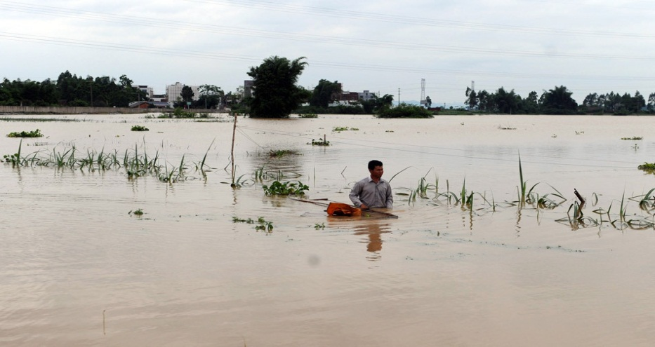
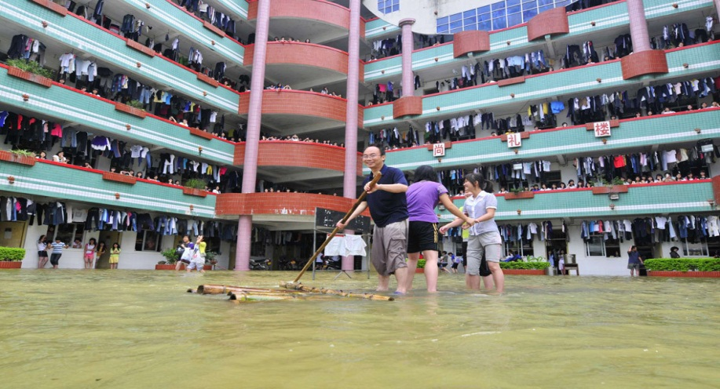
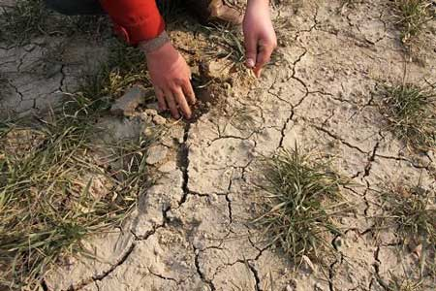
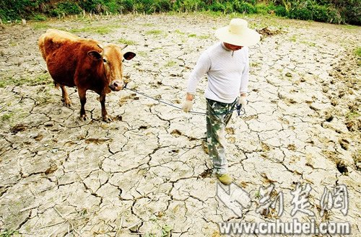
2012’s May- June Floods in South China & Drought in North China
Just in Guanxi, the heavy rainfall resulted in 21 million peoples to suffer flood disaster!
Same in Yellow R Huai R & Hai R, the extremely draught resulted in 67 million affected farm!

Slide 54
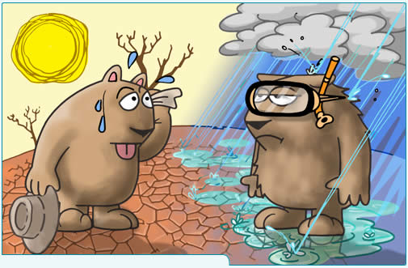

Slide 55
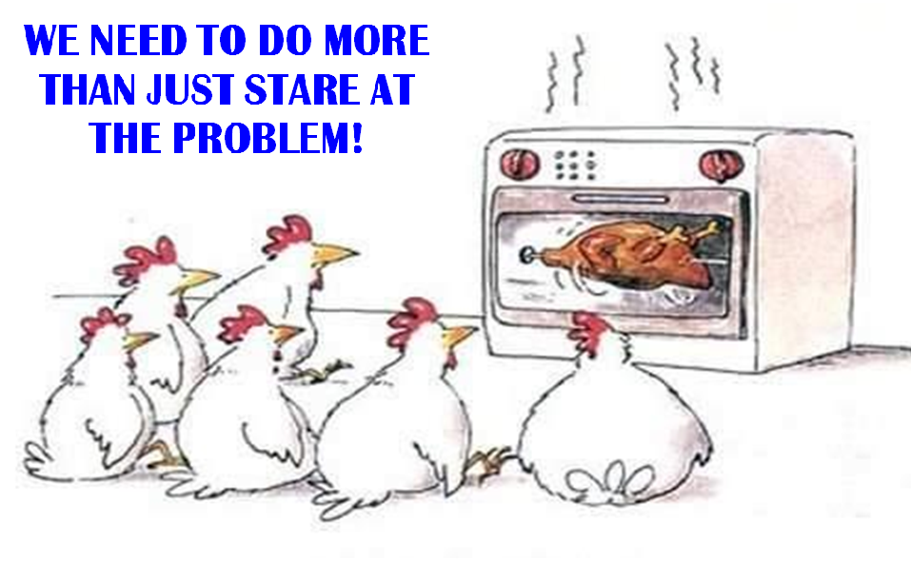

Slide 56
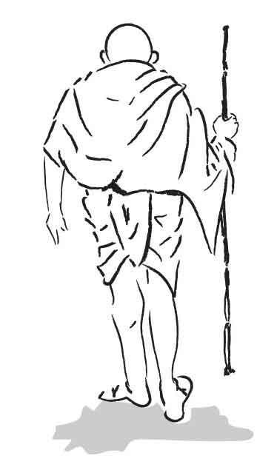
Be the change that you want to see in the world
“There is a sufficiency in the world for man’s need but not for man’s greed.”

