Slide 1
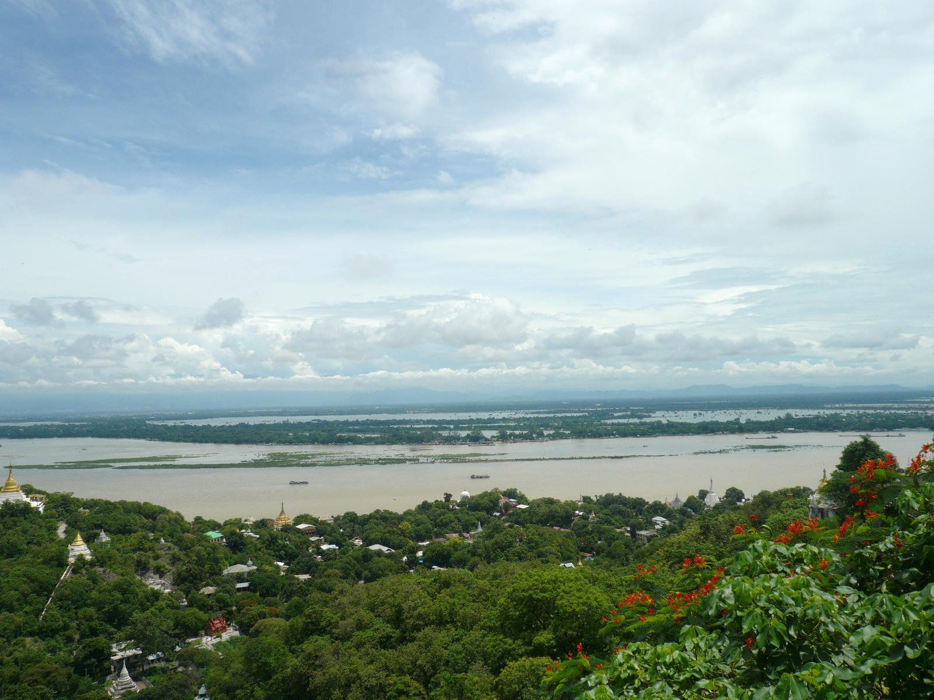
Impact Assessment of Climate Change on Water-Related
Disasters for Building Up an Adaptation Strategy
Yasuto TACHIKAWA
Hydrology and Water Resources Research Lab.
Dept. of Civil & Earth Resources Engineering, Kyoto University

Slide 2
Sousei Program (2012-2017)
Imminent global climate change
(AORI, U Tokyo)
Stabilization target setting (JAMSTEC)
Risk Information (MRI)
Impact assessments (DPRI, Kyoto U)
Natural Disaster
Water Resources
Ecosystem
Climate variability and change
Integrated prediction system
Long-term projection
Large-scale variations
Probabilistic climate projection
Producing a standard climate scenario
PI: Prof. Nakakita (DPRI,Kyoto U)

Slide 3
Key issues in SOUSEI PROGRAM
Generating PDF of extreme values with higher accuracy (New GCM data generation)
  PPE/SST ensemble to estimate uncertainty
  Use of regional scale model (RCM) to reduce local biases
Proposing adaptation and mitigation philosophy (Impact assessment of Climate Change)
  Projection of probabilistic risk
  Estimation of worst class cases
  Impact assessment, adaptation and mitigation strategy

Slide 4
Research items
Climate Projection
GCM/RCM Modeler
Impact Assessment
Adaptation
Projection of extreme
  Use of latest high-resolution GCM
  Dynamic perturbation
Reduction of uncertainty
  Improvement of model
  Ensemble projection
  TC ensemble
  Statistical downscaling
  Bias correction
  etc

Slide 5
Outlook SOUSEI Program for 2017
Making model
Projection considering uncertainty, variability and worst class
Impact assessment, mitigation and adaptation
Second Stage
GCM results
2017
Frist Stage
2016
IPCC AR6
GCM results
2014
2012
natural disasters, water resources and ecosystem

Slide 6
Developing GCM and RCM by MRI, JMA
2012
Frist Stage
2014
Second Stage
2017
60km AGCM ensemble runs with CMIP5’s SST
20km AGCM run with CMIP5’s SST
Dynamical Down Scaling by 5km NHM
(Three models)
Dynamical Down Scaling by 2km NHRCM
Improvement of processes in2km NHRCM
Coupling of 20km A-GCM with Ocean model
Run by 20km AO-GCM
Validation of output from A-GCM , NHRCM

Slide 7
Large number of GCM ensembles by MRI, JMA
Different SST settings
YS
Cluster 3
20km AGCM by MRI
Cluster 2
60km AGCM by MRI
Cluster 1
AS
60km AGCM by ME
Ensemble mean
RCP Scenario
Present climate
2.6
4.5
6.0
8.5
KF
Different cumulus convection parameterization
PPE

Slide 8
Flood and inundation simulation under a changing climate
Worst case scenario simulation on flood and inundation under a changing climate; and
Probabilistic evaluation of magnitude and frequency on flood and inundation under a changing climate.

Slide 9
Worst case scenario simulation on flood and inundation

Slide 10
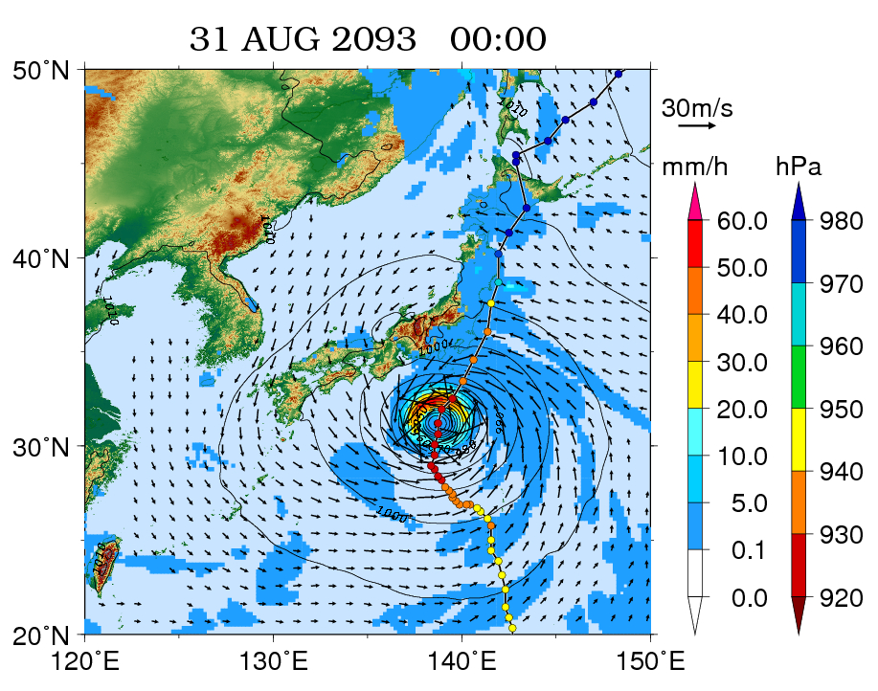
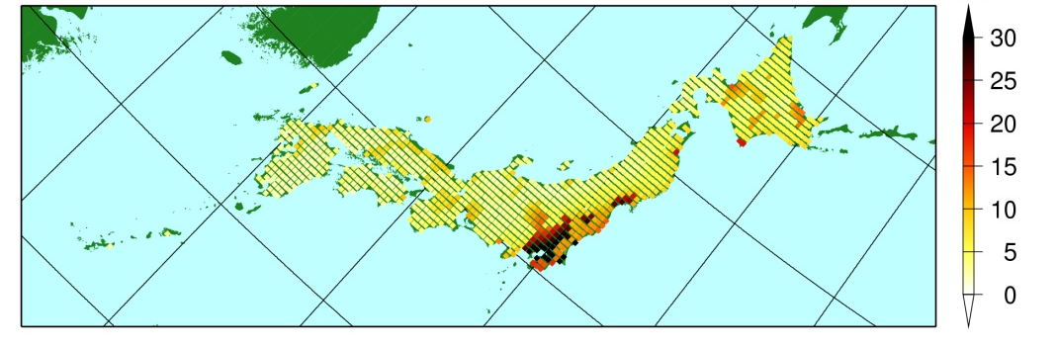
Future severe typhoon in GCM projection
Result from the 20-km GCM climate simulation in a future warming climate
A possible maximum typhoon realization in GCM projection under global warming.
Maximum Wind Distribution
Notes:
Heavy rainfall and high winds under typhoon conditions strongly depends on the track and intensity of typhoons.
Owing to the limited number of the actual severe typhoons, the assessment of the typhoon hazards with various tracks and intensities of typhoons is difficult.
Therefore, numerically generating severe cases by controlling typhoon tracks is a viable alternative in increasing the number of extreme cases.
Furthermore, quantitative estimates of typhoon hazards are important for impact assessment applications.

Slide 11
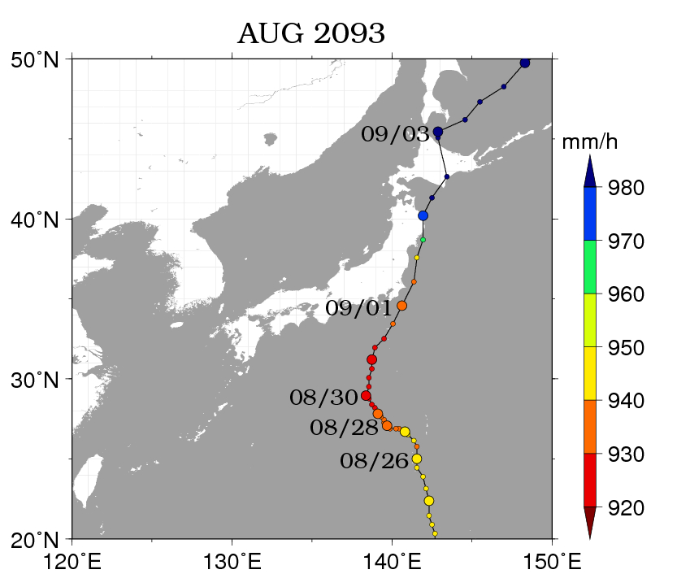
How water-related disasters will change
if typhoon takes different tracks?
hPa
(Ishikawa et al. 2013)
Notes:
11

Slide 12
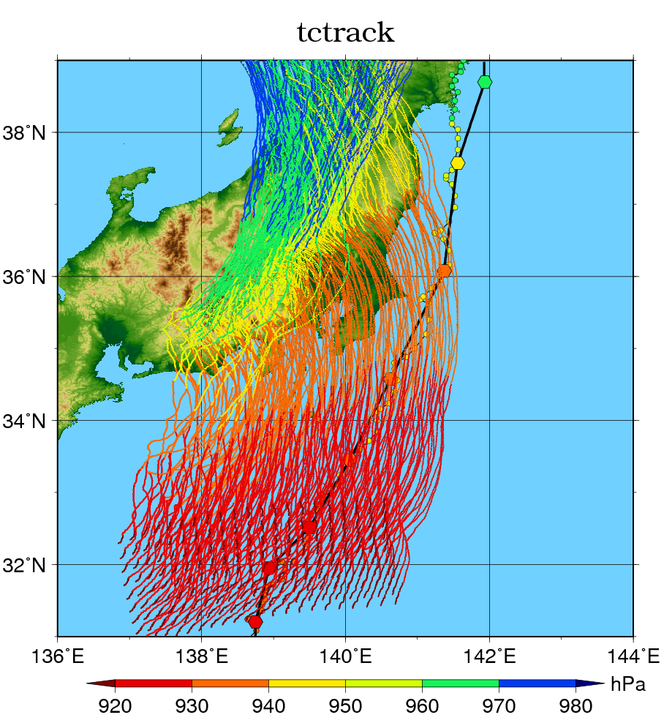
Virtual shifting of typhoon’s initial position- for making a worst scenario -
Virtual Shifting of typhoons initial position by keeping potential vorticity same
(a vorgas method)
Dynamic downscale by RCM
Worst case impact assessment on
Land： extreme wind and rainfall
Ocean： storm surge and wave height
NHM-5km
AGCM20
Ishikawa et al (2009)
Notes:
平成21年度の春以降に進んだ部分（スライド2枚中2枚目）

Slide 13
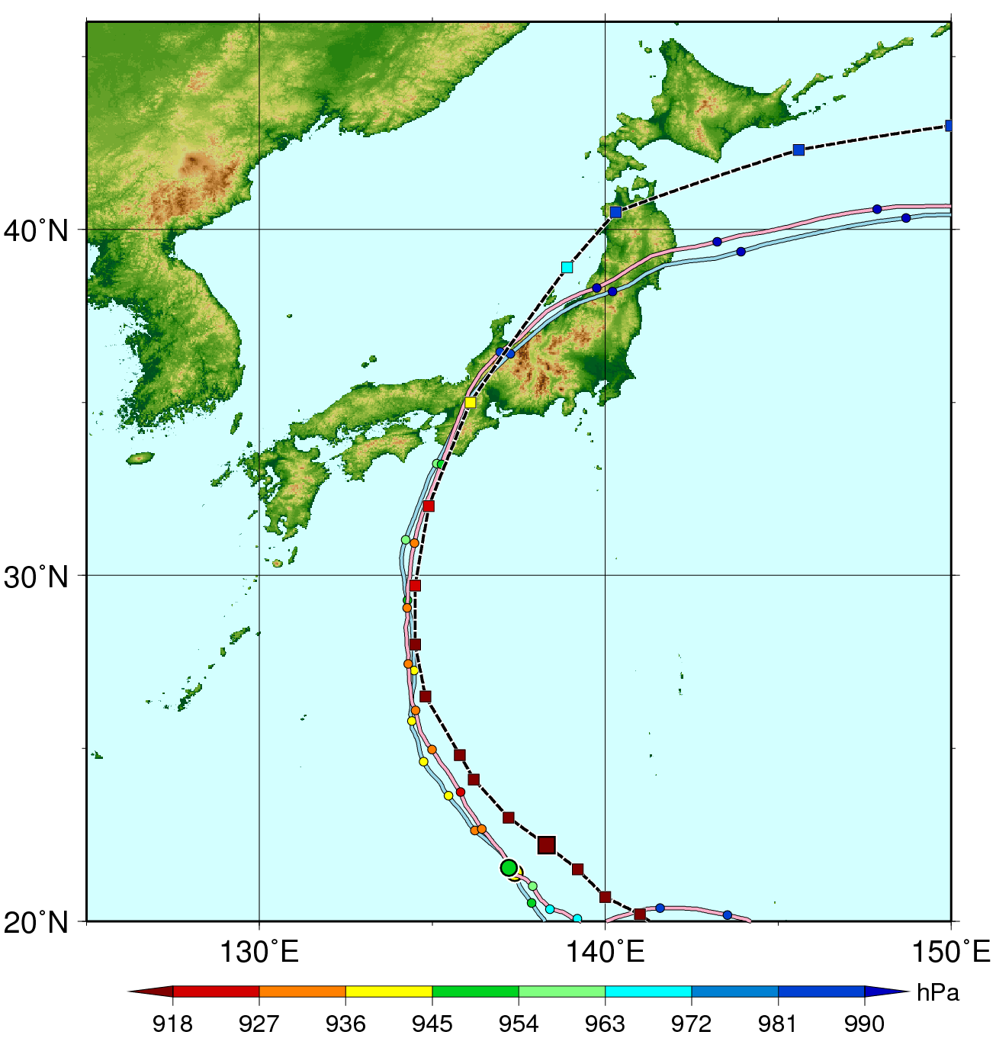
Isewan Typhoon (1959) pseudo-global warming experiment
Isewan Typhoon (1959) track and central pressure per 6hrs
Best track（black line）;
reproduction（blue）; and
pseudo-global warming experiment (pink color).

Slide 14
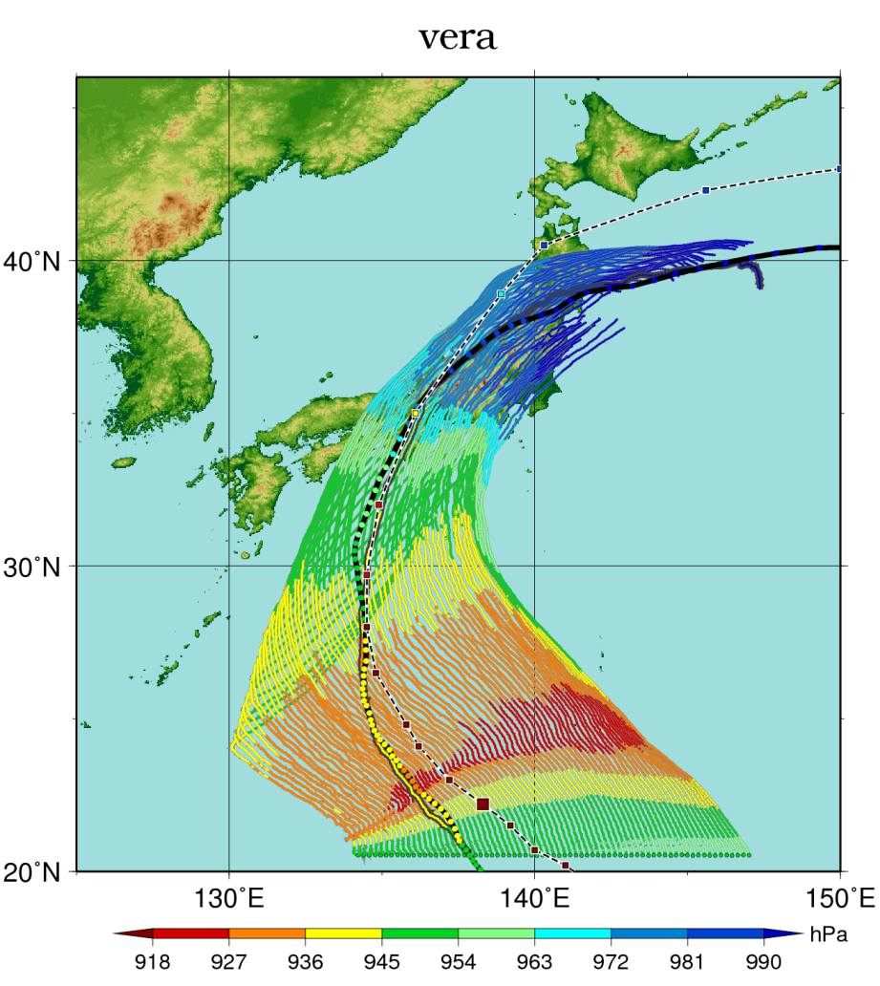
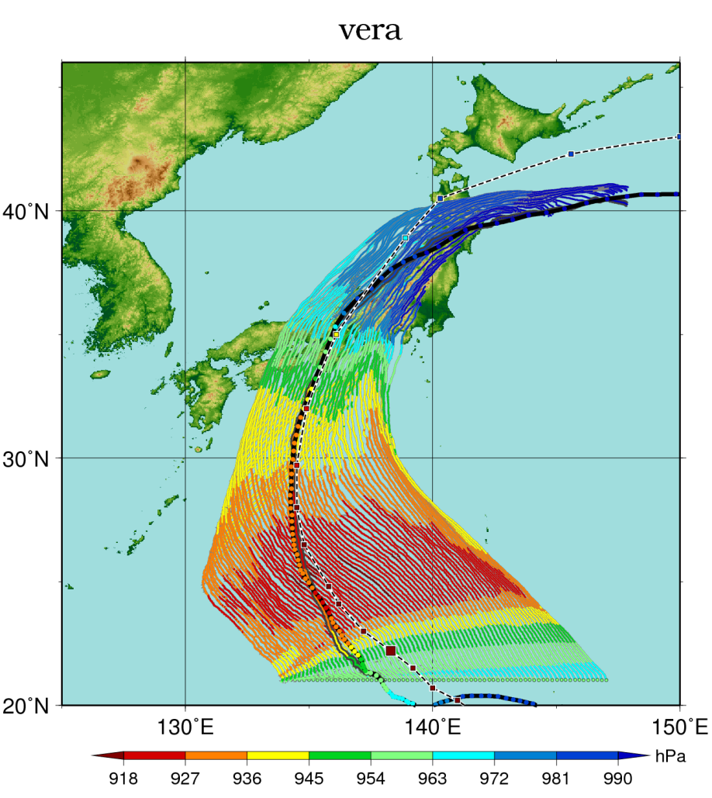
Virtual Shifting of typhoon’s initial position for the historical typhoon case (Isewan Typhoon, 1959)
Control run
pseudo-global warming experiment
Oku et al., 2013

Slide 15
Flood and inundation simulations under the largest-class typhoons
Various scenarios of the largest-class typhoons under a changing climate
Flood and inundation simulations
The worst case impact assessment

Slide 16
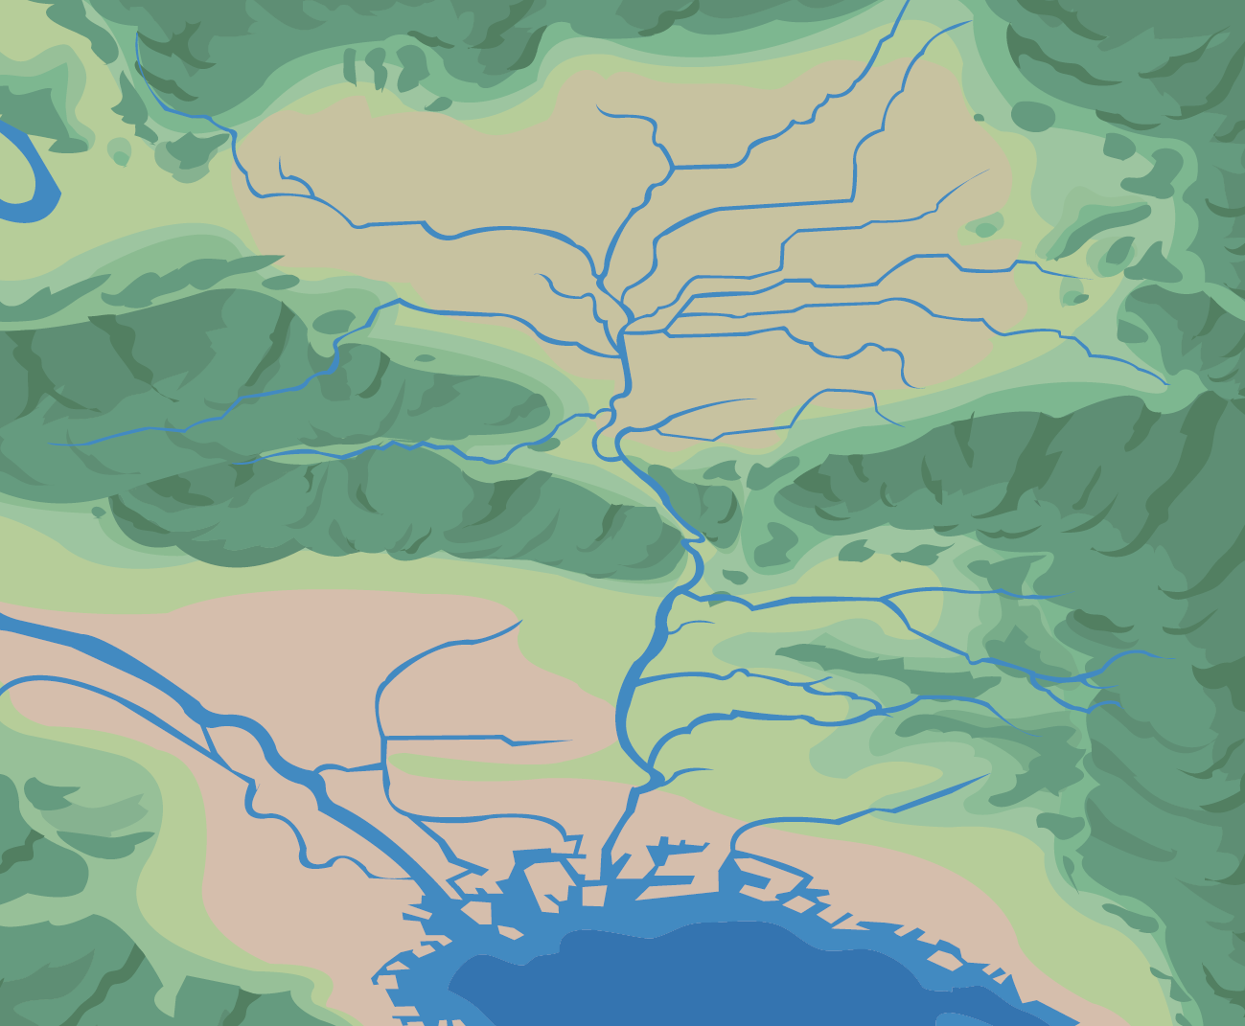
Flood and inundation disasters
Rainfall data under a changing climate
Rainfall-Runoff Model
including natural processes and dam operation
Sediment transport/Land slide
Inundation Model for lower flooding areas
Economic assessment
Storm surge

Slide 17
Rainfall-Runoff Model
rainfall
evapotranspiration
Water flow from each slope
seepage

Slide 18
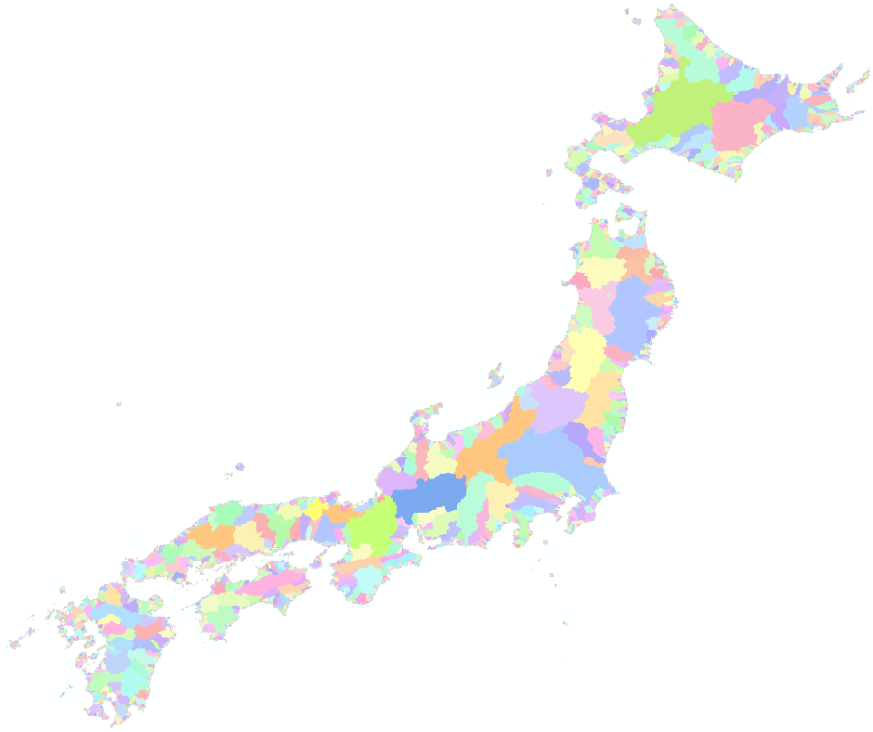
Distributed rainfall-runoff
model

Slide 19
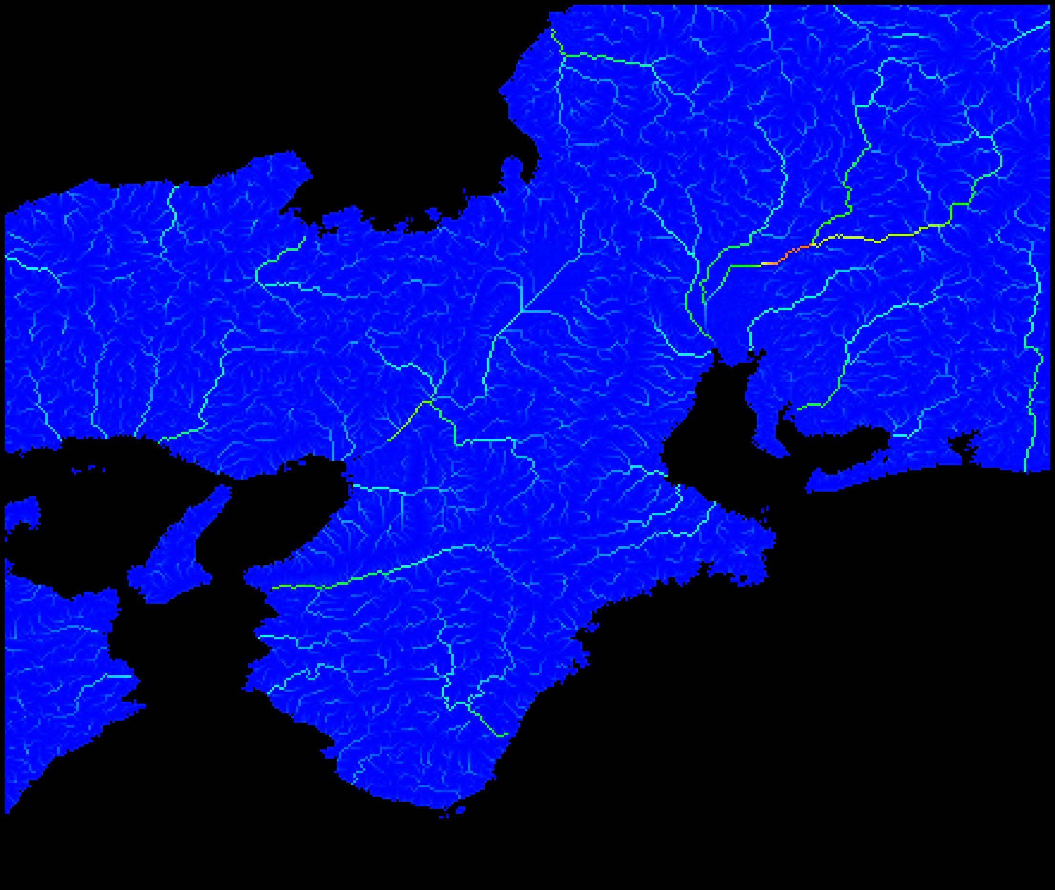
Flood simulation by the Isewan Typhoon

Slide 20
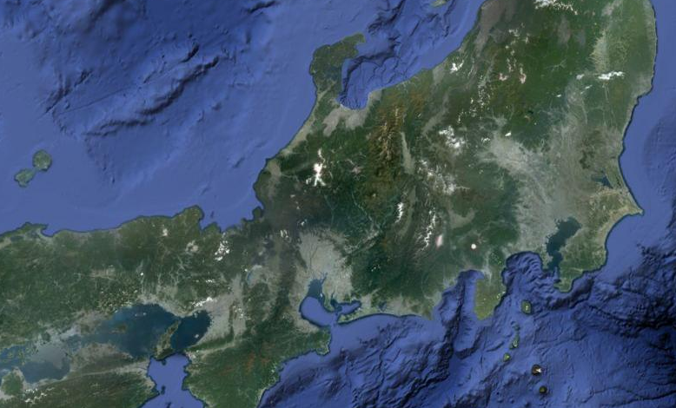
Wide-area inundation simulation model
Main river
Rainfall
Dyke broken, overflow
Flood water level and discharge
overflow
Sea
Urban river
Tokyo
Tone River, Edo River, Arakawa River,
Tokyo Bay
See water level
Nagoya
Kiso River, Shonai River, Ise Bay
Osaka
Yodo River, Neyagawa River, Osaka Bay

Slide 21
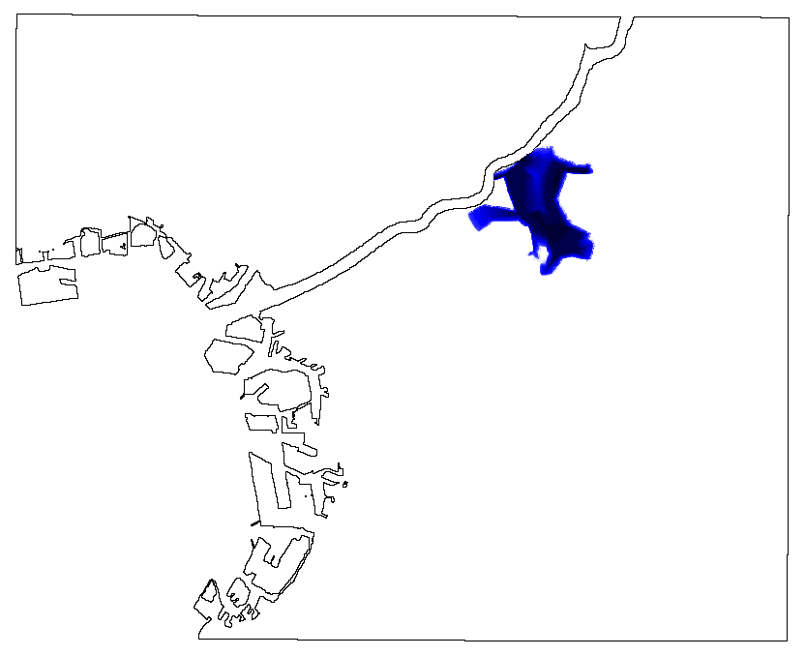
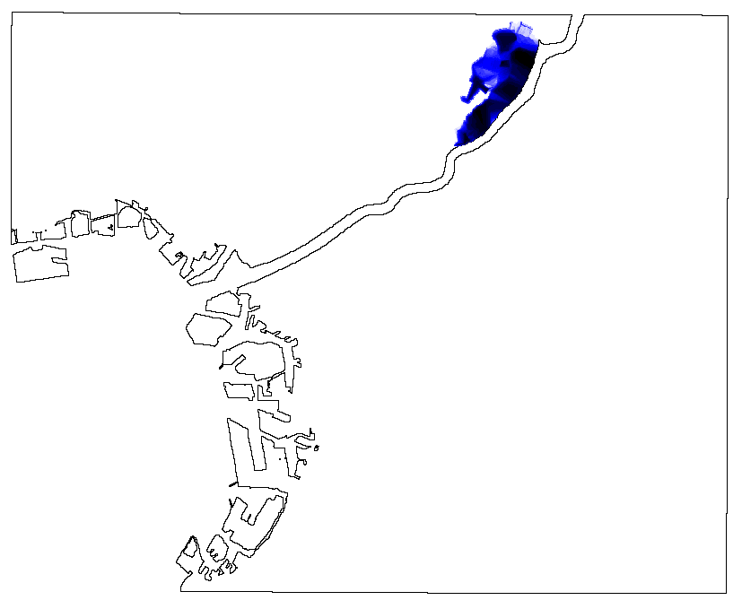
Wide-area inundation simulation model
Osaka area
Water depth distributuion after 6 hours

Slide 22
Future water resources projection in the Southeast Asian Region

Slide 23
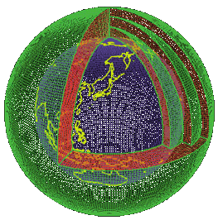
Future climate projection data using General Circulation Model developed by MRI, Japan
Current climate
experiment: 1979-2004
Near future climate
experiment: 2015-2039
Future climate
experiment: 2075-2099

Slide 24
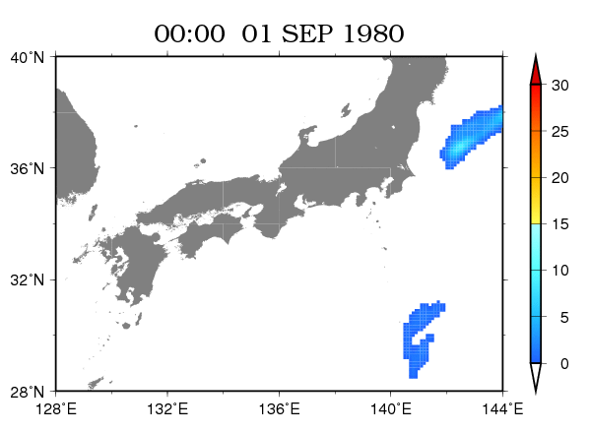
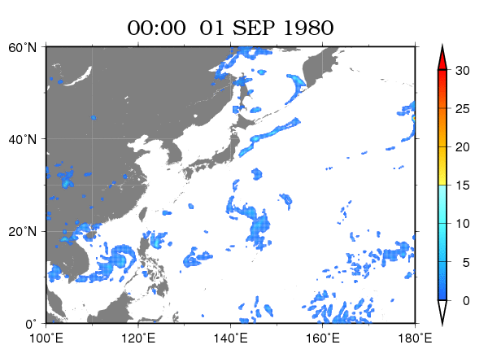
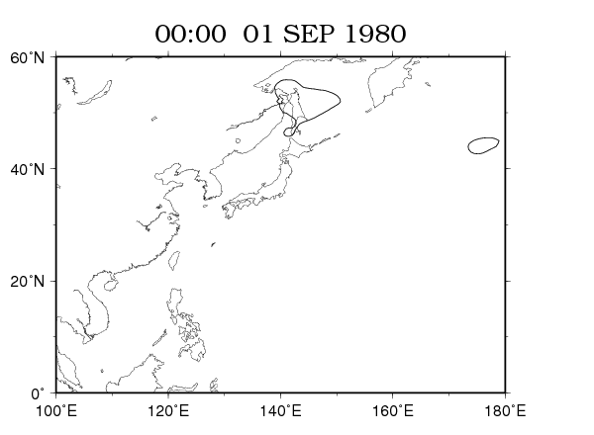
MRI GCM simulation
20km spatial resolution, hourly
Precipitation (mm/h)
Sea Level Pressure (hPa)

Slide 25
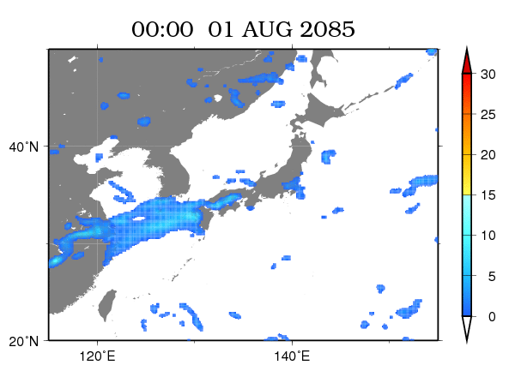
GCM rainfall projection for the end of 21st century
Precipitation (mm/hr)
Provided by Dr. Oku at DPRI, Kyoto University

Slide 26
GCM Projection data for runoff simulation
Precipitation (hourly)
Canopy layer
Evaporation from soil layer (daily)
Transpiration from root zone (daily)
Snow accumulation
Precipitation (daily)
Snowmelt (daily)
Surface runoff
generation
infiltration
Soil layer
Sub-surface runoff generation

Slide 27
Research Methodology
Input data
20 km resolution future
climate simulation data,
MRI-AGCM3.2S made by Morological Research Institute, Japan.
Present climate experiment: 1979-2008
Near future experiment: 2015-2044
Future climate experiment: 2075-2104
River flow routing model
for estimating river flow discharge
using the future climate data such as
rainfall, evaporation and so on.
Analyzing
the changes river flow discharge for the assessment of water resources, flood risks and drought risks.

Slide 28
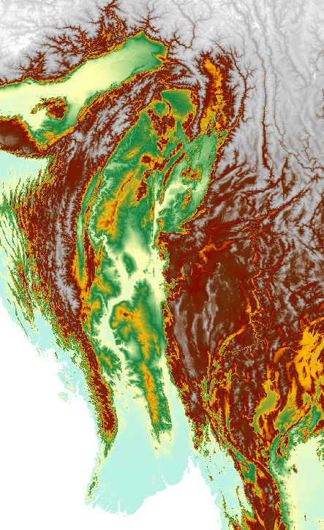
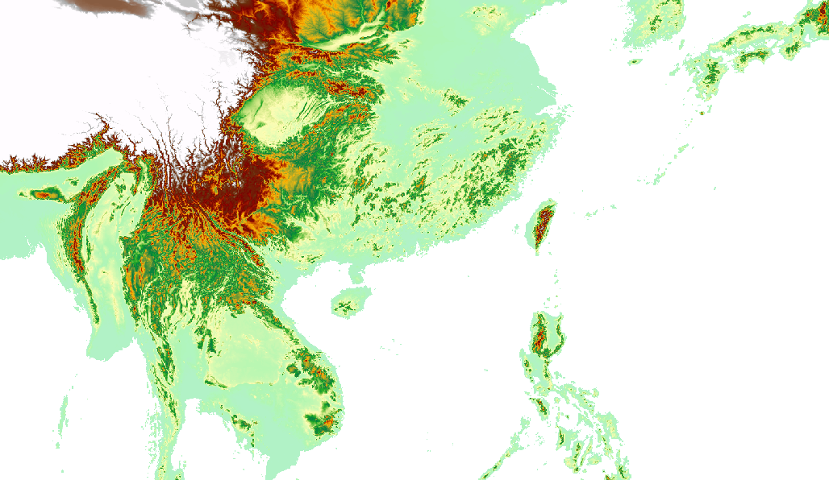
Topography Data
using USGS HydroSHEDS
(Hydrological data and maps based on SHuttle Elevation Derivatives at multiple scale)
http://hydrosheds.cr.usgs.gov/index.php
Elevation (m)

Slide 29
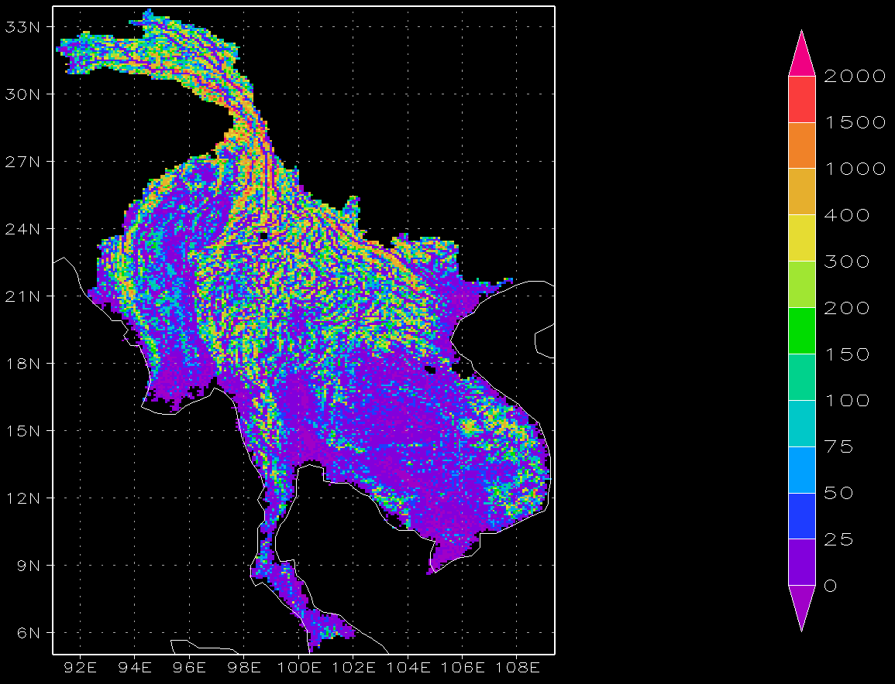
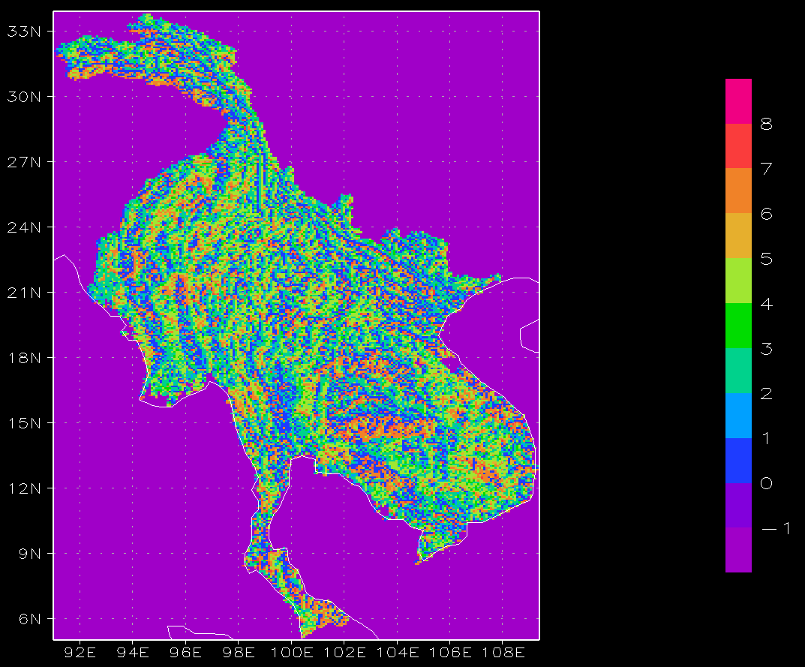
River Flow Routing Model
Elevation
Flow direction

Slide 30

Future Water Resources Simulation in Thailand
Supattana Wichakul and Yasuto Tachikawa

Slide 31
  Analysis Structure
Hydrologic Model
Based on Infiltration Variable Capacity concept
Observation Data
Bias Correction
GCM Data
Flow Routing Model
(1K-FRM)
Reservoir Operation Model
Inundation Model
Frequency Analysis of future discharge
Simulated Discharge
Final result for future assessment

Slide 32
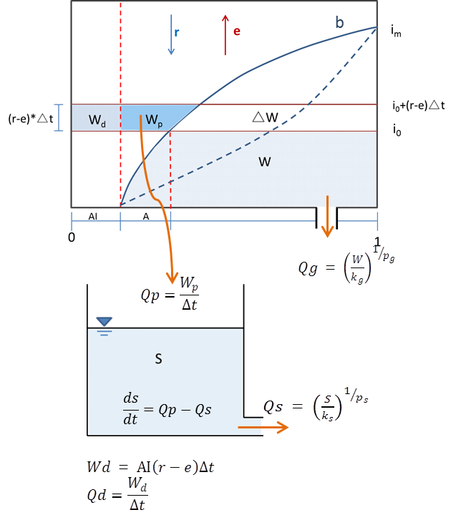
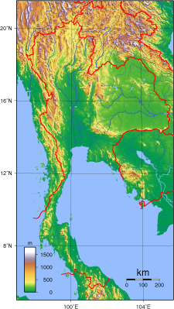
  Runoff Model
For each 20km grid, a conceptual model with variable infiltration capacity concept is applied.
rainfall
evapotranspiration
Groundwater
Subsurface runoff
Surface Runoff
Total Runoff

Slide 33
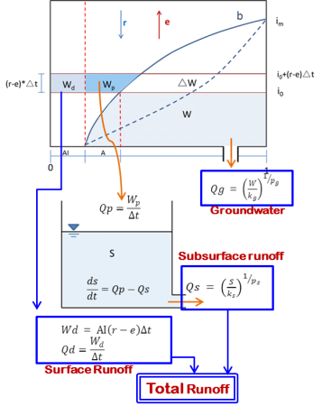
  Routing Model
  Runoff Model
runoff
Slope and river routing at each grid
Notes:
The quadratic function was applied to flooded area where cross-section of the river was accordingly changed with the over bank flow. The criterion to distinguish the type of the cross section is set by the number of upstream grids. When the number is larger than 35,000 (about 35,000 km²) the quadratic cross section is adopted for representing the inundated areas.
The value of B is equal to 1.06C^0.69; where C is catchment area at the points. These two values were determined and used in the Japanese catchment (Tachikawa et al., 2011).
To reproduce the inundation phenomena of the flood 2011 in Thailand, we assumed the quadratic cross section shape. The cross section parameter a was set to 0.00012 to reproduce a flood discharge properly.
In this study, we used the values of n and B same as the original model, n = 0.03 m^{-1/3}s and 11.0 m^{-1/3}s for channel and slope flow, respectively.
If H= 10 m T= 577.35 m T=2*(h/a)^(1/2)

Slide 34
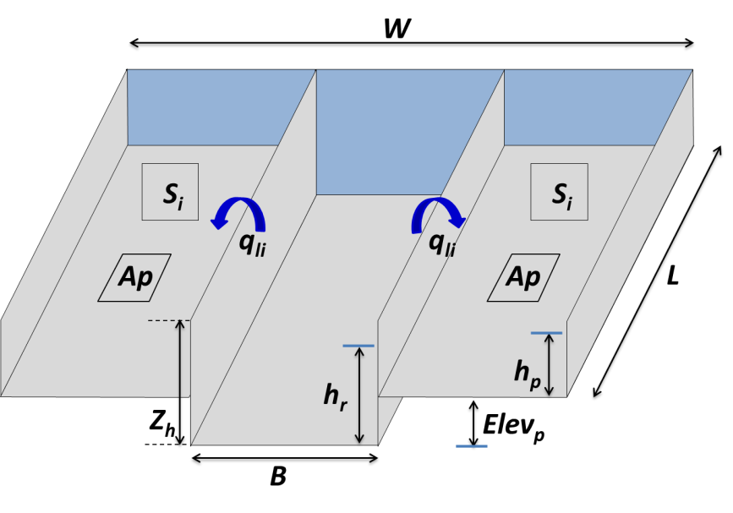
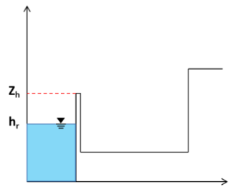
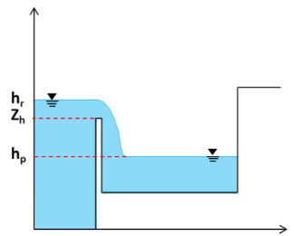
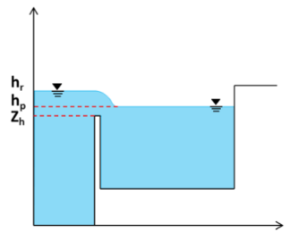
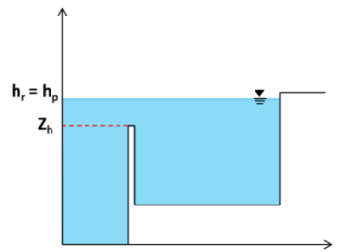
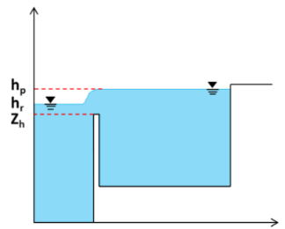
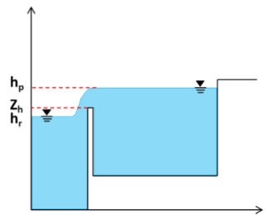
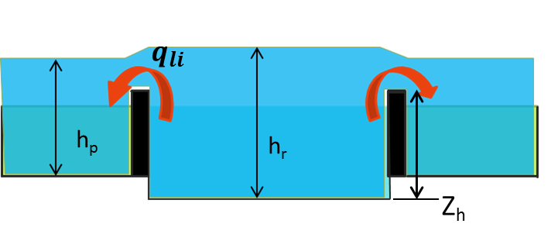
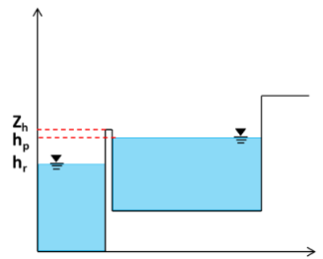
Inundation Model
River cross section modeling
Water movement depending
on river and inundation depth
(a)
(b)
(c)
(d)
(e)
(f)
(g)
Notes:
According to the value of $∆h$ indicating the lateral flow direction, the lateral inflow can be either positive or negative. To calculate water height in the floodplain pond h_{p}, we set datum at the river bed and identify a suitable elevation for floodplain pond Elev_{p}.

Slide 35
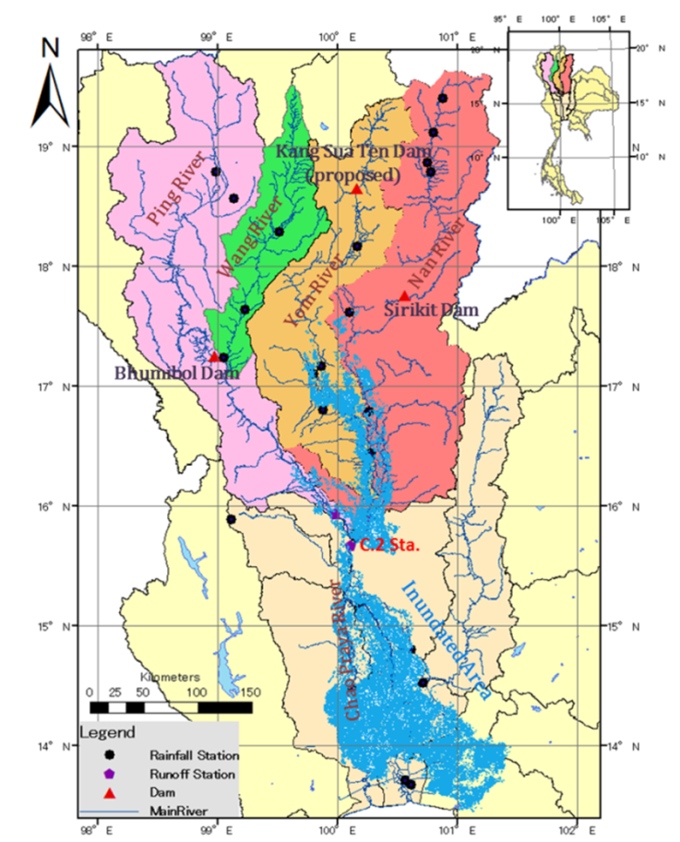
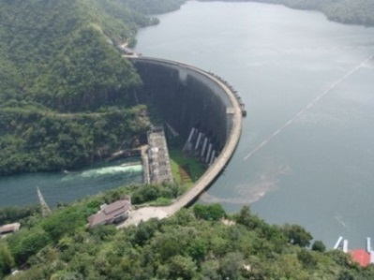
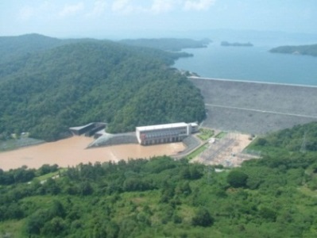
Dam reservoir operation model
The Bhumibol dam at the Ping River basin : the capacity 13,420 MCM.
The Sirikit dam at the Nan River basin : the capacity of 9,510 MCM.
Bhumibol dam
Sirikit dam
Sources of Photo : http://kromchol.rid.go.th
Notes:
-if then rule
- dam operation model was embedded into some particular grids of 1K-FRM where the dams locate. An algorithm to develop a general reservoir operating rules was a flexible function that can be adjusted for different dam features.
-1964 The Bhumibol (BB) dam spillway capacity 6,000 m³/s .
-Afterwards, in 1974 the Sirikit (SK) dam the spillway capacity 3,250 m³/s for the multi-purposes in the Nan River basin.

Slide 36
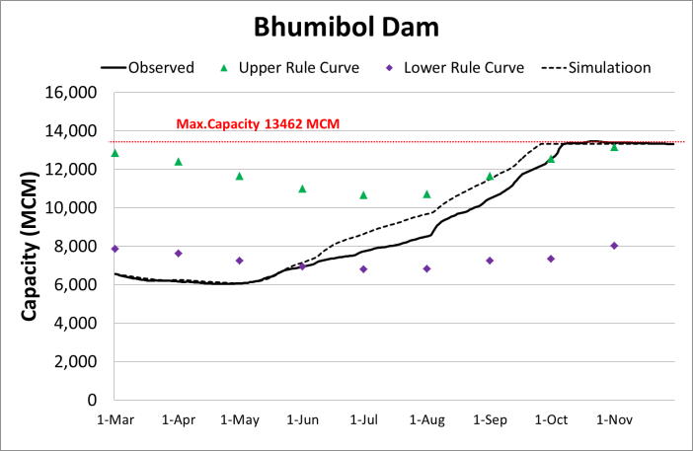
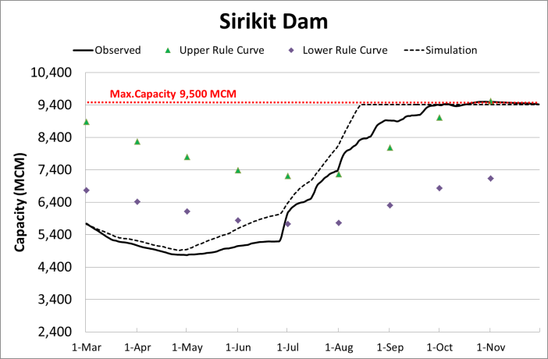
Simulation of dam reservoir operation
Bhumibol Dam Condition
Jan-Apr : release to downstream 200 m³/s
May-Dec : 15% of natural inflow
Sirikit Dam Condition
Jan-Apr : release to downstream 250 m³/s
May-Dec : 30% of natural inflow

Slide 37
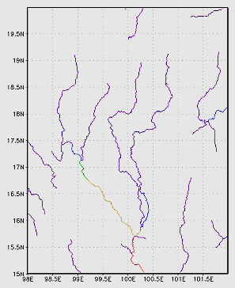


Runoff Simulation from March 1 to December 31 in 2011
Ping
Yom
Nan
Wang
C.2
Discharge in m³/s
A spatial distribution of estimated discharge on Oct 14, 2011

Slide 38
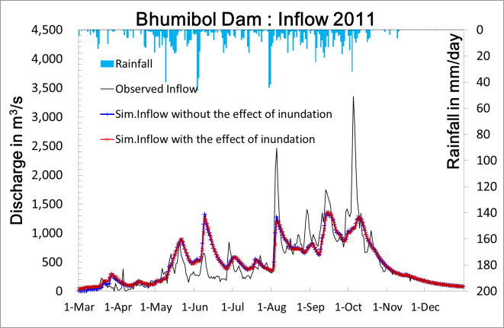
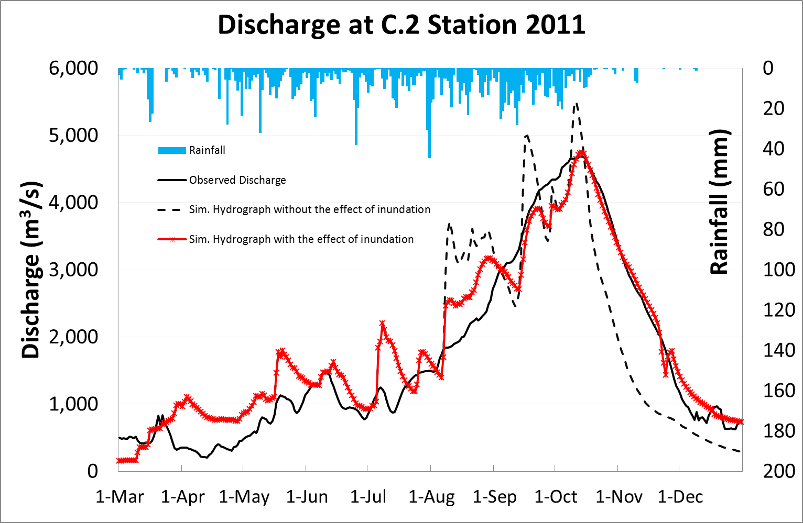
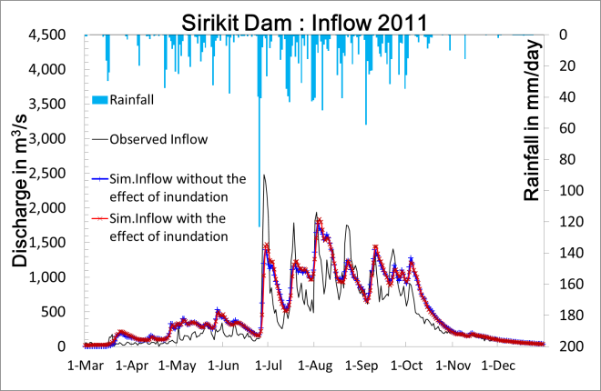
Discharge simulation results
At C. 2 station
NSE = 0.91,
RMSE = 388 m³/s, and
R² = 0.94
The parameter for the 1K-FRM in the routing part was Manning’s roughness coefficient n = 0.03 m^{-1/3}s and 0.7 m^{-1/3}s for channel and slope flows, respectively
Notes:
-To examine the applicability of the proposed method developed and embedded in the 1K-FRM, simulation was performed using input data obtained from the SXAJ model with model parameters listed in Table 3.2-1.
-Excess rainfall was then routed by the 1K-FRM, including the effects of dam release and inundation. Final results best fitting observed and simulated hydrographs are shown
-When data on simulated inflow including the inundation effect and observed inflow is analyzed, Nash-Sutcliffe efficiency (NSE) was 0.60 and 0.68, coefficient of determination (R²) was 0.61 and 0.73, and root mean square error (RMSE) was 320 m³/s and 275 m³/s at the BB and SK dams

Slide 39
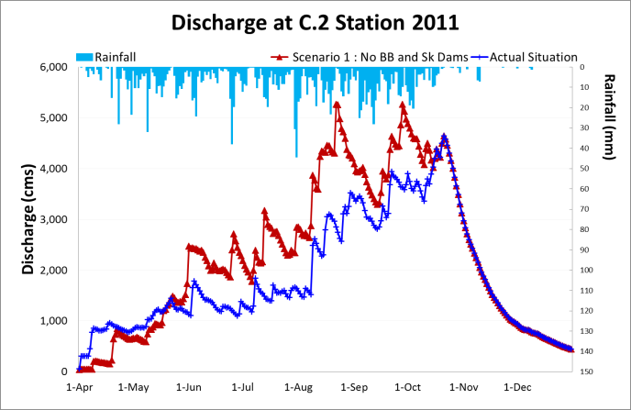
Effect of the Bhumibol and Sirikit dam
on flood 2011
Comparison of simulated discharge between actual situation,
and without the BB and SK dams at C.2 station.

Slide 40
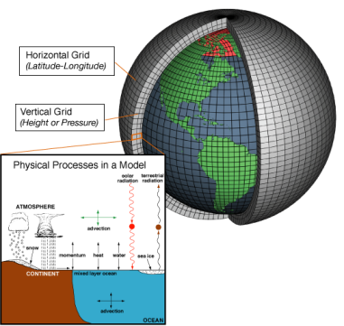
Discharge simulation using GCM outputs
Hydrologic Model
Based on Infiltration Variable Capacity concept
Observation Data
GCM Data
Flow Routing Model
(1K-FRM)
Reservoir Operation Model
Inundation Model
Simulated Discharge
Sources of Photo : http://celebrating200years.noaa.gov/breakthroughs/climate_model/modeling_schematic.html
Notes:
General circulation model (GCM)
is the effective tool available today for well understanding of the interaction of the atmosphere, ocean, land surface, and ice for understanding of a changing climate behavior in long term.

Slide 41
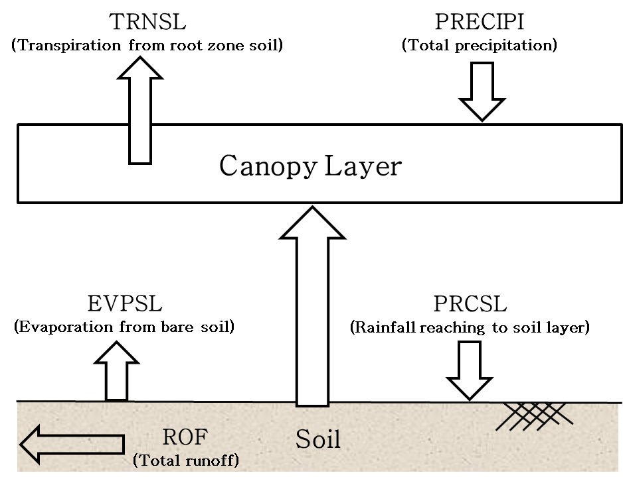

GCM outputs used for discharge simulation
The latest version is MRI-AGCM3.2s: 1920×960 of grid cells of about 20 km spatial resolutions (cut 20 x 48 of grid cell throughout the Chao Phraya River Basin).
Three climate experiments under the SRES A1B scenario.
1. Present climate experiment : SPA (1979-2008).
2. Near future climate experiment : SNA (2015-2044).
3. Future climate experiment : SFA (2075-2144).
Output

Slide 42
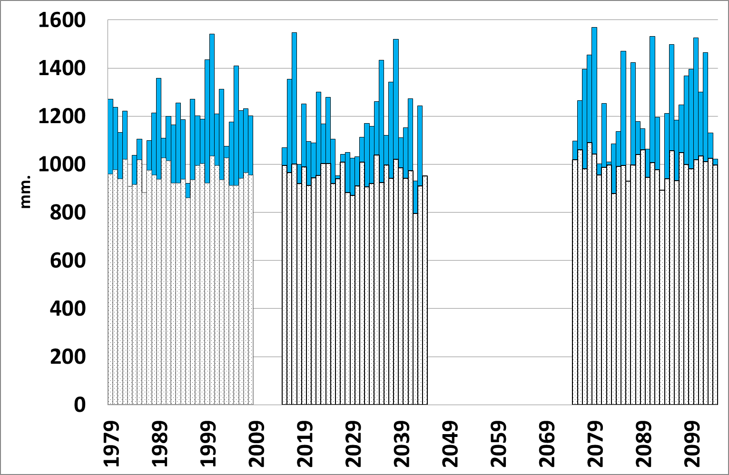
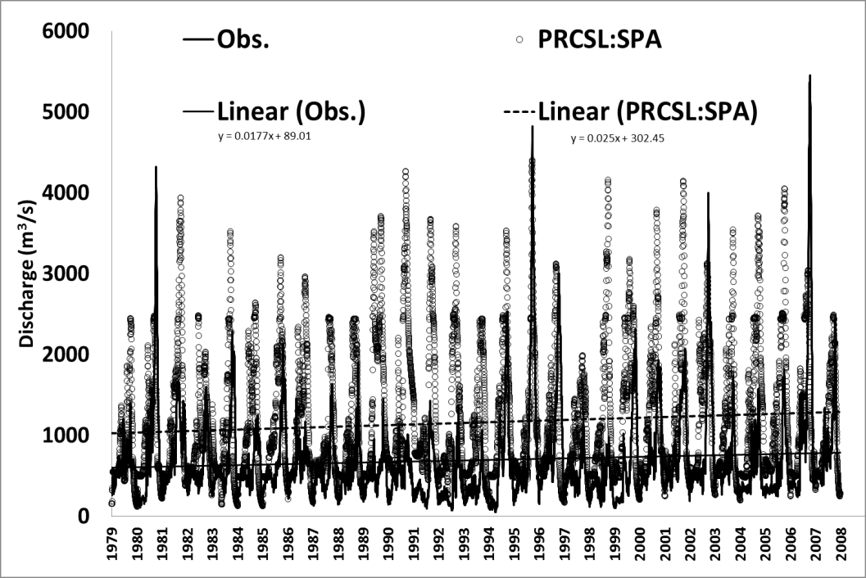
River flow simulation used for GCM outputs without bias corrections
Variability and trends of GCM outputs
Change in river discharge
Annual rainfall and (b) evapotranspiration data at
the C.2 station grid.
Comparison of observed and simulated discharge with GCM outputs at the C.2 station
Trends of both observed and simulated discharge are compatible to increase at the 1.8 % and 2.5 % level.
(-1.9%)
(+4.6%)
(-0.6%)
(+4.1%)
(-7.2%)
(+6.8%)
Notes:
The figure shows trends of both observed and simulated discharge are compatible to increase at the 0.18 and 0.25 % level.
-SPA runoff 19.7% of rainfall
-SNA runoff 18.6% of rainfall
-SFA runoff 20.1% of rainfall

Slide 43
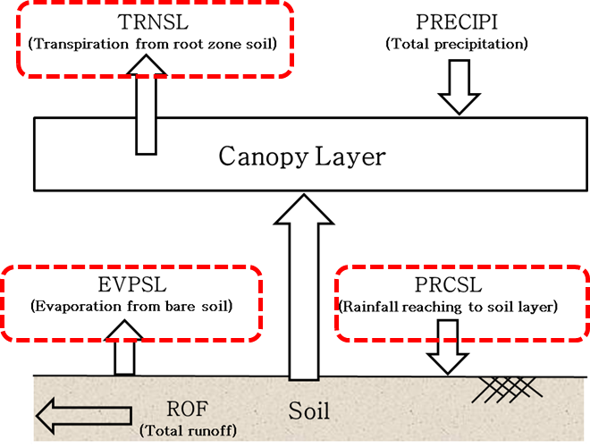
Bias correction of GCM outputs,
precipitation and evapotranspiration
    GCM Data : MRI-AGCM3.2S,
    Resolution 0.1875 degree, 1,120 Grids (Cols=28 Rows=40)
Reference truth data
1. APHODITE daily rainfall :
Resolution 0.25 degree, 770 grids (Cols=22 Rows=35) available for 1979-2007
2. Evapotranspiration :
A monthly mean reference crop evapotranspiration (ETo) calculated by the Royal Irrigation Department of Thailand (RID) using the FAO Penman-Monteith method with recorded climatology data for the 30 years from 1981 to 2010.
The data were collected from 26 observing stations.
Notes:
Asian Precipitation–Highly-Resolved Observational Data Integration Towards Evaluation of Water Resources
APHODITE = A daily gridded precipitation dataset covering a period of more than 57 years (1951-2007) recorded data was created by collecting precipitation data from a local organization in each country and analyzing rain gauge observation data across Asia.
-To remove bias from the GCM Evapotranspiration data, the long term observed data are needed for the reference truth data. Unfortunately, there is no direct observation of the evapotranspiration.

Slide 44


Bias correction of daily precipitation
Quantile-Quantile method
The GCM precipitation is mapped onto the observation precipitation at respective NEP of GCM quantile to observation quantile. This relationship can be mathematically expressed by the inverse of the observation data CDF as follows.
$P_{i_COR:SPA}= F_{obs}^{−1}(F_{RAW:SPA}(P_{i_RAW:SPA}$))
Transformation of the raw GCM precipitation data in baseline period.
Notes:
Quantile-quantile (Q-Q) bias correction method was proposed for removing intensity bias from the GCM precipitation based on the assumption that correction can be conferred from ranked historical simulation or observation data to equivalent ranks in future projection.
-We did not assume the shape of the theoretical. To remove the bias in the training period, CDFs of both raw GCM and observation precipitation were created accordingly.

Slide 45




Bias Correction of Evapotranspiration
Irrigation area effect
Averages of mean monthly evapotranspiration
Present climate experiment
Histograms comparing mean monthly evapotranspiration
Future climate experiment
Near future climate experiment
Notes:
One of the important factors leading the ET_{o} higher than the GCM evapotranspiration in the dry season is an effect for irrigated water. Most of the irrigation areas of the CPRB are located at the center of the basin.

Slide 46



River discharge assessment under a changing climate
Mean monthly discharge at the C.2 station for the present, near future and future climate experiments.
Duration curve of mean daily flow and standard deviation.
Low flow section of the flow duration curves constructed based on daily discharge of a period-of-record of each climate experiment.

Slide 47

Frequency analysis of extreme events
Maximum Daily discharge corresponding to different return periods for present climate (SPA), near future Climate (SNA) and future climate (SFA) for each location.
at C.2 Sta.
Tr=50 yr
N
at Y.16 Sta.
Y.16
P.17
N.67
C.2
at N.67 Sta.
Tr=30 yr
at P.17 Sta.
Tr=12 yr

Slide 48
  Findings
Changes in the projected river discharge at the C.2 station, Nakorn Sawan province can be concluded that
the mean annual discharge tends to increase in both near future and future projection periods;
2) during a dry season the tendency of low flow in the near future period leads to decrease; and
3) GEV was applied for flood frequency analysis which indicates that flooding frequency has increased, leading high flood risk in the future.
Flood in the basin will have more severity; especially in the near future (2015-2043) the magnitude of 80-year return period flood (5,034 m³/s) is greater than the devastating 2013 Thai flood (4,686 m³/s). Therefore, adaptation measures to protect damages of flood in the country are critical to accomplish.
Notes:
These findings of our study are also compatible with previous studies of Hunukumbura and Tachikawa (2012), and Kure and Tebakari (2012); but it is contradictory with the study result of Champthong et al., (2013).

Slide 49

Future water resources projection in the Indochina Peninsula
Duong Duc Toan and Yasuto Tachikawa

Slide 50


Study Area
109.5º E
34.0º N
Salween
River basin
Irrawaddy River basin
Red River basin
Mekong River basin
Chao Phraya
River basin
91.0º E
5.0º N

Slide 51
Study area, data and hydrological model
Topographic data:
_ Topographic information used in the study was generated from processing the scale-free global streamflow network dataset with a spatial resolution of 5 arc minutes.
GCMs data:
_ MRI-AGCM3.2S (20-km resolution)
_ MRI-AGCM3.2H (60-km resolution)
_ MIROC5 (140-km resolution)
Hydrological model:
_ Flow routing model with kinematic wave flow approximation, 1K-FRM

Slide 52

River Flow Simulation

Slide 53
Projection of river discharge
Methods:
River discharge in the Indochina peninsula region was projected by feeding 3-hourly runoff generation data from MRI-AGCM3.2S dataset into flow routing model 1K-FRM.
Future changes in river discharge in the region were examined by comparing simulated discharge in the near future climate experiment (2015-2044) and future climate experiment (2075-2104) with the one in the present climate experiment (1979-2008).

Slide 54


Changes in annual mean discharge
Ratio of annual mean discharge in the near future climate (left)
and the future climate (right) to the one in the present climate

Slide 55


Changes in mean of annual maximum daily discharge
Ratio of mean of annual maximum daily discharge in the near future climate (left)
and the future climate (right) to the one in the present climate

Slide 56


Changes in mean of annual minimum daily discharge
Ratio of mean of annual minimum daily discharge in the near future climate (left)
and the future climate (right) to the one in the present climate

Slide 57
Statistical analysis of river discharge changes
Methods:
The statistical significance of river discharge changes in the Indochina Peninsula region was assessed by comparing means of projected river discharge data in the near future climate and the future climate with those in the present climate.
The test for statistical significance of river discharge changes is chosen based on the distribution of projected river discharge data.
_ Shapiro-Wilk W test was applied for data normality test.
_ The parametric Welch correction t-test was applied for the river discharge data which have a normal distribution.
_ The non-parametric Mann-Whitney U test was performed to test for statistical significance of non-normal distribution river discharge data.

Slide 58


Statistical significance of changes
in annual mean river discharge
Statistical significant differences between annual mean discharge in the near future climate and present climate (left), and in the future climate and present climate (right)

Slide 59


Statistical significance of changes in annual mean maximum daily discharge
Statistical significant differences between mean of annual maximum daily discharge in the near future climate and present climate (left), and in the future climate and present climate (right)

Slide 60


Statistical significance of changes in annual mean minimum daily discharge
Statistical significant differences between mean of annual minimum daily discharge in the near future climate and present climate (left), and in the future climate and present climate (right)

Slide 61
Future changes and uncertainties in river discharge projected using different ensemble experiments
Methods:
Changes in river discharge projected using different ensemble experiments of the MRI-AGCM and MIROC5 were compared to assess the uncertainties in projections of future climate change.
Statistical significance of changes in river discharge was also compared and evaluated.

Slide 62
Future changes and uncertainties in river discharge projected using different ensemble experiments
Dataset | Resolution | Cumulus Convection Scheme | Sea Surface Temperature |  | Run name
MRI-AGCM3.2S | 20km | Yoshimura | Present Climate | Observation | YS_20
 |  |  | Future Climate | CMIP MME | YS_CMIP_20
MRI-AGCM3.2H | 60km | Yoshimura | Present Climate | Observation | YS_60
 |  |  | Future Climate | CMIP MME | YS_CMIP_60
 |  | Kain-Fritsch | Present Climate | Observation | KF
 |  |  | Future Climate | CMIP MME | KF_CMIP
 |  |  |  | Cluster 1 | KF_C1
 |  |  |  | Cluster 2 | KF_C2
 |  |  |  | Cluster 3 | KF_C3
MIROC5 | 150km | Chikira | Present Climate | Observation | MIROC5_P
 |  |  | Future Climate | CMIP | MIROC5_F
* Observation: Observational data by Hadley Center of Met Office, United Kingdom * CMIP MME: Coupled Model Intercomparison Project Multi-Model Ensemble

Slide 63








Future changes and uncertainties in river discharge projected using different ensemble experiments
Ratio of annual mean discharge in the future climate
to the one in the present climate
YS_CMIP_20
YS_CMIP_60
KF_CMIP
KF_C1
KF_C2
KF_C3
MIROC5

Slide 64








Future changes and uncertainties in river discharge projected using different ensemble experiments
Ratio of mean of annual maximum daily discharge in the future climate to the one in the present climate
YS_CMIP_20
YS_CMIP_60
KF_CMIP
KF_C1
KF_C2
KF_C3
MIROC5

Slide 65








Future changes and uncertainties in river discharge projected using different ensemble experiments
Ratio of annual minimum daily discharge in the future climate
to the one in the present climate
YS_CMIP_20
YS_CMIP_60
KF_CMIP
KF_C1
KF_C2
KF_C3
MIROC5

Slide 66








Statistically significant differences between annual mean discharge in the future climate and in the present climate
YS_CMIP_20
YS_CMIP_60
KF_CMIP
KF_C1
KF_C2
KF_C3
MIROC5

Slide 67








Statistically significant differences between mean of annual maximum daily discharge
in the future climate and in the present climate
YS_CMIP_20
YS_CMIP_60
KF_CMIP
KF_C1
KF_C2
KF_C3
MIROC5

Slide 68








Statistically significant differences between mean of annual minimum daily discharge
in the future climate and in the present climate
MRI_YS_CMIP_20
MRI_YS_CMIP_60
MRI_KF_CMIP
MRI_KF_C1
MRI_KF_C2
MRI_KF_C3
MIROC5

Slide 69
Findings
There are discrepancies on the ratio of river discharge change and area of statistically significant increase or decrease among simulations using different GCMs datasets.
A clear change of river discharge was detected and found statistically significant in the Irrawaddy River basin, especially the annual maximum daily discharge in the future climate.
In the central part of Vietnam, a decreasing trend of annual minimum daily discharge in the future climate was found statistically significant from simulations using MRI-AGCM3.2S and MRI-AGCM3.2H datasets. However, the simulation using MIROC5 dataset displayed an opposite trend. This opposition also occurs at the Chao Phraya River basin and middle part of the Mekong River basin.
For future further work, more GCMs’ data will be used to evaluate the uncertainty in climate projection and to investigate the factors contributed to the simulation biases of river discharge.

Slide 70
Thank you for your attention

